Slide 1
Unit 4 What's the best movie theater?
Section B (2a — 2e)
WWW.PPT818.COM

Slide 2
2a. Who is the most talented person you know? What can he/she do? Tell your partner about this person.
A: I think ... is the most talented person.
B: What can he /she do?
A: He/She ...

Slide 3
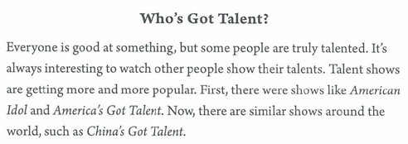
2b. Read the passage. Which three tatent shows are mentiond?

Slide 4
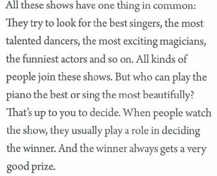
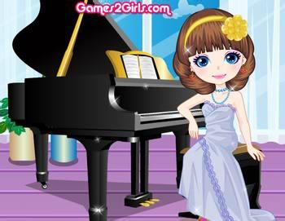

Slide 5
2c. Read the passage again and answer the questions.
1. What do talent shows have in common?
2. Who decides the winner?
3. Why do some people not like these shows?
4. Why do some people like these shows?
5. What do you think of these shows?
They try to look for the best singers, the most talented dancers, the most exciting magicians, the funniest actors and so on.
The people who watch the shows.
Because they think the lives of the performers are made up.
They are fun to watch and they give people a way to make their dreams come true.
I think they are the funniest shows. Because I can have fun of them.

Slide 6
2d. Underline all the superlatives in the passage.

Slide 8
Then write sentences using at least four of them.
best singer: In my class, Tom is the best singer because he can sing fast songs very well.
most talented dancer: In our school Larry is the most talented dancer because she can dance upside down.
... ...
... ...

Slide 9
Do a survey
Who's got talent in your class?

Slide 10
小结训练
( )1. In summer, the weather gets ______.
A. hot B. hotter C. the hottest D. hotter and Hotter
( )2. Thy are brothers, but they have nothing ____ common.
A. in B. at C. for D. to
( )3. He drew many ____ pictures last year. And now he draws
_____ in the city.
A. beautiful, beautiful B. beautifully, beautifully
C. beautiful, beautifully D. beautifully, beautiful
( ) 4. An Indian or a Chinese meal? It's up ____ you.
A. to B. at C. for D. in
( )5. Can you ____ a new conversation according to the picture?
A. make up B. put up C. stand up D. look up
D
A
C
A
A

