Slide 1
U4 Weekend
Sometimes I do housework.
WWW.PPT818.COM

Slide 2
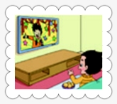
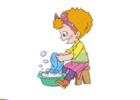
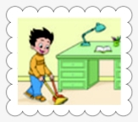
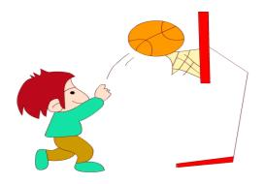
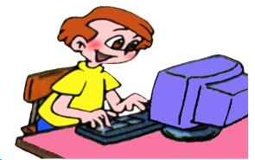
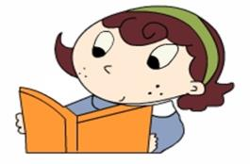

Slide 3
watch TV
wash clothes
clean the room
play football
play computer games
read a book

Slide 4
What do you do at the weekend?
I often …

Slide 5
Watch and answer:
What does Li Ming do at the weekend?

Slide 6
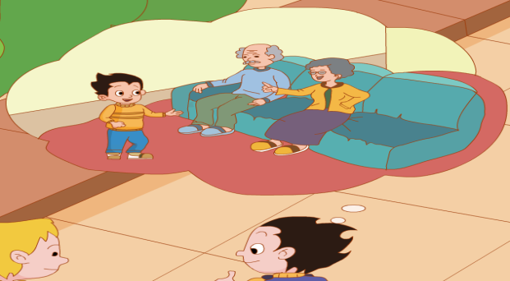
Watch and answer:
What does Li Ming do at the weekend?

Slide 7
Watch and answer:
What does Li Ming do at the weekend?
I often visit
my grandparents.

Slide 8
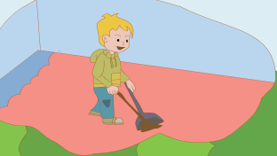
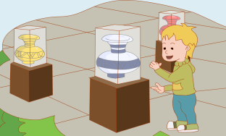
Listen and answer:
What does Tom do at the weekend?
Sometimes I do housework.
Sometimes I go to the museum.

Slide 9
Listen and repeat

Slide 11
What do you do at the weekend?
I often________.
Sometimes I __________.

