Slide 1
Module 6 A trip to the zoo
Unit 3
Language in use
WWW.PPT818.COM

Slide 2
Objective:
1. To ask and answer questions about animals with the interrogative form of the present simple tense
2. To introduce animals

Slide 3
语法讲解建议采用归纳法，如尽可能多的呈现一些相关例句，或可让学生从已学课文中找相应例句，引导学生试着从所观察到的语言现象中总结出语法规律。

Slide 4
Observe
Are you familiar with these sentences? They are all from the texts we have learnt.
1. — Does it come from China?
— Yes, it does.
2. It doesn’t eat meat.
3. — Does it eat meat?
— No, it doesn’t. It eats plants.
4. The tiger lives in Asia.

Slide 5
5. It eats plants and leaves, as well as grass, but the zebra doesn’t eat bamboo.
6. The elephant eats a little fruit.
7. The zoo has many animals.
8. The elephant lives in Africa and in Asia.
9. The panda eats about 30 kilos of bamboo a day.
10. It likes water and is good at swimming.

Slide 6
Guessing game
1. to test your sense of observation
2. to test your ability of short-term memory
3. to test your ability of inductive method

Slide 7
1. — _____ it _____ (come) from China?
— Yes, it ______.
2. It _______ _____ (not eat) meat.
3. — _____ it _____ (eat) meat?
— No, it ________. It _____ (eat) plants.
4. The tiger ______ (live) in Asia.
5. It _____ (eat) plants and leaves, as well as grass, but the zebra ________ ______ (not eat) bamboo.
Does come
does
Ready?
doesn’t eat
go
Does eat
doesn’t
eats
lives
eats
doesn’t
eat

Slide 8
eats
6. The elephant _____ (eat) a little fruit.
7. The zoo ______ (have) many animals.
8. The elephant _____ (live) in Africa and in Asia.
9. The panda ______ (eat) about 30 kilos of bamboo a day.
10. It ______ (like) water and _____ (be) good at swimming.
has
lives
eats
likes
is

Slide 9
Grammar
行为动词的一般现在时(2)

Slide 10
比较下列两组句子
We have dinner at school.
You sing very well.
They go to school on Sunday.
当主语是第一人称、第二人称、第三人称复数或复数名词时，谓语动词要用原形。
He never listens to music.
She always wears school clothes.
It often eats meat.
当主语为he/she/it单数名词时，谓语动词要用第三人称单数形式。

Slide 11
动词第三人称单数形式的变化：
构成方法 | 例词
在词尾加-s
help→helps know→knows
get→gets read→reads
以字母s, x, sh, ch结尾的动词加-es
guess→guesses fix→fixes
teach→teaches wash→washes
以字母o结尾的动词加-es
go→goes
以辅音字母加y结尾的动词,先变y为i,再加-es
carry→carries
worry→worries

Slide 12
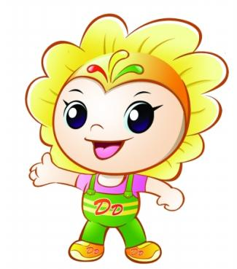
把下列动词变为第三人称单数形式。
read
carry
watch
do
reads
carries
watches
does

Slide 13
如果表示不常做某事，该怎样表达呢？
她不说英语。
She doesn’t speak English.
他住地离学校不远。
He doesn’t live far away from school.
主语是第三人称单数的行为动词的一般
现在时否定形式是在行为动词前加
doesn’t (does not )，这时要注意把谓语动
词还原为动词原形。

Slide 14
如果要问别人是否经常做某事，我们要采用下面的表达方式：
—Does the panda eat meat?
—No, it doesn’t.
—Does it eat bamboo?
—Yes, it does.
—Does he play the piano every day?
—No, he doesn’t.

Slide 15
从以上例子可以看出，行为动词的第三
人称单数一般现在时疑问形式是在句首
加助动词does ，而加does之后，后面的
谓语动词像否定句一样也要用原形。
例如：
Does he get up very early?
他起床很早吗？
Does the panda come from China?
熊猫来自中国吗？

Slide 16
总结行为动词一般现在时的各种句式变化：
肯定 | 否定 | 疑问 | 回答
He does… | He does not/ doesn’t do… | Does he do…? | Yes, he does. No, he doesn’t.
She does… | She does not/ doesn’t do…? | Does she do…? | Yes, she does. No, she doesn’t.
It does… | It does not/ doesn’t… | Does it do…? | Yes, it does. No, it doesn’t.
The+可数名词单数/不可数名词/… does… | The+可数名词单数/不可数名词/… does not/ doesn’t do …. | Does the+可数名词单数/不可数名词/… do…? | Yes, it does. No, it doesn’t.

Slide 17
以下部分为课本练习，供老师在对答案时选择使用。

Slide 18
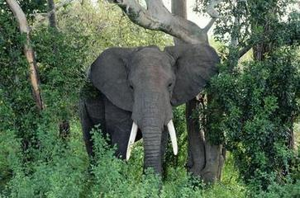
P40
1
Work in pairs. Look at the pictures. Ask and answer.
Name: Meimei
From: Yunnan, China
Favourite food: fruit
— Does Meimei the elephant come from Yunnan, China?
— Yes, it does.

Slide 19
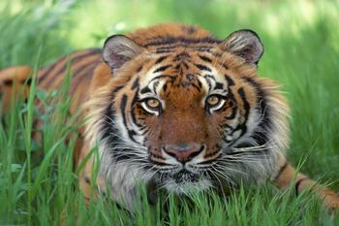
Name: Kingba
From: Asia
Favourite food: meat

Slide 20
P40
2
Complete the sentences with does or doesn’t.
1. — ______ this panda come from China?
— Yes, it ______.
2. — _____ this panda eat fish?
— No, it _______.
3. — ______ this monkey like fruit?
— Yes, it ______.
4. — ______ this monkey live in Africa?
— No, it _______.
5. The zebra ______ like meat.
Does
does
Does
doesn’t
Does
does
Does
doesn’t
doesn’t

Slide 21
P40
3
Complete the passage with the correct form of the words in brackets.
My favourite animals (1) _____ (be) zebras. Look at this one. It (2) ______ (be) cute. It (3) _____ (be) black and white like the panda. But it (4) ______ (do not) come from Asia. It (5) ______ (come) from Africa. It (6) ______ (eat) grass.
are
is
is
doesn’t
comes
eats

Slide 22
P41
4
Complete the word map.
giraffe
monkey
elephant
panda
elephant
Africa
zebra
Asia
The world
of animals
tiger
monkey
America
Europe
monkey

Slide 23
Module task:
Making a poster of your favourite animal

Slide 24
Ⅰ. Work in groups. Find out about an animal.
☺Talk about your favourite animal.
☺Choose one animal to write about.
☺Find out about the animal.
It’s | big/ small/ tall, black and white/…
It comes from | Asia/ Africa/…
It eats | meat/ grass/ bamboo/…

Slide 25
Ⅱ. Make a poster about your group’s animal.
☺Draw it or find a photo.
☺Write some information about it.
Ⅲ. Present your poster to the class.

Slide 26
Review
现在把行为动词第三人称单数的各种
句式总结如下：
肯定句：主语+动词的第三人称单数形式
否定句：主语+doesn’t +动词原形
疑问句：Does+主语+动词原形？
肯定回答：Yes, 主语+does.
否定回答：No, 主语+ doesn’t.

Slide 27
Ⅰ. 用方框中所给单词或短语填空，每个单词或短语限用一次。
funny, in fact, its, on the front of, even
1. This animal eats fruit, bread and _________ candies.
even

Slide 28
funny, in fact, its, on the front of, even
2. The kangaroo has a pocket ____________ the body.
3. This is a very _________ book. You can read it.
4. I have a dog and _________ name is Dahua.
5. This animal isn’t from Asia. _________, it is from Africa.
on the front of
funny
its
In fact

Slide 29
Ⅱ. 用所给动词的正确形式完成下面的短文。
There is a big zoo in our city. There
(1) _________ (be) many different kinds of animals. There is a tiger (2) _______ (call) Liangliang. It (3) _________ (come) from Asia. It usually (4) _________ (eat) some small animals for food. It (5) _________ (not eat) grass or leaves.
are
called
comes
eats
doesn’t eat

Slide 30
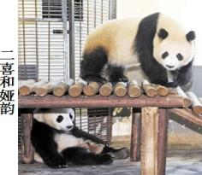
Ⅲ. 根据情景，选用适当的句子补全对
话。
A. How many pandas are
there in the zoo?
B. It is next to my home.
C. Do pandas like hot weather?
D. What is your favourite animal?
E. They are different.

Slide 31
A: Good morning, Xu Fei.
B: Good morning, Wen Li.
A: Do you know Changsha Ecological Zoo
(长沙生态动物园)?
B: Yes, I do. (1) _________
A: Oh, that’s wonderful.
B: (2) _________
A: Pandas. (3) _________
B: There are four now. Erxi and Yayun are two
new pandas.
A: What are they like?
B: (4) _________ Erxi is very lively (活泼的), but
Yayun is very quiet (安静的).
A: That is too interesting. Changsha is very hot. (5)
_______
B: No, they like cool weather.
B
D
A
E
C

Slide 32
Homework
1. Finish the exercises in Learning English.
2. Preview the new words and
expressions in Module 7.
3. Search for information about the history of computer.

