Slide 1
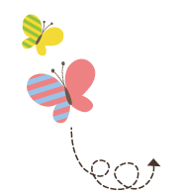
Module 8
WY 六年级下册
Unit 2 Why are you wearing a hat?
WWW.PPT818.COM

Slide 2
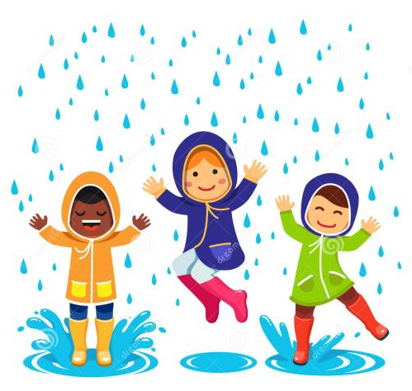
What are they wearing?

Slide 3
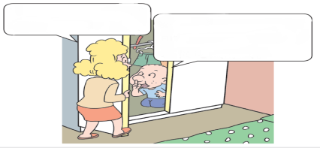
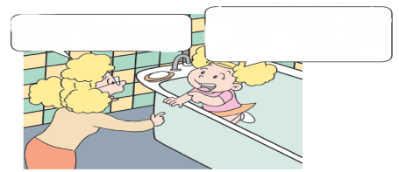
1. Look, listen and say.
Why are you here?
We’re playing hide-
and-seek.
We’re playing hide-
and-seek.
Why are you here?

Slide 4
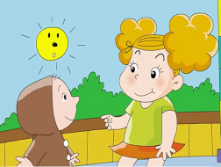
2. Listen and read.
Amy: Why are you wearing a raincoat?
Tom: Because it’s going to rain.
Daming: Why are you wearing a hat?
Lingling: Because it’s going to rain.
Dad: Why are you wearing a T-shirt?
Sam: Because I’m going to play basketball.
Mum: Why are you wearing a dress?
Amy: Because I’m going to the theatre.

Slide 5
知识点 1
—Why are you wearing a raincoat?
你为什么穿着雨衣？
—Because it’s going to rain.
因为要下雨了。
问句是一个由Why 引导的现在进行时的特殊疑问句，用来询问对方为何穿/ 戴某种服饰。
用法：

Slide 6
Why are you wearing（a / an） + 服饰？
句型结构：
答语：
Because + 原因.
— Why are you wearing sunglasses?
你为什么戴着墨镜？
— Because it’s going to be sunny.
因为会是大晴天。
例句：

Slide 7
raincoat /΄reɪnkəʊt/ n. ( 名词) 雨衣
例句：
Put on your raincoat. It’s raining.穿上你的雨衣。天正在下雨。
短语：
a red raincoat 一件红色雨衣
加法记忆法：
rain（雨）+ coat（外套）=raincoat（雨衣）
魔法记忆：
“下雨”（rain）时穿的“外套”（coat）就是“雨衣”（raincoat）。

Slide 8
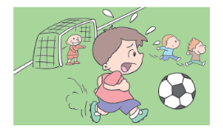
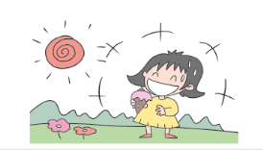
3. Read and write.
A: Why is he tired?
B: Because he is playing football．
A: Why ?
B: Because ?
is she laughing
she is happy

Slide 9
趣味活动：头脑大风暴。
六人一组，一人用英语说表示情绪的单词，如“sad”, 其他同学立刻做出sad 的表情，并大声读出这个单词“sad”。小组成员轮流进行。

Slide 10
4. Listen and say. Then sing.
WHY，WHY，WHY... ?
Why, why, why are you looking at the sky?
Why, why, why, why, why?
Why, why, why are you looking at the sky,
looking at the sky so high?
Because I can see something looking down at me, looking down at me.
Because I can see something looking down at me.
There’s a big bird in the tree!

Slide 11
5.Find the answers to the riddles.
Why did the girl
go into space?
Why did the boy eat fast?
Why did the dog sit under the tree?
Because it didn’ t
want to be a hot dog.
Because she wanted to be a star.
Because he was eating fast food.

Slide 12
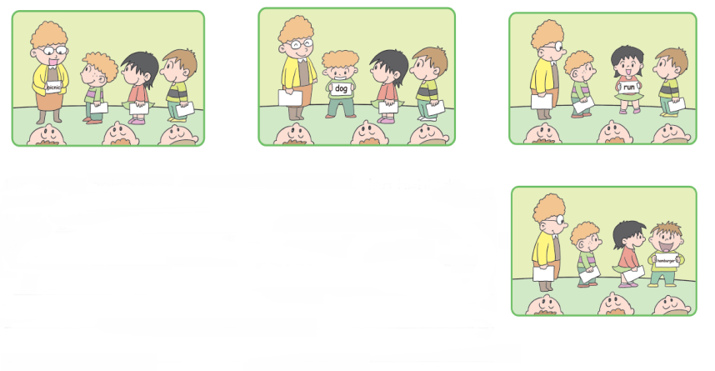
6.Do and say. Then write the story.
Lingling is going to have a picnic. There is a dog behind Lingling. Lingling is running...

Slide 13
一、给下列问句选择合适的答语。
（ ）1. Why is she crying?
（ ）2. Why do you go there?
（ ）3. Why are you wearing a cap?
B
C
A
Because I’ m going to play football.
B. Because she is sad.
C. Because I want to get my book.

Slide 14
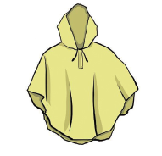
二、根据图片提示完成句子。
It will rain this afternoon.
You’d better take your ____________ .
raincoat

Slide 15
本节课我们学习了以下知识，请同学们一定加强巩固，以便能和同学们进行灵活交流哦！
重点词汇：raincoat
重点句式：Why are you wearing a hat?

Slide 16
1 熟记本节课所学的句型、短语和单词，必须会听、说、读、写。
2 将Listen and read的对话朗读流利。
3 完成配套的课后作业。

Slide 17
Thank you!

