Slide 1
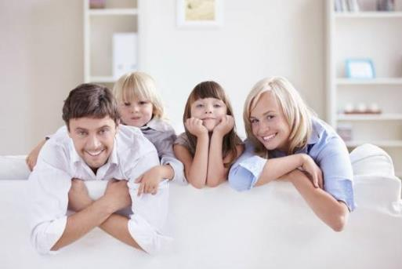
My parents
6
WWW.PPT818.COM

Slide 2
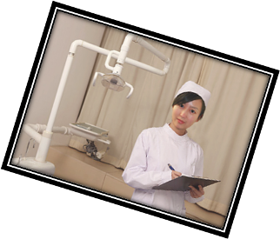
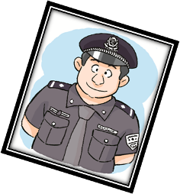
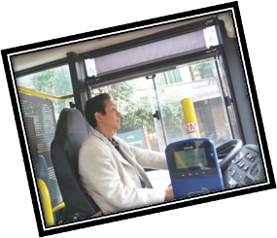
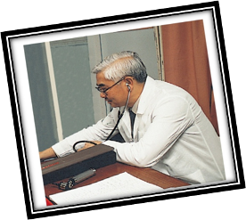
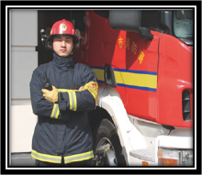
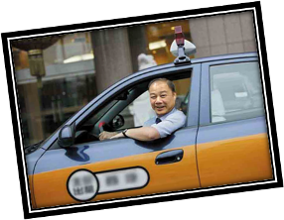
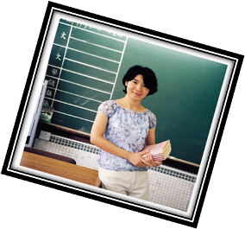
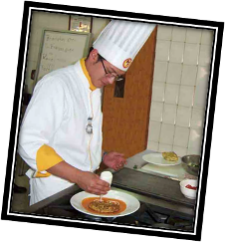
Look and say

Slide 3
Look and read
fireman
teacher
policeman
cook
bus driver
nurse
doctor

Slide 4
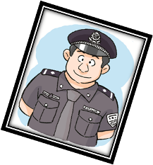
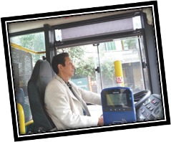
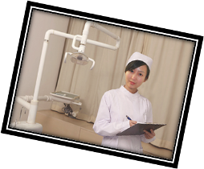
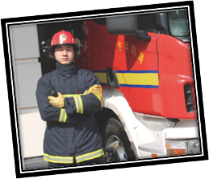
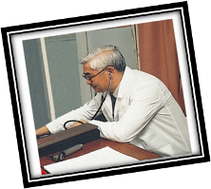
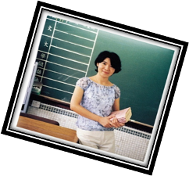
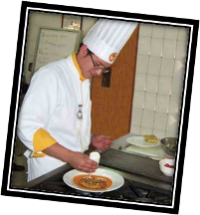
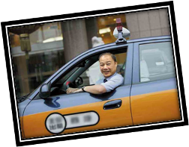
Ask and answer
What does he/she do?
He/She is a …
1
3
2
4
5
7
8
6

Slide 5
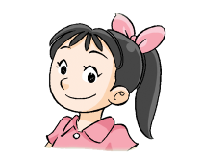
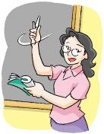
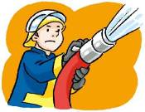
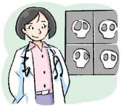
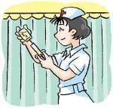
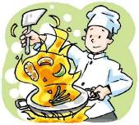
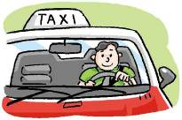
？
Think and say
What does your father do?
What does your mother do?
My father is a …
My mother is a …

Slide 6
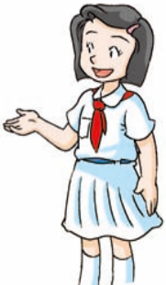
Look and read
Jill loves her family.
Her family is happy.
Jill loves her parents.
Jill loves her mother.
Her mother is kind and nice.
Jill loves her father.
Her father is strong and brave.
?
Her mother is kind and nice.
?
Her father is strong and brave.

Slide 7
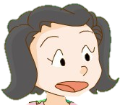
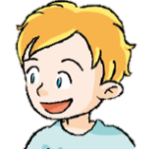
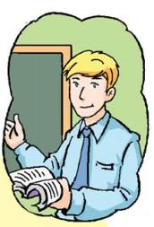
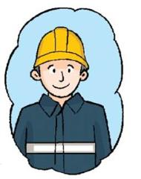
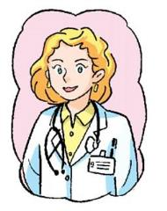
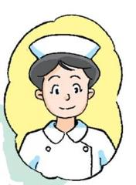
Listen and match
Jill’s parents
Peter’s parents

Slide 8
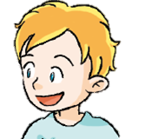
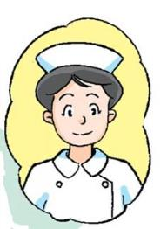
Listen and match
Jill’s parents
Peter’s parents

Slide 9
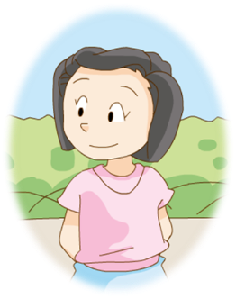
Think and answer
What does Jill’s father do?
What does Jill’s mother do?
What do Jill’s parents do?
Jill’s father is a ______.
Jill’s mother is a _______.
fireman
nurse

Slide 10
Look and read
Who is he?
He is Jill’s father.
What does he do?
He is a fireman.
Who is she?
She is Jill’s mother.
What does she do?
She is a nurse.

Slide 11
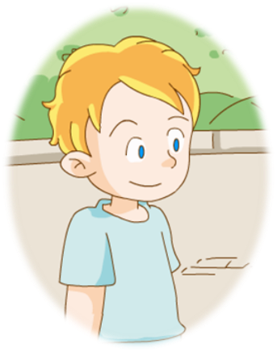
Ask and answer
What does Peter’s father do?
What does Peter’s mother do?
What do Peter’s parents do?
Peter’s father is a teacher.
Peter’s mother is a doctor.

Slide 12
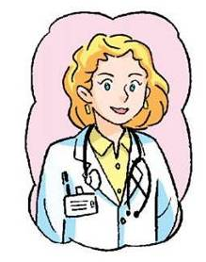
Look and read
What does Peter’s father do?
He is a teacher.
What does Peter’s mother do?
She is a doctor.
What do Peter’s parents do?
His father is a teacher.
His mother is a doctor.

Slide 13
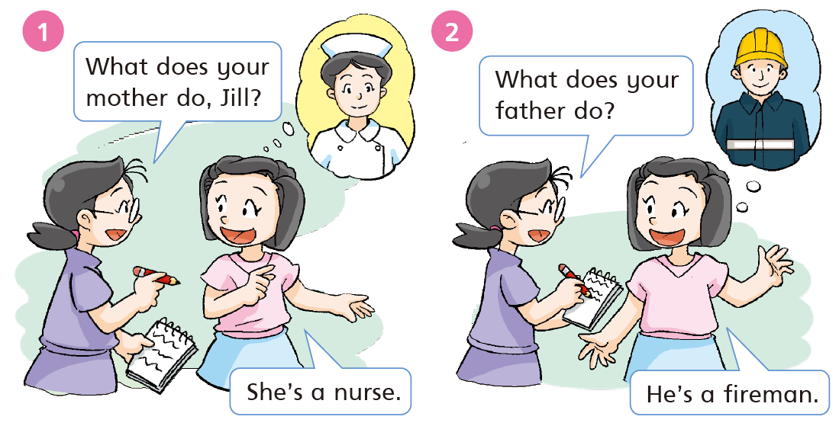

Slide 14
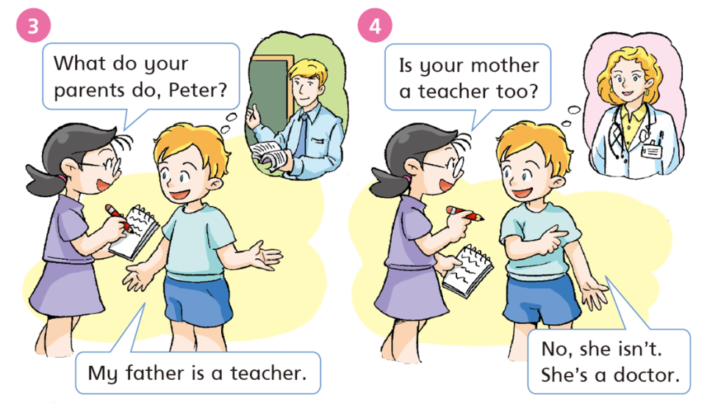

Slide 15
Let’s read together!

Slide 16
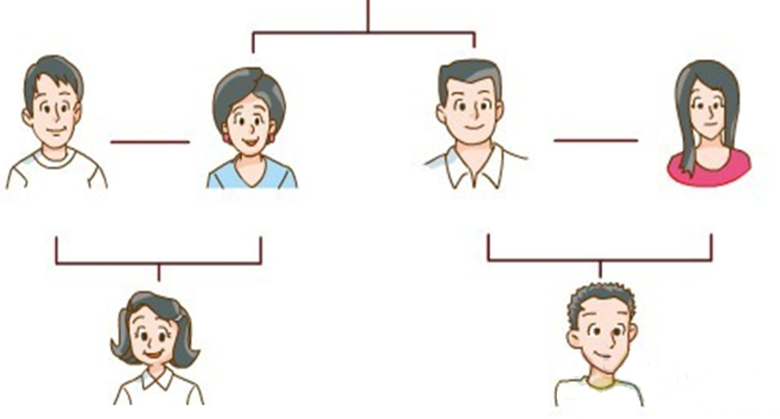
Read and write
My name is Jill. I’m a student.
I have a happy family.
_______
_______
_______
__________
He can …
She can…
He can …
She can …
_______
_______

Slide 17
Jill's family
My name is Jill. I’m a student. I go to school every day. I have a happy family. My father is a fireman. He can put out fires. My mother is a nurse. She helps sick people in the hospital.
My aunt is a shop assistant. She is kind and nice. She sells things to people. My uncle is a teacher. He teaches students every day. He likes his job. My cousin is a student. He can play football well. I love my family.

Slide 18
Read and write
My name is Jill. I’m a student.
I have a happy family.
fireman
nurse
teacher
shop assistant
_______
_______
_______
__________
put out
fires
help sick
people
teach
students
sell things
to people
_______
student
student
_______

Slide 19
Homework
听读并背诵P26.

