Slide 1
Unit 10
I’ve had this bike for three years.
Section B 3a—3b
WWW.PPT818.COM

Slide 2
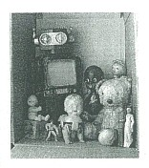
Do a survey!
3a
Name | What | How long | Who gave you | Why you like | More information

Slide 3
Making conversations
3a
Such as:
A: What’s your favorite thing from childhood?
B: This book.
A: How long have you had it?
B: I’ve had it for over ten years.
A: Who gave it to you?
B: My grandmother.
A: Why do you like it so much?
B: Because it’s very special for me, it can tell my a lot of knowledge.
A: Can you say anything more about it?
B:...

Slide 4
Role play
3b
A : What’s he favorite thing from childhood?
B : His favorite thing is...
A : How long has he had it?
B : He has had it for/ since...
A : Who gave it to him?
B : His…
A : Why does he like it so much?
B : Because…
...

Slide 5
How to write a passage
In the first paragraph, introduce your favorite thing | My favorite thing from childhood is . I’ve had it for/ since . gave it to me.
In the second paragraph, talk about why it is special | I like so much because . It’s special to me because . I think .
In the third paragraph, write about a story or memories | Has given me many memories. I remember when .

Slide 6
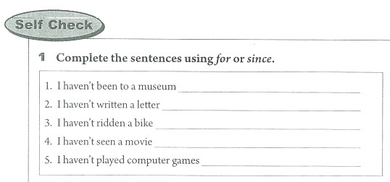
Have a race!
[参考答案] 1. for two years 2. since two years ago 3. for a long time 4. since last year 5. for two months

Slide 7
Play a game!
排队造句
这个游戏可以用来练习陈述句和一般疑问句的变换。教师根据句子的长短准备若干张卡片。如句子“She has had the pen for two yeas.” 要准备6张卡片,其中 “she”和“has”,要在正面大写首字母，反面小写首字母，标点符号正面写句号“.”,反面写问号“?”。游戏开始,教师将这6张卡片发给6位学生,然后说一句话,如“她拥有这支钢笔两年了吗?”(或用英语说：“Has she had the pen for two years?”), 这6位学生听到后应立即按句子次序排好队并将卡片高高举起。拿“has”的要将首字母大写的一面朝外,拿“she”的要将首字母小写的一面朝外，拿标点符号的要将问号朝外。 这个游戏也可以在两个组之间比赛,站队站得快和准的小组获胜。

Slide 8
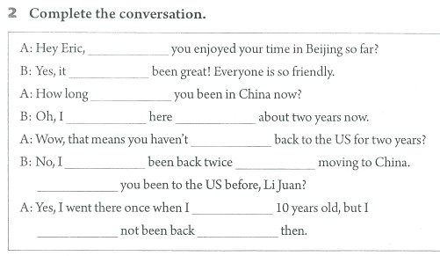
Have a race!
[参考答案] have; has; have; have been; for; been; have; since; Have; was; have; since

Slide 9
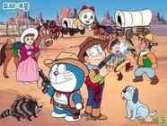
Role-play
A: Hey, Eric, have you enjoyed your time in Beijing so far?
B: Yes, it has been great! Everyone is so friendly.
A: How long have you been in China now?
B: Oh, I have been here for about two years now.
A: Wow, that means you haven’t been back to the US for
two years.
B: No, I have been back twice since moving to China.
Have you been to the US before.
A: Yes, I went there once when I was 10 years old, but I
have not been back since then.

Slide 10
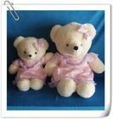
你的父母和朋友是否也有自己孩童时最喜欢的东西呢？调查一下并写出你的调查结果吧！

