Slide 1
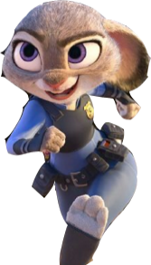
Sport
第一课时
WWW.PPT818.COM

Slide 2
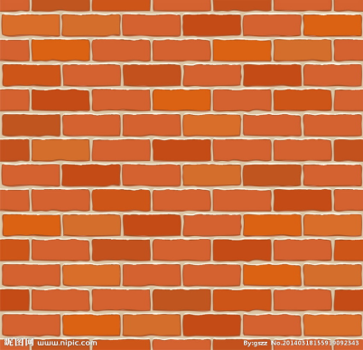
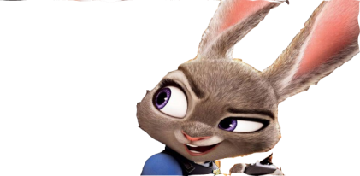
The tree is tall.
Judy is small.
She is behind the wall.
The apple is small.
It will fall in fall.

Slide 3
Make a chant
small
tall
ball
fall
call
wall
_____ is tall
_____ is small.
____ is behind the wall.

Slide 4
Let's chant
PPT模板：www.1ppt.com/moban/ PPT素材：www.1ppt.com/sucai/
PPT背景：www.1ppt.com/beijing/ PPT图表：www.1ppt.com/tubiao/
PPT下载：www.1ppt.com/xiazai/ PPT教程： www.1ppt.com/powerpoint/
资料下载：www.1ppt.com/ziliao/ 范文下载：www.1ppt.com/fanwen/
试卷下载：www.1ppt.com/shiti/ 教案下载：www.1ppt.com/jiaoan/
PPT论坛：www.1ppt.cn PPT课件：www.1ppt.com/kejian/
语文课件：www.1ppt.com/kejian/yuwen/ 数学课件：www.1ppt.com/kejian/shuxue/
英语课件：www.1ppt.com/kejian/yingyu/ 美术课件：www.1ppt.com/kejian/meishu/
科学课件：www.1ppt.com/kejian/kexue/ 物理课件：www.1ppt.com/kejian/wuli/
化学课件：www.1ppt.com/kejian/huaxue/ 生物课件：www.1ppt.com/kejian/shengwu/
地理课件：www.1ppt.com/kejian/dili/ 历史课件：www.1ppt.com/kejian/lishi/

Slide 5
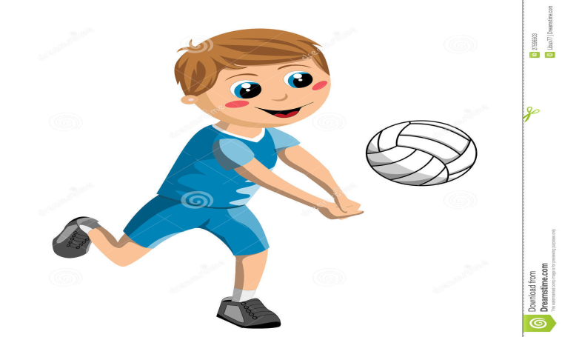
How can you play _______?
volleyball
hit the ball

Slide 6
The ball is round.
The ball is black and white.

Slide 7
How can you play ?
football
kick the ball

Slide 9
How can you play ?
basketball

Slide 10
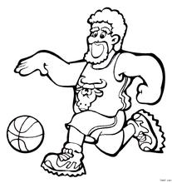
How can you play basketball?
bounce the ball

Slide 11
ball games
volley
foot
basket
ball
volleyball
football
basketball

Slide 12
How can you play table tennis?
hit the ball

Slide 13
kick the football
bounce the ball
hit the ball
hit the ball

Slide 14
Quick response
1. Please read every word card I show you.
2. Please be quiet and act it out when you see a bomb on the word card.

Slide 17
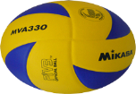

Slide 18
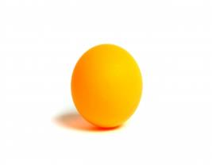
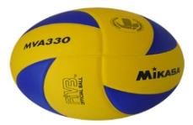
Guess
What do I like playing?
Do you like playing...?

Slide 19
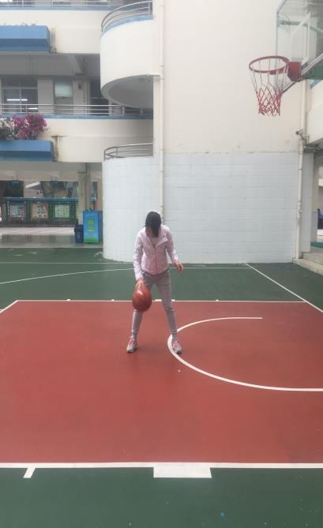
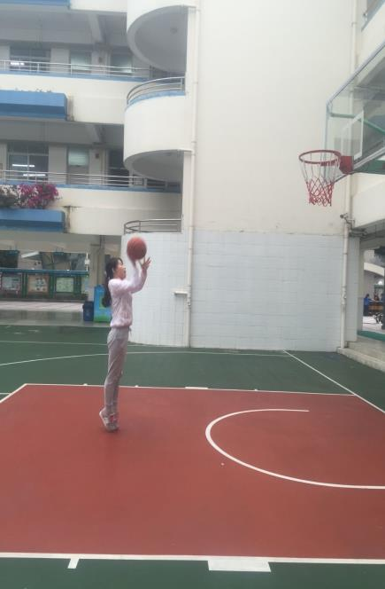

Slide 20
I like playing basketball.
bounce
I can______ the ball .
It's____.
fun
It makes me______.
healthy
fit
strong

Slide 21
A:What do you like?
B:I like playing....

Slide 22
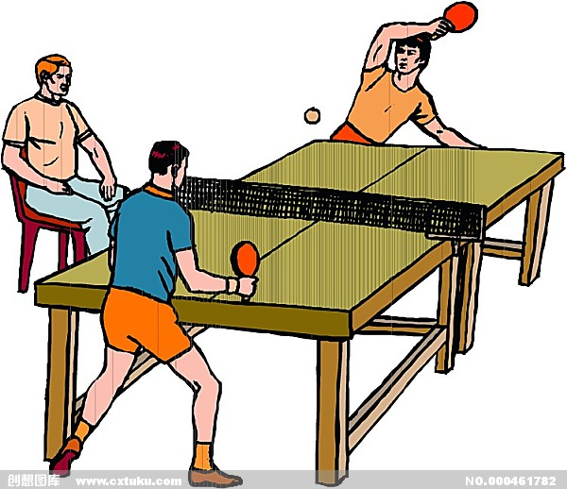
I like playing table tennis.
I can____ the ball over the net.
hit
fun
It's____.
It makes me______.
fit

Slide 23
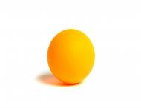
My favourite ball game
I'm_____.
I'm_____.
I like _____ _____.
I can_____ _____ _____.
It's____.
It makes me______.

Slide 24
Judy, Join us!
Football Club
Do you like _____ _____?
Do you like______ in a team?
Can you _____the ball?
playing football
playing
kick

Slide 25
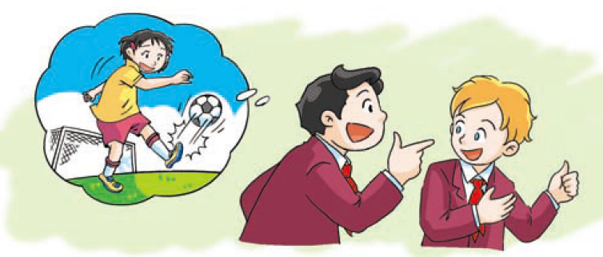
1. What do they like doing?
They like playing football.
2. They will join the
______ _______.
football club

Slide 26
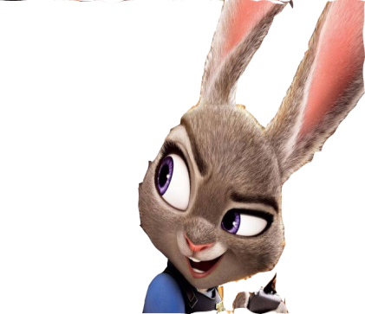
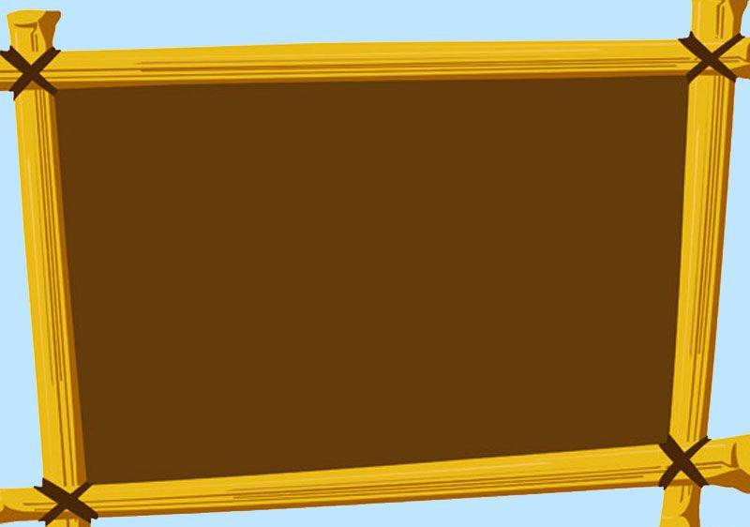
Wow! The football club looks great. I also want to join the football club, but how about my classmates? Umm, Can you make some posters for me ? I want to take them back to Zootopia.

Slide 27
Join us!
____ ______Club
Do you like _____ _____?
Do you like______?
Can you _____the ball?

Slide 28
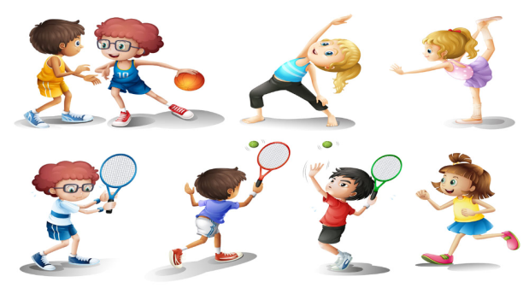
Homework
1. Point and read U5 Sport.
2. Write a text about” My favourite ball game” and share it with your friend.

