Slide 1
Unit 3 Lesson 16
Li Ming's Summer Holiday
WWW.PPT818.COM

Slide 2
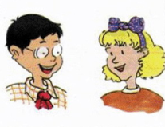
Warm -up
What will you do this summer holiday, Jenny?
I will go on a trip to the sea.
I will…
What about you?

Slide 3
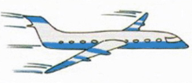
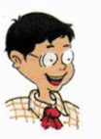
Let’s talk
I will fly home on June 25.
I will be in China for the summer holiday.

Slide 4
Let’s talk
I will say hello to my mother and father.

Slide 5
Let’s talk
I will visit my aunt and uncle. I will play with my cousin.

Slide 6
Let’s talk
I will meet my friends.
I will play ping-pong with them.

Slide 7
Let’s talk
I will miss Canada, but I will feel happy to see China again.
Danny and I will miss you, too. We will call you!

Slide 8
Circle the key words you learn.
happen beach
Canada visit
sea meet

Slide 9
Ask and answer
1. When will Li Ming fly home? He will fly home on June 25.
2. What will he say to his parents? He will say hello to his parents.
3. What will he do with his friends? He will play ping-pong.

Slide 10
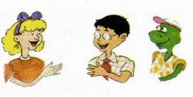
Let’s guess
You'll buy some meat.
What will I do? Number 2!
You'll buy some fruit.

Slide 11
Summary and Evaluation
What have you learned in this class?
A excellent B good C adequate D need improvement
内容 | 学生自评 | 小组互评
我能认真听老师讲课，听同学发言
遇到我会回答的问题主动举手了
活动中坚持使用英语来交际
我能积极参与小组讨论活动，能与他人合作。

Slide 12
Homework
Finish your exercise book Lesson 16.

