Slide 1
Unit 8 Save Our World!
Let's Sort Garbage!
WWW.PPT818.COM

Slide 2
Learning Targets
1. Be able to use the words: sort, empty, metal, plastic, recycle, amount, litter, do with, too much, give sth. to sb. , be made into, a piece of, go for a walk, take out
2. Learn to sort the garbage
3. Learn and master the usage of “it”
4. Learn some key sentences:
· What do you do with your garbage？
· Danny empties two bags of garbage onto the floor.

Slide 3
· After they sort the garbage, Danny and Jenny are surprised.
· People throw too much away.
· One of the wheels is broken.
· It's dangerous to leave broken glass on the ground.
· Once, I cut my foot on a piece of broken glass.

Slide 4
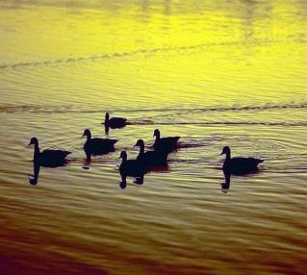
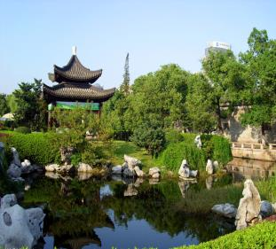
Lead in
Green environment

Slide 5
The damaged environment
deforestation
garbage

Slide 6
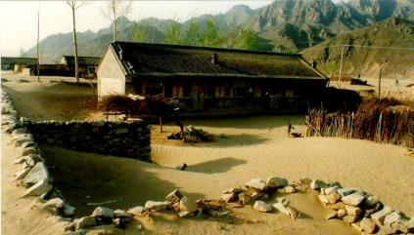
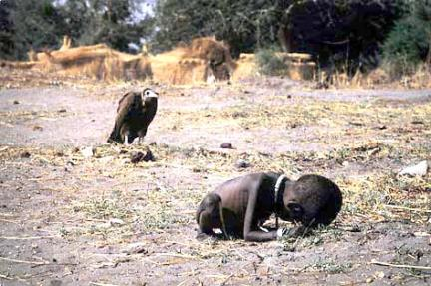
starvation
desertification

Slide 7
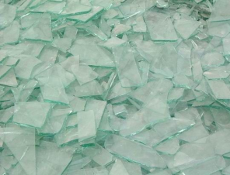
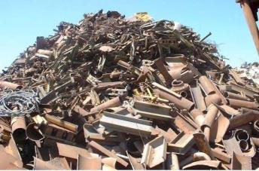
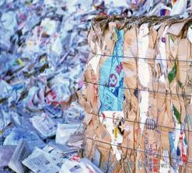
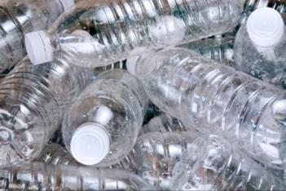
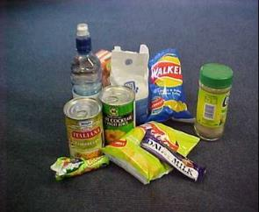
sort the garbage
glass
metal
paper
plastic
packagingand others

Slide 8
Think and answer
Are you green?
Do you try to walk or ride a bike to school?
Do you buy new clothes just because they are the latest fashions?
Do you open a window instead of turning on air-conditioning?

Slide 9
Discussion
What should we do to protect the environment?
1. Turn lights off.
2. Collect cans and paper, and sell them for recycling.
3. Try our best to save energy.
4. Ride a bike to school.
5. Use both sides of the paper.
6. Don't throw litter away everywhere.

Slide 10
Words and expressions
sort
empty
metal
plastic
recycle
amount
v. 分类；整理
n. 类；种类；类型
v. 把……弄空
adj. 空的
n. 金属
n. & adj. 塑料(的)
v. 回收再用；再循环
n. 量；数量

Slide 11
litter
do with
too much
give sth. to sb.
be made into
a piece of
go for a walk
take out
n. 垃圾
v. 使乱七八糟；乱扔
处理
太多
给某人某物
被制作成……
一张/一片/一块……
去散步
拿出；取出

Slide 12
THINK ABOUT IT
What do you do with your garbage?
What kinds of things can be recycled and reused?

Slide 13
Presentation
Listen and read the passage.
Danny empties two bags of garbage onto the floor.
Jenny: That's a lot of garbage！Can I help you sort it?
Danny: Yes, please. Let's put the glass here, the metal here, the plastic here and the paper here.
(After they sort the garbage, Danny and Jenny are surprised. Almost all of it can be reused or recycled！They need to throw away only one small bag of

Slide 14
garbage！)
Jenny: People throw too much away. They shouldn't waste so much!
Danny: That's right. Look！There is more paper than plastic. And there is less metal than plastic. There is the least amount of glass.
Jenny: And the most amount is paper. It is a waste to use paper only on one side.

Slide 15
Danny: Hey！I found a toy car. One of the wheels is broken. I'll take this car home and clean it. Then I'll use some glue to fix the broken wheel. When I finish fixing this car, I will give it to my little cousin, Debbie.
Jenny: Nobody should throw away a toy like this. It can be fixed. It's not right to waste things. Look at all of the glass. It can all be recycled and made into new glass.

Slide 16
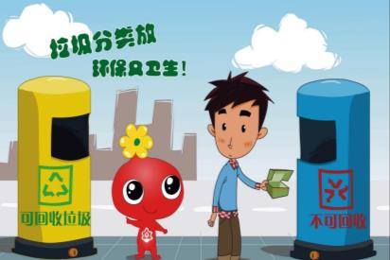
Danny: A lot of glass is broken. It's dangerous to leave broken glass on the ground. Once, I cut my foot on a piece of broken glass.
Jenny：Litter can hurt people!

Slide 17
Let’s Do It!
Read the lesson and write true (T) or
false (F).
1
1. There is a lot of garbage: glass, metal, plastic and paper. ( )
2. There is the most amount of glass and the least amount of paper. ( )
3. Danny found Debbie’s toy car in the garbage. ( )
4. Danny once cut his foot on a piece of broken glass. ( )
T
F
F
T

Slide 18
Circle the words that “it” refers to in each sentence.
2
Example:
It is a waste to use paper only on one side.
It is fun to travel.
It is not right to waste things.
It is quite easy to find information with this program.
They think it is rude to point with a finger.
It is dangerous to leave broken glass on the ground.

Slide 19
Learn to learn
As we all know, “It” can be used to refer to time, weather, distance or something mentioned before. Study the sentences above. Can you find other ways of using “it” ?

Slide 20
PROJECT
SORT THE GARBAGE
Go for a walk around your neighbourhood. Take a bag with you and pick up any garbage you see. Wear gloves because garbage is dirty.

Slide 21
Bring the garbage to school. Don't throw it away!
What kind of garbage did you find？Sort the garbage. Make a pile for paper, plastic，metal, glass and other things.

Slide 22
·How much of each type of garbage do you have？
·What type do you have the least/most amount of？
Do you want to throw away the garbage now？Don't! What else could you do with it？Think！Could you use some of the garbage again？How?
How could people make less garbage？Talk about this and write down your ideas.Now you can take out the garbage!

Slide 23
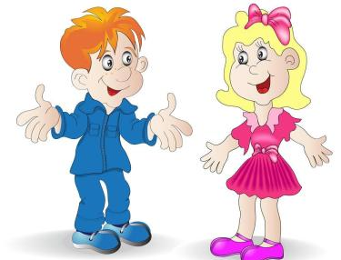
Language points
1.What do you do with your garbage？
do with 处理。它常与特殊疑问词what搭配使用。
例：What should I do with this problem？
我应该如何处理这个问题？

Slide 24
2. Danny empties two bags of garbage onto the floor.
empty v. 倒空 adj. 空的
例：The streets began to empty after midnight.
午夜过后街上行人开始稀少了。
Vargas emptied his tool bag.
瓦格斯腾出自己的工具袋。

Slide 25
3.After they sort the garbage, Danny and Jenny are surprised.
sort v．分类；整理。常用短语：sort out 把……整理好，分类。
例：I must sort out my clothes for the party.
我必须把聚会上要穿的衣服整理好。

Slide 26
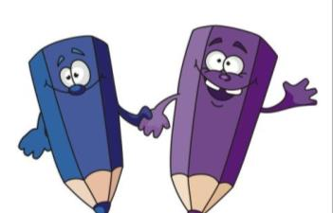
4. Almost all of it can be reused or recycled!
1) 此句为含有情态动词的被动语态，其构成形式为：情态动词(can / may / must / should) +be + 过去分词。
例：The flowers should be watered every day.
花儿应该每天浇水。
Cars mustn’t be parked here.
小轿车不可以停放在这里。

Slide 27
2) re-是前缀，意思是“再，重新”。例：rewrite, replay, reappear, rebuild, remarry等。
reuse意思是“重新使用；再使用”。
例：She often reuses old envelopes.
她经常重复使用旧信封。
recycle意思是“使再循环；使……重新利用，重复利用”。
例：They recycle empty tins so as to use the metal.
他们回收空罐头盒以利用其金属。

Slide 28
5. People throw too much away.
【辨析】too much、too many与much too
too much:
too many:
much too:
太多，修饰不可数名词或修饰比较级，含有“过分，难以接受”之意。
太多，修饰可数名词的复数。
太……，修饰原级。

Slide 29
6. One of the wheels is broken.
one of… ……之一。它后面跟可数名词复数。它作主语时，谓语动词用第三人称单数形式。
例：One of my friends comes from Canada.
我的一个朋友来自加拿大。

Slide 30
7. It's dangerous to leave broken glass on the ground.
(1)该句中it是形式主语，真正的主语是“to leave broken glass on the ground”。
(2)leave v．使保留；让……处于(某种状态、某地等)。其后可接名词、形容词、动词不定式、现在分词、过去分词或介词短语充当宾语补足语。

Slide 31
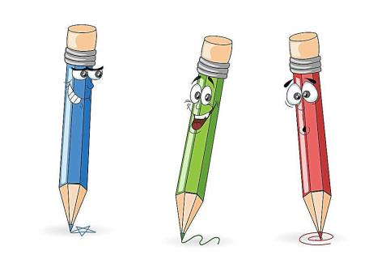
该句中 “leave broken glass on the ground” 的结构为“leave＋名词＋介词短语”。
例：Don't leave your socks on the sofa.
不要把你的袜子放在沙发上。

Slide 32
8. Once, I cut my foot on a piece of broken glass.
a piece of 一张/一片/一块…… 它后面常跟不可数名词，但是要注意piece 是可数名词。该短语作主语时，谓语动词的数取决于piece的单复数形式。
例：I have a piece of good news to tell you.
我有一条好消息要告诉你。

Slide 33
Grammar
1. it 的用法：
（1）it作代词
it不仅可以指代具体的物品，而且还可以指代时间、距离、路程、天气等。
例：It is half past five now.现在五点半了。
It is sunny and hot in my hometown in summer. 在我的家乡夏季晴朗、炎热。

Slide 34
（2）it作形式主语
当句子的主语过长时，为避免头重脚轻通常将it置于句首作形式主语，而将真正的主语(通常是不定式短语、动名词或主语从句)放在句子的后面。
例：It is important for us to use English as much as possible.
对我们来说尽可能多地使用英语是很重要的。
It is reported that there will be a thunderstorm tomorrow. 据报道明天将会有一场暴风雨。

Slide 35
（3）it作形式宾语
当句子的宾语过长时，常用it作形式宾语，用来代替真正的宾语(通常是不定式短语、动名词或宾语从句)。例：I found it hard to walk through the forest in five hours. 我发现在五个小时之内穿越森林是件很困难的事。
Jim thinks it is a pity that he didn't win the first place in the English competition. 没有在英语竞赛中获得第一名，吉姆觉得很遗憾。

Slide 36
2. 动词不定式作主语的用法
动词不定式的基本形式为“to + 动词原形”，其否定形式是“not + 动词原形”。它能起名词的作用，在句子中充当主语、表语、宾语和宾语补足语。动词不定式在作主语时，常用it作形式主语，而往往将动词不定式放在谓语或表语之后。
例：It’s not easy to learn a foreign language well.
(= To learn a foreign language well is not easy.)
学好一门外语不容易。

Slide 37
在此句型中，如果要说明动词不定式的动作是谁做的，可在不定式前加一个for引起的短语，作不定式的逻辑主语。即：It is + 形容词 + for sb. + to do sth.(对某人来说做……是……)。
例：It’s difficult for us to finish the work.
对我们来说，完成这项工作很困难。
It’s hard for me to answer your question.
要我回答你的问题很难。

Slide 38
但是，如果表语是kind, nice, right, wrong, clever, polite等描述行为者的性格、品质的形容词，则应在不定式前加一个of引起的短语。即：It is + 形容词 + of sb + to do sth (某人做……是……)。
例：It is kind of you to help me with my lessons.
你帮助我做功课，太好了。
It is so nice of you to come to see me.
你来看我太好了。

Slide 39
It takes/took + sb + some time + to do sth 意为“做……花了某人多少时间”
例：It takes her an hour to review her lessons every day.
她每天花一个小时复习功课。
It took more than 100,000 slaves twenty years to build the Great Pyramid.
十万多个奴隶花了20年的时间建成了那座大金字塔。

Slide 40
It is + 名词 + to do sth 意为“做……是……”
例：It is our duty to serve the people.
为人民服务是我们的责任。
It is an honour to make a speech here. 在这儿演讲很荣幸。
注意： 动词不定式作主语，同时有一个不定式作表语时，不能转换成“It’s … to do sth.”的句型。
例：[正]To see is to believe. [误]It’s to believe to see.
百闻不如一见。

Slide 41
Exercises
一、根据句意和首字母及汉语提示完成句子。
This beautiful bowl is made of _____ (金属).
2. The streets soon e______ when the rain began.
She found the ring while s______ some clothes.
When my clothes are worn out, I generally _____ them _____(扔掉).
metal
mptied
orting
throw
away

Slide 42
5. There isn't much metal in the bodywork of this new car. It’s mainly ______(塑料).
6. The Japanese r______ more than half their waste paper.
7. Please wait at the school gate. John will ___ you ___ there.
8. About two percent of fast-food packaging ends up as l_____ (垃圾).
plastic
ecycle
pick
up
itter

Slide 43
二、单项选择。
A
1. It is not always easy _____ invitations.
A. to refuse B. refusing
C. to be refused D. being refused
2. It is bad for your eyes ___ computer games
too much.
A. plays B. to play
C. play D. playing
3. It _____ him four hours and a half to do the work.
A. spent B. used C. needed D. took
B
D

Slide 44
4. It was careless _____ him to break the coffee cups.
A. for B. to
C. with D. of
5. What a pleasure___ with them!
A. is it to work B. it is to work
C. to work D. to be worked
D
B

Slide 45
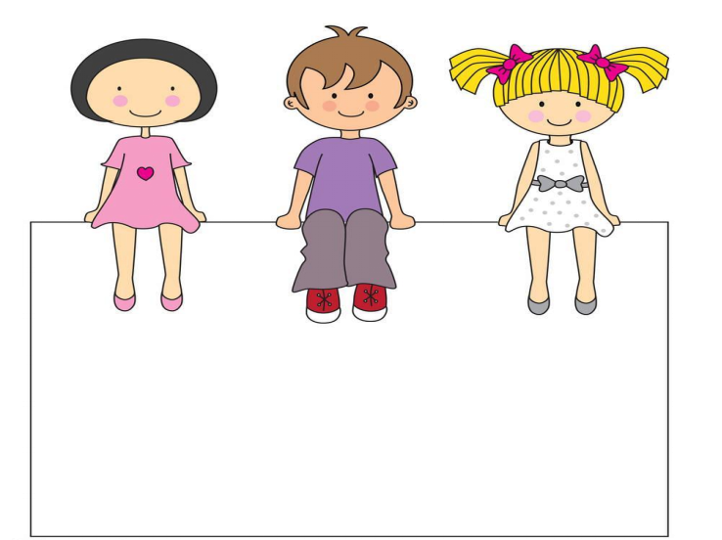
Summary
1. Learn some new words and expressions.
2. Be able to understand the passage .
3. Learn the usage of it and the infinitive as the subject.

Slide 46
Homework
1. Finish the exercises of Lesson 45.
2. Preview next lesson.
3. Tell your parents and your friends about the knowledge we learnt today and sort and reuse garbage together.

