Slide 1

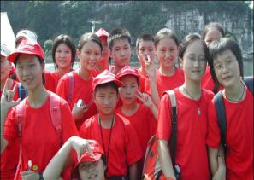
Module 7 Summer in Los Angeles
Unit 3 Language in use
WWW.PPT818.COM

Slide 2
Language practice
When are you leaving and how long are you going to stay there?
It sounds crazy but I don’t know what to take.
Shorts are good, or you can wear light trousers.

Slide 3

Grammar

Slide 4
并列复合句
1. 概念
并列句是指由并列连词and，but，or等把两个以上的简单句连在一起而构成的句子。
2. 并列复合句的构成
基本结构：简单句 + 并列连词 + 简单句。例如：
I help him and he helps me. 我帮助他，他帮助我。
3. 并列连词前后两简单句之间的关系
（1）并列关系。例如：
They are watching TV and the others are listening to the radio.
他们在看电视，其他人在听广播。
（2）选择关系。例如：
The children can go with us, or they can stay at home.
孩子们可以跟我们走，也可以待在家里。
（3）转折关系。例如：
He was tired, but he didn't stop working.
他感到疲惫，但是没有停止工作。

Slide 5
4. 使用并列复合句要注意的几种情况
（1）并列复合句有时不使用连词，而用分号隔开（前后两句之间的关系须相当紧密）。例如：
We fished all day; we did not catch a single fish.
我们钓了一天鱼；我们一条鱼都没有钓到。
（2）并列连词后的简单句如果与其前的简单句有相同的部分，则相同部分可以省略。例如：
Snoopy lives in his own world and (Snoopy) finds real life is hard to understand.
史努比生活在自己的世界里，发现现实生活难以理解。

Slide 6

1 Join the two parts of the sentences with and, but or or.
I would like to go to England ...
You should wear a raincoat ...
You can go by plane ...
I did not bring my sunglasses ...
I have bought my ticket ...
You can take two bags ...
a) ... I have got my passport.
b) ... practise my English.
c) ... I can buy a new pair.
d) ... they must not weigh too much.
e) ... you can carry an umbrella.
f) ... you can take the train.
Work in pairs and say the sentences.

Slide 7
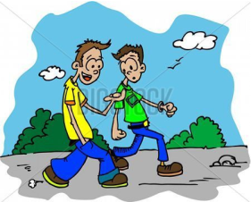
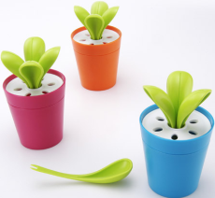
I would like to go to England and practise my English.
You should wear a raincoat or you can carry an umbrella.
You can go by plane or you can take the train.
I did not bring my sunglasses but I can buy a new pair.
I have bought my ticket and I have got my passport.
You can take two bags but they must not weigh too much.

Slide 8
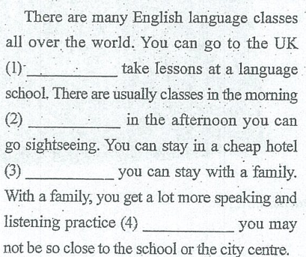

2 Complete the passage with and, but and or.
and
and
or
but

Slide 9
3 Work in pairs.
Student A: Say a sentence about travel.
New York is a long way from Beijing.
Student B: Add to Student A's sentence with another sentence beginning with but.
But London is closer.
Student A: Add to Student B's sentence with another sentence beginning with but.
But the weather isn’t as good as in New York.
Continue to add to each other's sentences.

Slide 10
4 Read the advertisement. Complete the sentences with the words or expression in the box.
Want to learn about the culture in the UK?
Come and join us!
Let a British family teach you all about the culture in the UK.
Students study together in groups.
After-school activities for students.
For students from all over the world.
Cost: £ 800 for a four-week course.

Slide 11
5 Work in pairs. Imagine that you are going to take a summer English course in Australia. Write down questions about the course. Use the words or expression in the box in Activity 4 to help you.
How long does the course last?
Now ask and answer.
— How long does the course last?
— It lasts for four weeks.

Slide 12
6 Complete the conversation with the words and expressions in the box.
beginning chance experience grow up
information last provide take part in
Mrs Smith: Excuse me.
David: Yes, how can I help you?
Mrs Smith: I’d like to get some (1)____________ about your summer camp.
David: Yes, of course. Our summer camp is a great (2)____________ for children. They learn about themselves, live close to nature and make new friends.
Mrs Smith: It sounds wonderful. And how long does it (3)________？
David: Three weeks, starting from the (4)_________ of July.
Mrs Smith: How many students are there in each group?
information
experience
last
beginning

Slide 13

provide
David: Eight. By the small group size, we (5)___________ students with a new experience of friendship.
Mrs Smith: That’s great. And do you plan different activities?
David: Yes, of course. Students can (6) ______________ different activities to get close to nature and try out new ideas.
Mrs Smith: Sounds good.
David: Yes, and it gives your child the (7)__________ to live away from home.
Mrs Smith: That’s true. Summer camping is always good to help children (8)___________.
take part in
chance
(to) grow up

Slide 14

Module task
Having a class discussion
about summer courses

Slide 15
Plan what you want to say about summer courses. Think about the answers to these questions.
Have you ever taken a summer course? How was it?
Is it better to take a summer course or do something completely different?
Do you like taking summer courses in subjects you are not doing well in?
Do summer courses make it difficult to start school again in autumn?
Now write two good things and two bad things about taking summer courses.

Slide 16
Practice
用合适的并列连词填空
1. Work hard, _____ you will pass the driving test.
2. Stop cutting trees, _____ the earth will become worse and worse.
3. They bought Granny a present ____ she liked it very much.
4. They all went to the cinema ____I didn't.
5. — Hello, Mr. Huang!
— I'm sorry, ____I don't think I know you.
6. The little boy is very young _____ he can look after himself well.
7. Go along the street, turn to the left at the end of the street ____ you’ll find the post office.
8. Some are reading newspapers, _____ others are playing basketball.
9. Be careful, ________ you will fall off the bike.
10. My aunt doesn't have much money, _____ she always enjoys herself.
and
or
and
but
but
but
and
and
or
but

Slide 17
Homework
1.Revise the words and expressions in Module7.
2.Write a short passage about your summer camps.

