Slide 1
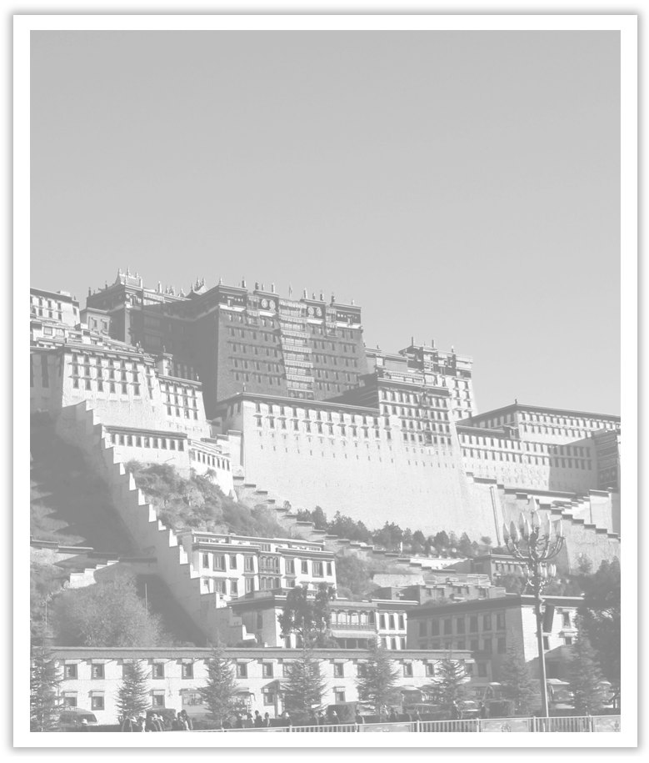
Unit 1 Cultural Heritage
Section Ⅵ The Rest Parts of the Unit(P_{6～12})
WWW.PPT818.COM

Slide 2
Ⅰ.单词语境记忆——根据汉语提示写出单词的适当形式
1.Lily is a high school student who wants to be a ____________(职业的) actress.
2.The WHO said that ____________(加工的) meat may lead to cancer.
3.There are some good rules and ____________(传统) in my family, which benefit me a lot.
professional
processed
traditions

Slide 3
4.The ____________ (历史上著名的) building is as much part of our heritage as the paintings.
5.President Xi once ____________ (引用) a Chinese saying, “Close neighbors are better than distant relatives.”
6.It was not until 1911, when the first vitamin was ____________ (找到), that people realized the importance of it.
historic
quoted
identified

Slide 4
Ⅱ.短语语境填空——根据汉语提示写出适当的短语
1.It has been two years since I ________________ (从事) training volunteers.
2.The tourists ________________ (拍照) themselves standing in front of the ancient temple.
3.The teacher noticed that Johnny had been looking out of the window for a long time.She decided to ________________ (引起他的注意).
4.Several of the members ________________ (提出) suggestions of their own at the meeting.
5.John ____________ very ____________ (熟悉) software development.He’s been working on IT for twenty years.
6.—Any good way to get there on time？—Only by ________________(加速).
worked on
took photos of
get his attention
came up with
is
familiar with
speeding up

Slide 5
Ⅲ.句式语境仿写
1.Today, the caves are just as international as they were at the time when people travelled the Silk Road.
如今，这些洞穴和人们在丝绸之路旅行时一样是国际化的了。
[仿写] 这个小女孩看上去和她上初中时一样漂亮。
The girl looks _______________________ at the time when she was in junior school.
2.Appreciating one’s own cultural heritage is very important for understanding oneself.欣赏自己的文化遗产对于了解自己非常重要。
[仿写] 早睡早起被认为是个好习惯。
___________________________________ is considered a good habit.
as beautiful as she was
Going to bed early and getting up early

Slide 6
记单词
Ⅰ.语境串记多义词
1.In the process of making preserved meat, there are several processes to pay special attention to when processing the meat.
在制作腊肉的过程中，有几个步骤在腌肉时需要特别注意。
2.The quality of this kind of quality bean is that it has some qualities that other beans haven’t.
这种高质量的大豆的特征是它具有其他大豆所没有的一些品质。

Slide 7
Ⅱ.词族联记一类词
1.同义
2.反义
①opinion→idea/view
②process→procedure
①download →upload
②entrance →exit

Slide 8
句型公式
1.“as＋adj.＋as...”意为“像……一样……”。
2.动名词短语作主语。

Slide 9
1.entrance n. 入口；进入 enter v.进入
We met a professional archaeologist at the entrance to the Great Pyramid.(教材P₆)
我们在大金字塔的入口处遇见了一位专业的考古学家。
[合作探究] 体会entrance的用法和意义
An entrance fee is a sum of money which you pay before you go into somewhere like the theater.入场费是你在进入剧院之类的地方之前支付的一笔钱。
She made her entrance into the supermarket, bought a bottle of water and came out in the street.她进了超市，买了一瓶水， 然后出来上了街。

Slide 10
[自主发现]
①________________ 在……的入口处
②entrance fee ________________
③______________________ 进入
at the entrance to
入场费
make one’s entrance into

Slide 11
[巩固内化] 补全或翻译句子
①Gaokao is the National College __________________ (入学考试) in China which started in 1952.
②That child, following his mother，____________________________(进了动物园).
③游客们在景区门口排起了队。
________________________________________________________________________
Entrance Exam
made his entrance into the zoo
The visitors lined/queued up at the entrance to the scenic area.

Slide 12
2.quality n.质量；品质；素质；特征adj.优质的；高质量的
Nearly 500，000 high-quality digital photographs have been produced since the international project started in 1994.(教材P₈)
自1994年国际项目开始以来，已经制作了将近50万张高质量的数码照片。
[合作探究] 写出quality在下列各句中的汉语意思
①He has all the qualities of a good teacher.
他有一个好老师应有的全部____________。
②The school should pay attention to quality-oriented education.
学校应该重视____________教育。
品质
素质

Slide 13
③One quality of wood is that it can burn.木料的一个____________是能燃烧。
④We and our future generations all need a quality life.
我们及我们的下一代都需要过____________生活。
特征
优质的

Slide 14
[词块积累]
be of high quality 质量上乘
quality and quantity 质量和数量
quality guarantee 品质保障
core quality 核心素养
quality products 优质产品
quality-oriented education 素质教育

Slide 15
3.contrast n.&vt.对比；对照
Words to show comparison and/or contrast (教材P₈)
表示比较和/或对照的单词
[合作探究] 体会contrast的用法和意义
It’s interesting to contrast the British legal system with the American one.
将英国的法律制度与美国的法律制度进行对比是很有趣的。
In contrast to/with his brothers, Tom is rather short.
与几位兄弟相比，汤姆的个子相当矮。
By contrast, Mary is much more diligent than Tom.
相比之下，玛丽比汤姆勤奋得多。

Slide 16
She had almost failed the exam but her sister in contrast had done very well.
她几乎考试不及格，但是与之相反她的姐姐却做得很好。
[自主发现]
①contrast A ____________ B 比较A和B
②in contrast ____________ 与……比较起来/形成对比
③____________ 比较起来；与此相反
④____________ 相比之下；与之相比
with
to/with
in contrast
by contrast

Slide 17
[巩固内化] 单句语法填空
①His white hair was in contrast ____________ his dark skin.
②China has a large population.____________ contrast, Canada has a very small population.
③When the artificial flowers ____________ (contrast) with natural ones, you can hardly tell the difference.
with/to
By/In
are contrasted

Slide 18
4.identify vt.确认；认出；找到； 识别；把……看成 identity n.身份；一致
Underline the relative clauses that the writer uses to identify the following.
(教材P₈)在作者用来识别下列内容的相关从句下划线。
[合作探究] 体会identify及其派生词的用法和意义
①This app helps you use the camera to identify color in time.
这个应用程序可以帮助你使用相机及时____________颜色。
②We were not able to identify you using the information you provided.
我们不能通过你提供的信息来____________你的身体。
③I identified the jacket at once; it was my brother’s.
我立即____________了那件外套，它是我兄弟的。
识别
确认
认出

Slide 19
④It’s said that experts have identified a related threat to children’s health.
据报道，专家已经____________了一种对儿童健康的相关威胁。
⑤He identified himself as an old friend of the family.
他____________这家人的老朋友。
⑥The police are trying to find out the identity of the man killer.
警方正在努力查明杀人凶手的____________。
[自主发现]
⑦identify sb ____________ sth 确认某人做某事
⑧identify oneself ____________ 自称是……
找到
自称是
身份
doing
as

Slide 20
[巩固内化]
(1)单词拼写
①Having confirmed the ____________ (身份) of the visitor, the gatekeeper let him in.
(2)单句语法填空
②She identified herself to the police ____________ the driver of the car.
③Scientists ______________(identify)more than forty chemicals in tobacco so far.
④Firstly, our ____________(identify) can be revealed and we can be in trouble.
[思考] 表示“认出”的词或短语还有哪些？
________________________________________________________________________
identity
as
have identified
identity
recognize, know, tell from, pick out

Slide 21
5.Today, the caves are just as international as they were at the time when people travelled the Silk Road.(教材P₈)
如今，这些洞穴和人们在丝绸之路旅行时一样是国际化的了。
【句式解读】 句中as international as they were是比较状语从句，其结构为“as＋adj./adv.＋as＋从句”，意为“像……一样……”。
【用法总结】
(1)as...as possible 尽可能……的/地
(2)as＋形容词或副词＋as sth 像/和……一样……
(3)as＋adj.＋a/an＋名词＋as... 和……一样……的……

Slide 22
①We should plant trees as many as possible.我们应该尽可能多种树。
②This film is as interesting as that one.这部电影和那部电影一样有趣。
③Tony is as clever a boy as his brother.
托尼是一个和他兄弟一样聪明的男孩。

Slide 23
[巩固内化] 翻译句子
①这位老人的生活和20年前的一样平静。
________________________________________________________________________
②她和她妈妈一样是位好老师。
________________________________________________________________________
③让我们尽可能多地试着说英语！
________________________________________________________________________
The life of the old man is as peaceful as it was 20 years ago.
She is as good a teacher as her mother.
Let’s try speaking English as much as possible!

