Slide 1
Unit 3 Healthy or unhealthy
WWW.PPT818.COM

Slide 2
Free talk
1、Do you think breakfast is important？
2、Why do you think breakfast is important？

Slide 3
what did you have for breakfast this morning？
what did you have breakfast this morning？
I had some ______ ________
bread and milk

Slide 4
what did you have breakfast this
morning？
I had ____________
a hamburger and some cola.

Slide 5
what did you have breakfast this
morning？
I had an egg and apple。

Slide 6
what did you have breakfast this
morning？
I had some fruit and milk

Slide 7
T:what did you have breakfast this morning？
S:I eat a lot of candy and chocolate
T:that's not healthy. you should eat a lot of fruit

Slide 8
1、 How about your breakfast？
T:I had an egg and milk for breakfast
（1Did you have breakfast this morning？
（2 What did you have for breakfast？
I had ___________
（3 Do you think your breakfast is healthy？

Slide 9
Guess ？
（4 Which kinds of foods are healthy？

Slide 10
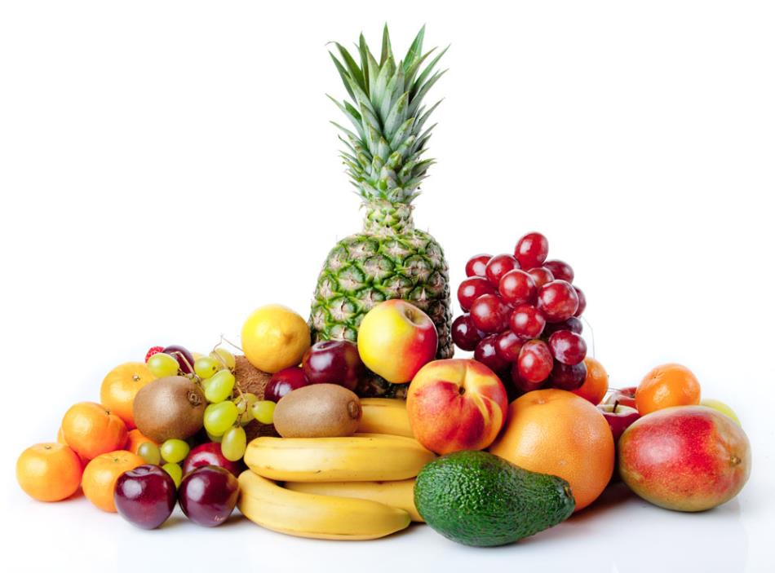
Fruit

Slide 11
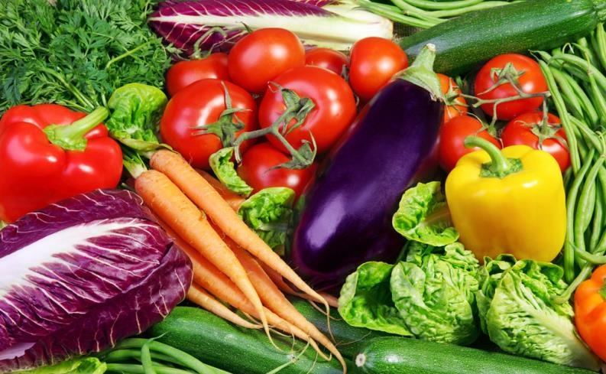
vegetable

Slide 12
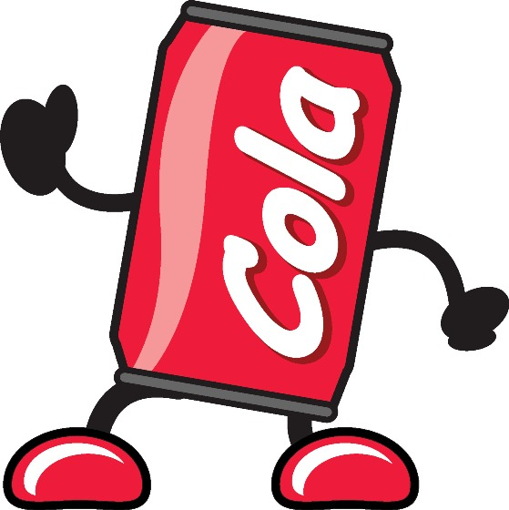

Slide 13
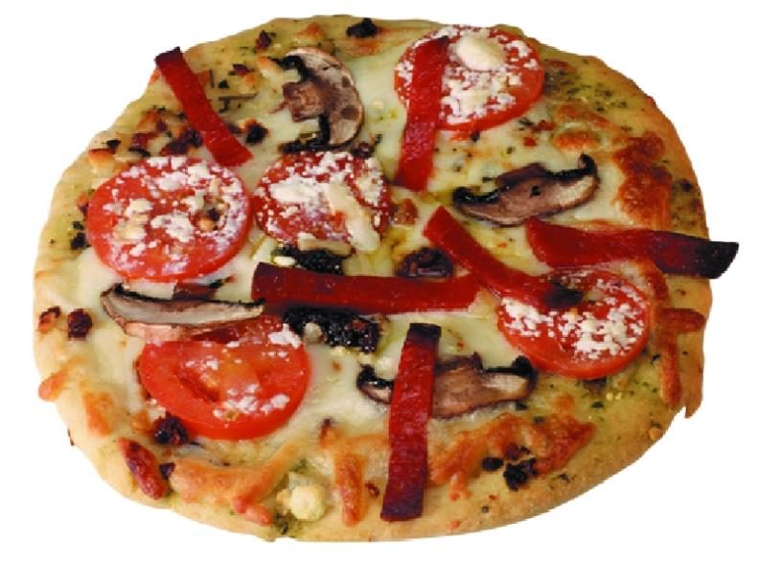
pizza

Slide 14
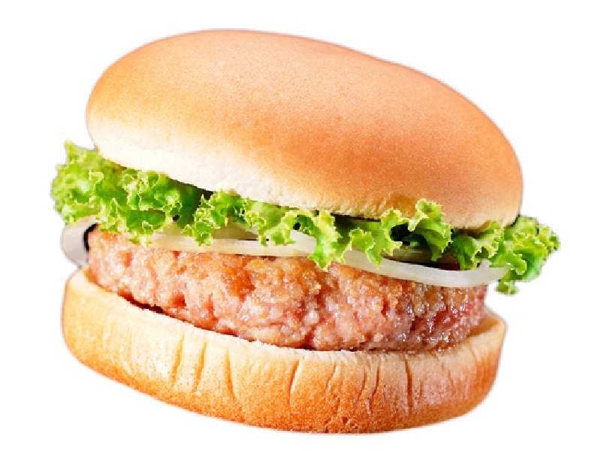
hamburger

Slide 15
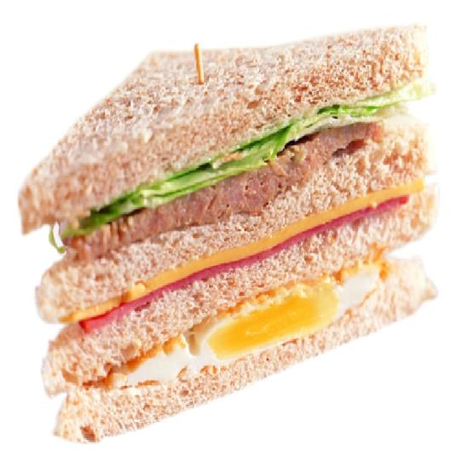
sandwich

Slide 16
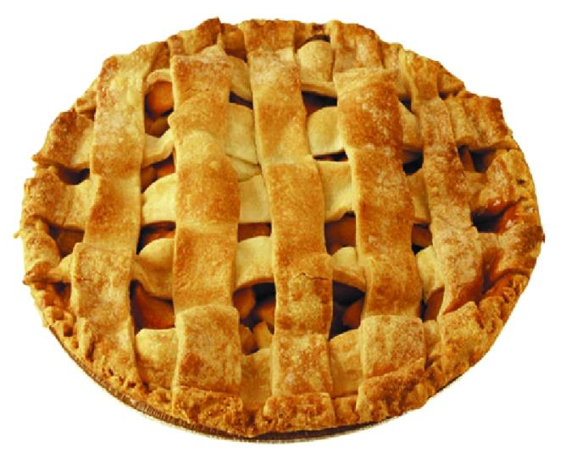
pie

Slide 17
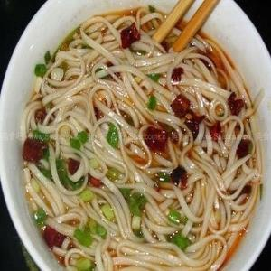
noodles

Slide 18
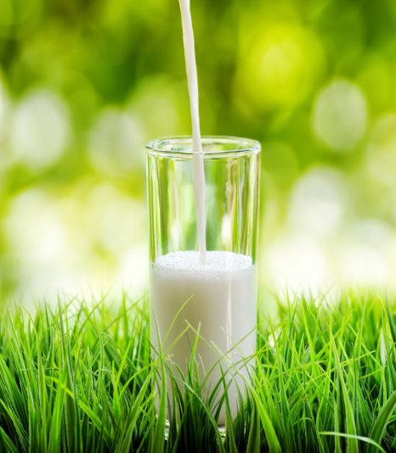
milk

Slide 19
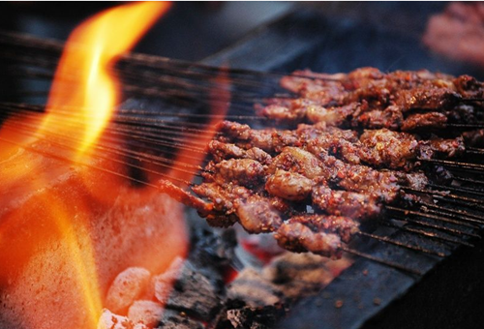
barbecue

Slide 20
2、we go back to our text，How about their breakfast？
1)听录音熟悉课文内容
2）理解课对话内容（分别找出三个人的早餐，其中哪一位的早餐生活最健康）
3）分角色朗读课文（３人一组）

Slide 21
Think：what do you have for breakfast?

Slide 22
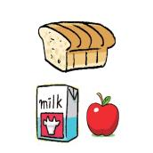
What do you have for breakfast?
a little
We should eat _____meat .
We should eat____
_{bread and drink some milk}
some
a lot of
We should eat____
_{vegetables and fruit}

Slide 23
Perform
创设相对真实情景，三人一组分角色扮演

