Slide 1
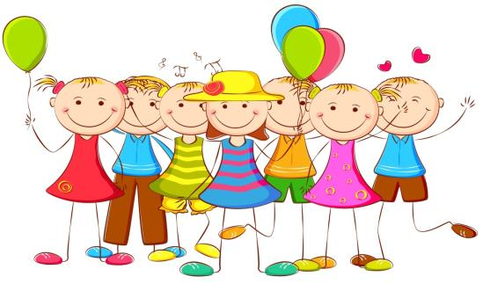
Children’s Day
第一课时
WWW.PPT818.COM

Slide 2
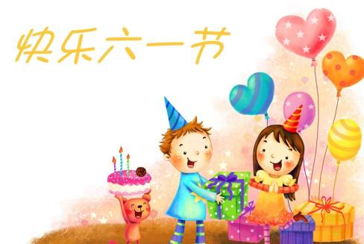
A riddle
It's a big day for us.
It's in June.
We sing and dance on this day.
We have a party, too.
What day is it?
It's Children’s Day.

Slide 3
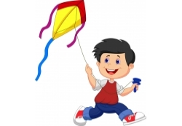
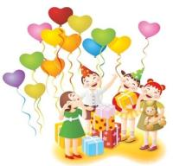
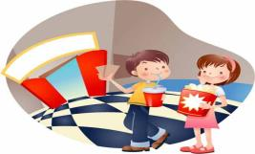
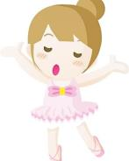
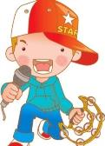
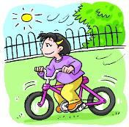
Free talk
What do you do on Children's Day?
We … .
watch a film
fly a kite
have a party
dance
sing
ride a bike

Slide 4
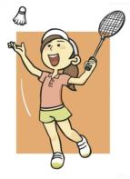
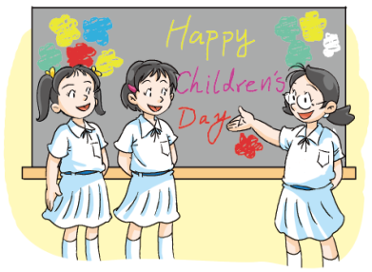
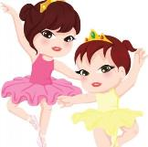
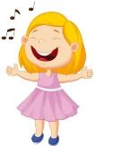
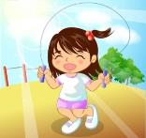
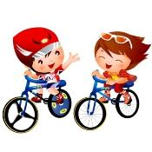
Let's guess
What does Alice do on Children's Day?

Slide 5
Watch and check
What does Alice do on Children's Day?

Slide 6
Read and answer
What does Alice do in the morning?
She has a party and sings a song.
2. What does Alice do in the afternoon?
She goes to the zoo with her parents.

Slide 7
Discuss
What does Alice do at the party?
2. What does Alice see at the zoo?

Slide 8
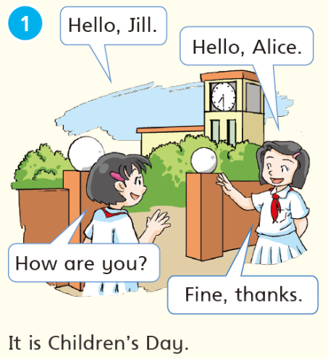
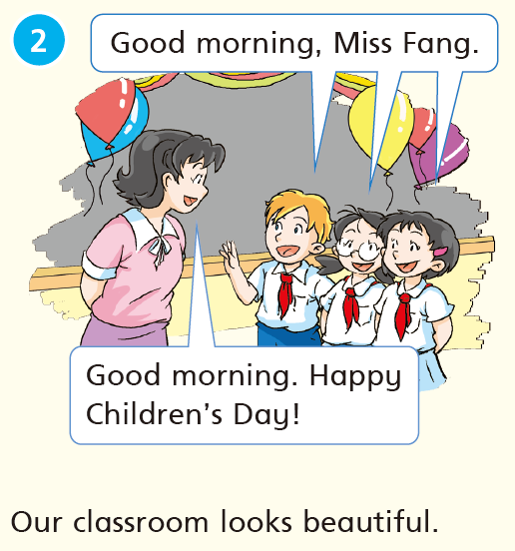
Listen and repeat

Slide 9
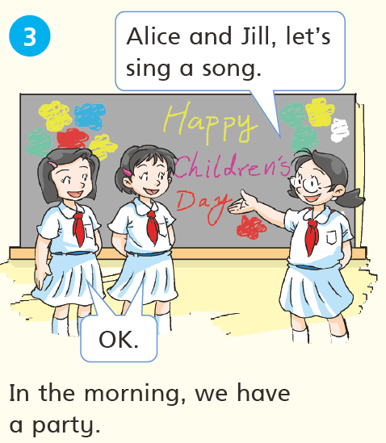
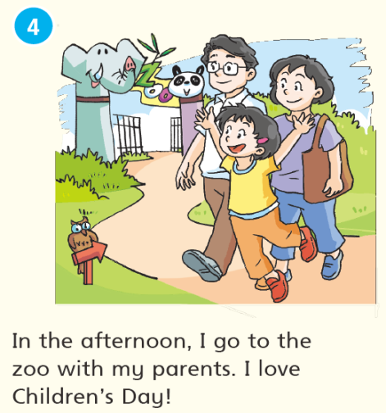
Listen and repeat

Slide 10
Group work
Hello, Jill. It’s Children’s Day. How are you today?
Fine, thanks.
Good morning, Miss Fang.
Good morning. Happy Children`s Day.
Our classroom looks beautiful.
Let’s begin our party.
OK. Let’s sing a song.
What are you going to do this afternoon?
I`m going to the zoo with my parents.
Have a good time.
Thanks. You, too.

Slide 11
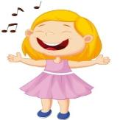
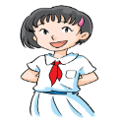
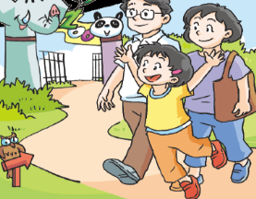
Let's retell
It’s Children’s Day. Alice is
very happy. In the morning, she
____________________________.
In the afternoon, she _____________________________.

Slide 12
Read and think
What does Alice do in the evening?
Is Alice happy on Children's Day? Why?

Slide 13
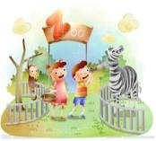
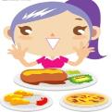
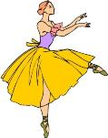
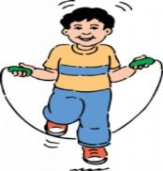
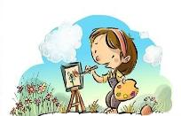
Let's chant
Little boy, little boy, what can you do?
I can sing and go to the zoo.
Little girl, little girl, what can you do?
I can dance and eat much food.
Little boy, little boy, what can you do?
I can skip and play with you.
Little girl, little girl, what can you do?
I can read and draw in the zoo.

Slide 14
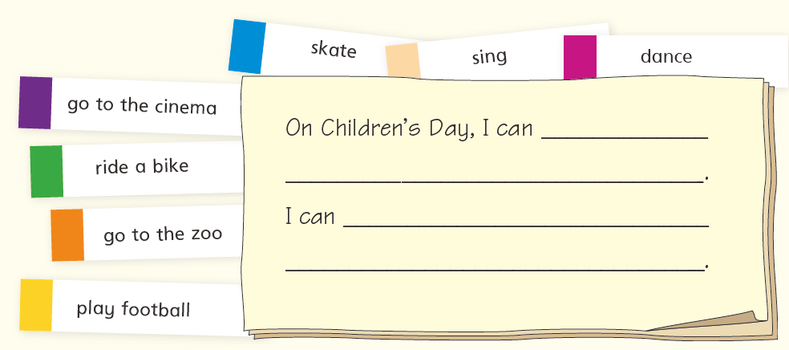
Think and write
What can you do on Children’s Day?

Slide 15
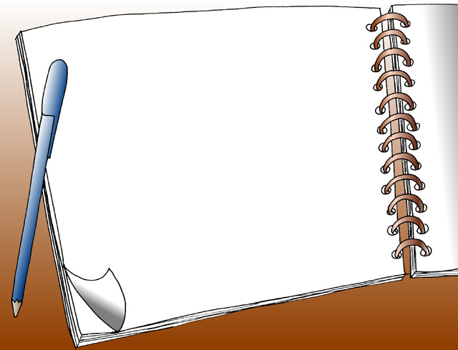
Homework
1. Listen to Page54 “Listen and say”
and repeat three times.
2. Choose one to do.
Retell Alice's Children's Day and
write it down.
(2) Use “On Children’s Day, I can ...” to
write at least three sentences.

