Slide 1
Unit 2
How do you come to school
五年级
第2课时
五年级
WWW.PPT818.COM

Slide 2
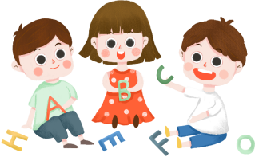
Read a story
I AM Going to the Sun

Slide 3
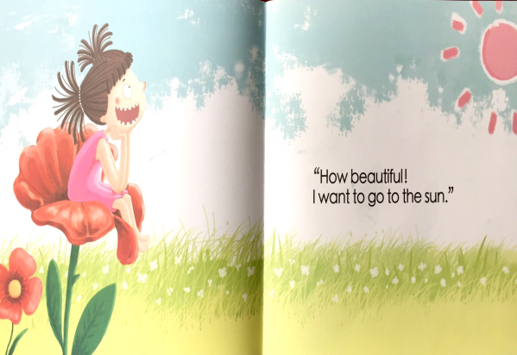

Slide 4
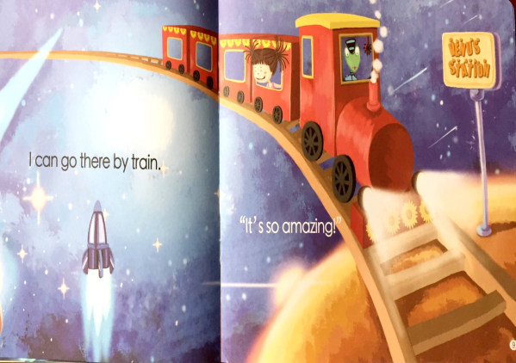

Slide 5
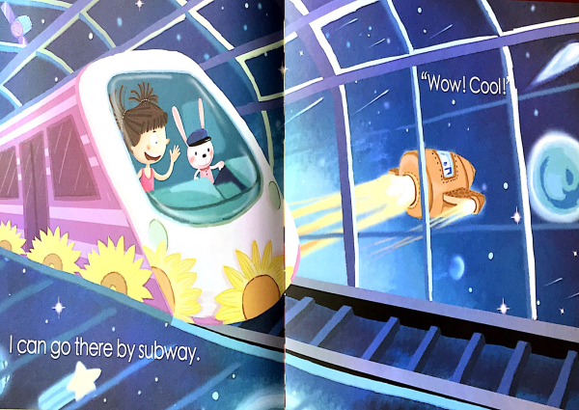

Slide 6
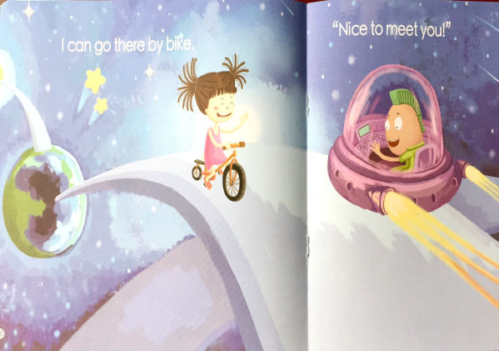

Slide 7
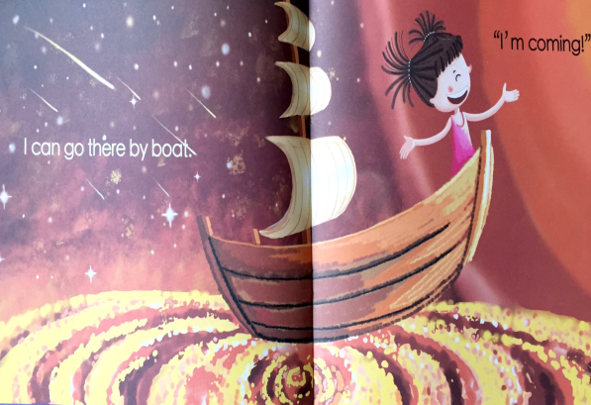

Slide 8
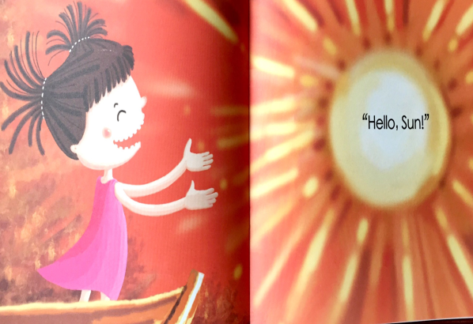

Slide 9
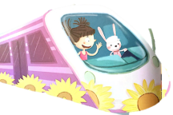
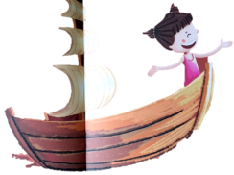
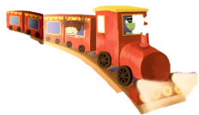
Q:How does the girl go to the sun?
Public Transport

Slide 10
Public Transport
Q:What else do you know?

Slide 11
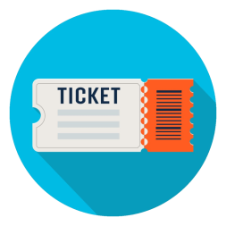
Ticking time
I can talk about public transport.
I can talk about where I live.
I know the sound of "tr".

Slide 12
name
Public Transport
function

Slide 13
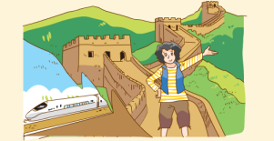
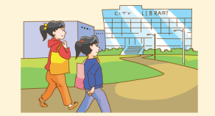
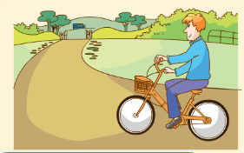
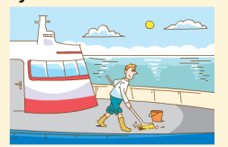
Look and say
A: Where …live?
B: …
A: How …go…？
B: …

Slide 14
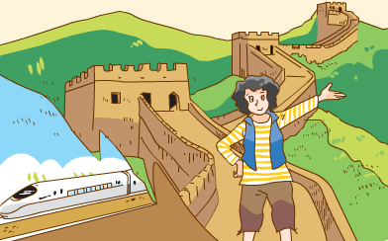
My aunt lives in Beijing.
We sometimes visit her…

Slide 15
transport
tree
metro
tr /tr/
trousers
train
travel

Slide 16
Sound time
Traffic, traffic, on the street,
Beep beep, beep beep!
Trains, trains, through the trees,
Choo-choo, choo-choo！
tr
train
travel
tree
trousers

Slide 17
Ticking time
I can talk about public transport.
I can talk about where I live.
I know the sound of "tr".

Slide 18
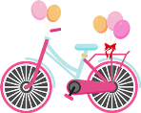
Think and write
Where do you live? How do you go to school? How do your parents go to work? What about your friend?
I live .
It is near .
I go to school .
My father goes to work .
My mother goes to work .

Slide 19
Think and write
Where do you live? How do you go to school? How do your parents go to work? What about your friend?
I live .
It is near .
I go to school .
My father goes to work .
My mother goes to work .
in Sunshine Town
school
on foot
by car
by bike

Slide 20
Think and write
My friend lives .
It is near .
He/She goes to school .
His/Her father .
His/Her mother .

Slide 21
My friend lives .
It is near .
He/She goes to school .
His/Her father .
His/Her mother .
Su Hai
on Moon Street
City Library
by bus
goes to work by metro
goes to work by metro, too

Slide 22
Think and write
My friend lives .
It is near .
He/She goes to school .
His/Her father .
His/Her mother .

Slide 23
Ticking time
I can talk about public transport.
I can talk about where I live.
I know the sound of "tr".

Slide 24
Homework
1. Talk about the public transport.
2. Finish the writing.
3. Try to sing the song.

