Slide 1
Module
8
Time off
Unit 1 I can hardly believe we’re in the city centre.
WWW.PPT818.COM

Slide 2
Think about it!
Do you like to travel? Where do you want to go?
Do you know some world famous tourist attractions?

Slide 3
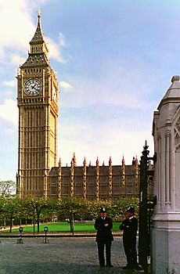
Let’s play a game!
Look at each picture (symbol building) and
say out the name of the city in two seconds.
Big Ben
London

Slide 4
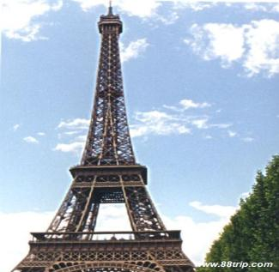
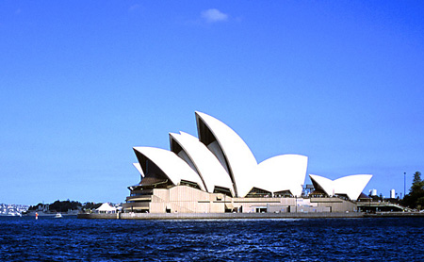
Eiffel Tower
Paris
Opera House
Sydney

Slide 5
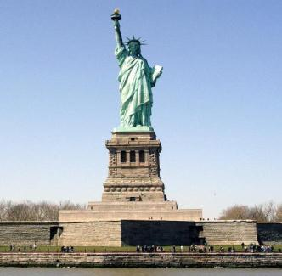
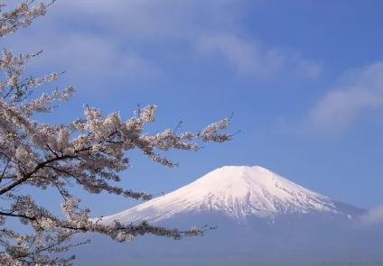
the Statue of Liberty
New York
Fuji Mountain
Japan

Slide 6
Teaching aims
1. Teaching aims:
To get the main ideas of the listening material and the conversation
To understand the object clause with that in context
To be able to introduce a place of interest in your home town

Slide 7
2. Main contents:
Key vocabulary
hardly, take up; point out; at the top of; waste
Key structures
I can hardly believe we’re in the city centre.
I don’t think they allow people to swim in the lake.
I hope it will be cooler up here.

Slide 8
Words and expressions
/'hɑ:dli/
/saIts/
hardly
几乎不；几乎没 adv.
certain
占去（时间或空间）
point out
指出；指明
(用复数)风景；名胜 n.
sights

Slide 9
Words and expressions
/'θɜ:stI/
/weIst/
thirsty
渴的 adj.
at the top of
在……的顶端
浪费；滥用 v.
浪费；滥用 n.
waste

Slide 10
Words and expressions
/ skweə /
/'kIlə'mi:tə/; kI'lɔmItə
/ʃeIp /
/'hju:mən/
/ weIk/
(表示单位面积) 平方的 adj.
square
千米；公里 n.
kilometre
shape
外形；形状 n.
人 n.
human
唤醒；醒来 v.
wake
唤醒某人
wake sb. up

Slide 11
Words and expressions
/'sʌmbədI/
/ə'baʊt/
/pɑ:θ/
/pʊl/
/'freʃ'wɔ:tə/
somebody
某人；有人 pron.
about
向四周；向各处 adv.
path
小路；路径 n.
pull
(用手) 拉，牵，扯 v.
freshwater
淡水的 adj.

Slide 12
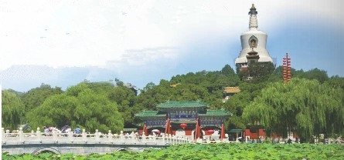
1. Look at the photo and listen. What is the conversation about?
The conversation is about going to Beihai Park.

Slide 13
2. Listen again and choose the correct answer.
Tony has / hasn't heard about Beihai Park.
2. Tony guesses that the park is very popular / not very popular.
3. Lingling suggests that they spend the day there / Darning and Betty come too.
4. Lingling thinks / doesn't think the park will be busy.

Slide 14
Tapescript
Tony: I've heard that Beihai Park is very
beautiful.
Lingling: Yes, it is. Shall we go for a walk there?
Tony: That's a great idea. Maybe Daming
and Betty will come too.
Lingling: Let's tell them that we're going to

Slide 15
spend the day there.
Tony: I guess it's a very popular place.
Will there be lots of people there?
Lingling: Well, lots of people go there, but
it's a big park, so I don't think it'll
be very busy.
Tony: I hope not.

Slide 16
Watch and read
Everyday English
_{• Here we are.}
_{• Wow!}
_{• I can hardly believe…}
_{• That’s too bad.}
_{• Come on!}

Slide 17
3. Listen and read.
Lingling: Here we are. Welcome to Beihai Park.
Tony: Wow! It’s so quiet that I can even
hear the birds singing! I can hardly
believe we're in the city centre.
Lingling: This park is famous for its lake, the
bridge and the ancient buildings on
the hill. The lake takes up over half of
the park area. Let's walk along the

Slide 18
lake, cross the bridge and climb up
the hill. Then I can point out the sights
of Beijing for you.
Tony: Yes, good idea. I'm sure it'll be
fantastic to see the city from the top.
Daming: But I'm so tired, and it's so hot here.
I don't want to climb. The lake looks
nice and cool. Why don't we go for a
swim?
Lingling: I don't think they allow people to
swim in the lake. It's dangerous.

Slide 19
Daming: That's too bad. Then why don't we
have our picnic here? I'm so
hungry and thirsty.
Lingling: I think it's better to have our picnic
at the top of the hill.
Tony: Come on! Let's not waste any more
time.
Daming: All right. I hope it will be cooler up
there.

Slide 20
Now complete the sentences about Beihai Park.
Beihai Park is so______ that you can even
hear the birds singing.
2. The park is famous for its_____, bridges and the ancient buildings on the hill.
3. The lake takes up ________ of the park area.
4. You can point out the ______ of Beijing
from the top of hill.
5. They do not allow people to swim _________.
quiet
lake
over half
sights
in the lake

Slide 21
4. Read the sentences and answer the questions.
hardly sights thirsty waste
1. “I can hardly believe we’re in the city centre.”
Does Tony know they are in the city centre or
not?
Tony doesn't think they are in the city centre.

Slide 22
2. “Then I can point out the sights of Beijing
for you.”
Does Lingling want them to look at something
or listen to something?
3. “I’m so hungry and thirsty.”
Does Daming want something to drink?
Lingling wants them to look at something.
Yes, he does.

Slide 23
4. “Let’s not waste any more time.”
Does Tony think they arc spending their
time well or badly?
Tony thinks they are spending their time badly.

Slide 24
Pronunciation and speaking
5. Listen and how the speaker pronounces the words.
1. It’s so quiet here that I can even hear the
birds singing.
2. Let’s walk along the lake, cross the bridge
and climb up the hill.
3. I don’t want to climb.
Now listen again and repeat.

Slide 25
连读的基本规则
句中两词相邻时，如果前一个词的词尾是辅音音素，而后一个词的词首是元音音素， 则往往需要连读。如：Will it take a lot of time to go to town on foot?
以字母r或re结尾的词，在与元音音素开头的词相邻时，/r/要读出来。如:There is a pair of shoes.
英语语音中/j/和/w/是半元音，如果前一个词以辅音音素结尾，后一个词以半元音，特别是/j/开头，也要连读。如： Did you go to Shanghai last year?
如果短语之间或分句之间有停顿，其相邻的音不连读。如：Can you speak Chinese or... English?

Slide 26
6. Work in pairs. Talk about a place of
interest in your home town.
Student A: You’re a visitor from another
country.
Student B: You’re introducing a place of
interest in your home town to
student A. You can talk about:
where it is
where it is what is special about it
any other information you know about it
how big it is
how old it is

Slide 27
Use these expressions:
I guess (that)…
I know (that)…
I think (that)…
I’m sure (that)…
I can’t believe (that)…

Slide 28
Language points
1. time off
★time off “休假，放假” , 是名词短语。
例如：
You work too hard. You should take some time off.
你太辛苦了，应该休息一段时间。
Her boss gave her time off.
她的老板准了她的假。

Slide 29
2. I can hardly believe we’re in the city centre.
我几乎不敢相信我们是在市中心。
hardly adv. 意思是“几乎不，几乎没有”与
seldom等词一样，本身含有 否定的意思。
I hardly know you.
我不太认识你。
He was given hardly 24 hours to pack his bags.
只给了他不到24小时的时间来打点行装。
hard adv. 努力地
You must work hard.
你必须努力工作。

Slide 30
3. It’s so quiet that I can even hear the birds
singing!
这里如此安静，以至于我甚至可以听到鸟叫声！
so…that…引导结果状语从句，意思是“如此……以至于……”,如：
I was so tired that I slept in this chair.
我太累了，以至于在椅子上睡着了。

Slide 31
4. The lake takes up over half of the park area.
湖占据了这个公园一半多的面积。
这里的take up表示“占用，花费(时间、空间或精力等）”。例如：
This desk takes up too much room.
这张桌子太占地方。
I know you are very busy. I don't want to take up too much of your time.
我知道你特别忙，不想占用你太多的时间。

Slide 32
5. Let's walk along the lake, cross the bridge
and climb up the hill.
咱们沿湖散步，过桥去爬山吧。
walk along 沿着…走
Walk along the road and turn right at the
traffic lights.
沿着这条路走,在交通灯处向右转.
climb up 爬上；攀登
If I climb up a tree, I can see farther.
如果我爬到树上的话，我就能看得更远一些了。

Slide 33
6. Then I can point out the sights of Beijing for
you.
然后我可以为你们指出北京的景点。
这里的point out 表示“指出”。例如：
If you see that boy, please point him out for me.
如果你看到那个男孩，请把他指给我看。
Did Ms Du point out where you were wrong?
杜老师有没有指出你什么地方错了 ？

Slide 34
7. I'm sure it'll be fantastic to see the city from
the top.
我想从山顶上俯瞰北京一定很棒。
fantastic = wonderful 极好的;极妙的;了不起的
She's a fantastic dancer.
她的舞跳得非常好。
What a fantastic goal!
这球进得多漂亮!

Slide 35
8. I don't think they allow people to swim in
the lake.
我想这里禁止游泳。
allow sb. to do sth. （ sb. 不可以省略）
允许某人做某事 = allow doing sth.
His parents won’t allow him to stay out late.
他的父母不会允许他在外待得很晚。
They allowed smoking in this room only.
他们只允许在这间屋子里抽烟。

Slide 36
Exercise
一、单项选择题。
It was raining very _____. What's worse,
my car broke down.
A. heavy B. hardly C. hard D. heavier
2. China is ______for its delicious food.
A. good B. famous C. popular D. like
C
B

Slide 37
3. —Excuse me. Can you tell me the way to
the bookstore?
—Walk along the road and ____ the bridge,
and you will see it in front of you.
A. across B. cross C. through D. over
4. We don't allow people _____ in the cinema.
A. smoke B. smoked
C. smoking D. to smoke
B
D

Slide 38
5. I believe ______ my dream will come true
one day.
A. what B. which C. who D. that
6. Look! The boys are trying to climb _____
the tree to pick some apples.
A. with B. off C. of D. up
7. -- Did you find the small village yesterday? -- Yes, without any difficulty, for it has
______ changed over years. （2010年安徽）
A. hardly B. greatly C. clearly D. nearly
D
D
A

Slide 39
8. The Internet is very useful for us. We can find information______.
(2010年河北) A. easy B. easily C. hard D. hardly
9. --- Would you like some coffee? --- No, thanks. I _____ drink coffee. Coffee
is bad for my stomach. （2010四川省宜宾市） A. almost B. already C. hardly D. still
B
C

Slide 40
二、根据句意和首字母提示写单词。
1. I like the beautiful s_____ of this city.
2. He is very t______ and he needs some
water now.
3. I can h_____ understand what he said
because he speaks English too quickly.
4. They walked around the lake and c____
the small bridge.
ights
hirsty
ardly
ross

Slide 41
Homework
Learn the new words and expressions in this module.
Describe a park around your home or school .

