Slide 1
Unit 5
Amazing things
WWW.PPT818.COM

Slide 2
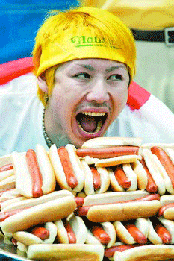
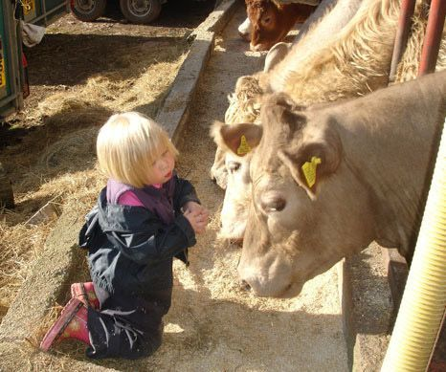
talk with animals
eat 54 hotdogs in 12 minutes

Slide 3
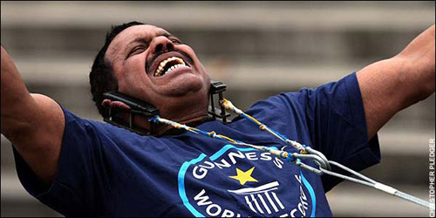
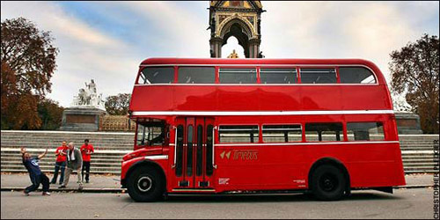
make the bus move with his ears

Slide 4
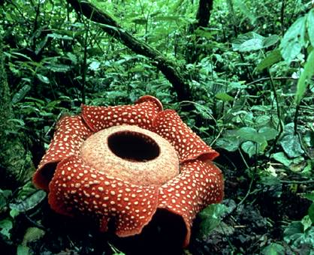

Slide 5
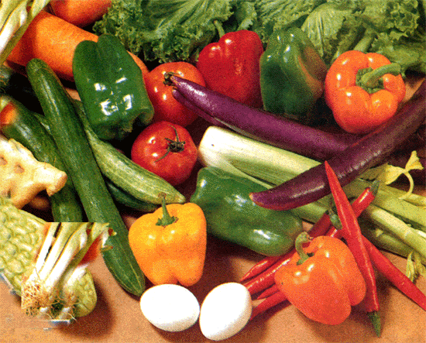
strange 奇怪的

Slide 6
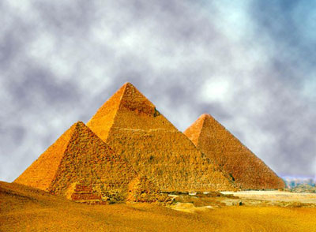
Each stone is about 2000kg.
pyramid

Slide 7
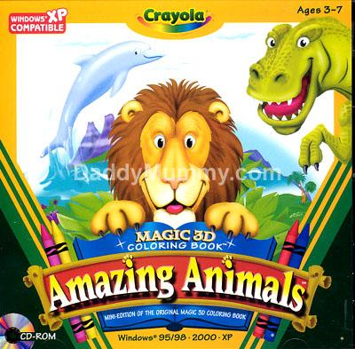
Can you guess who we are?

Slide 8
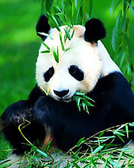
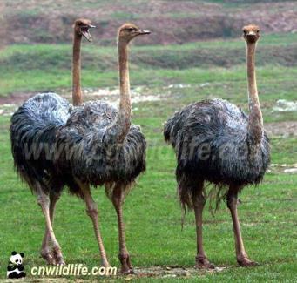
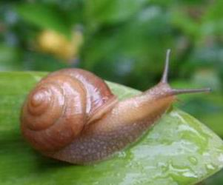
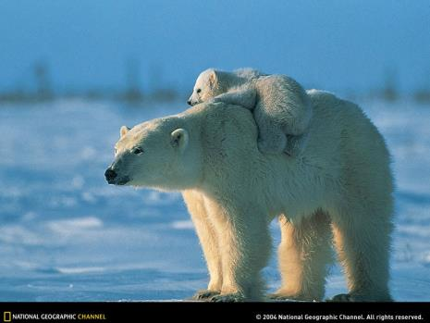
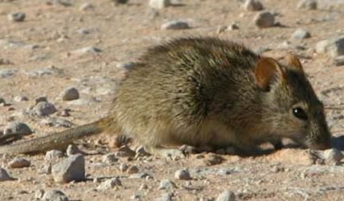
panda
snail
ostrich
It is/has/lives/likes/…
polar bear
mouse

Slide 9
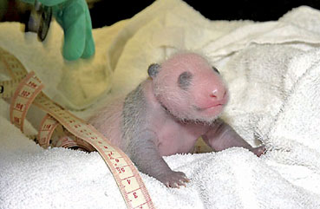
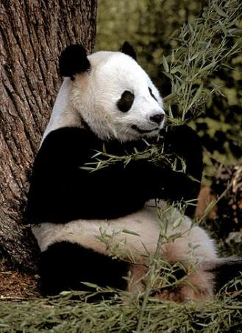
100g
130kg
A. 100g B. 500g C.3 kg D.5kg

Slide 10
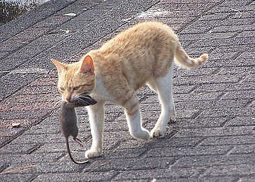
a kind of mouse in Africa

Slide 11
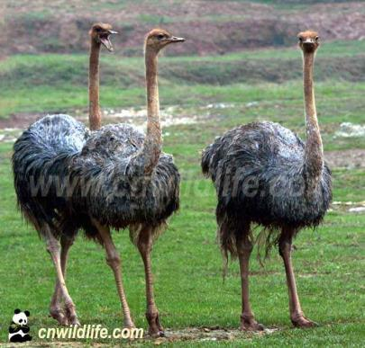
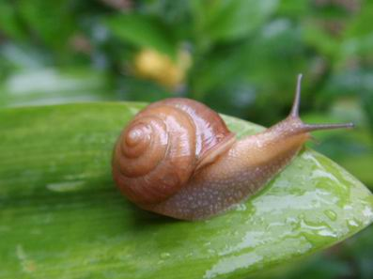
snail
can sleep for 3 years
has more than 10,000 teeth
the biggest bird
ostrich
can’t fly

Slide 12
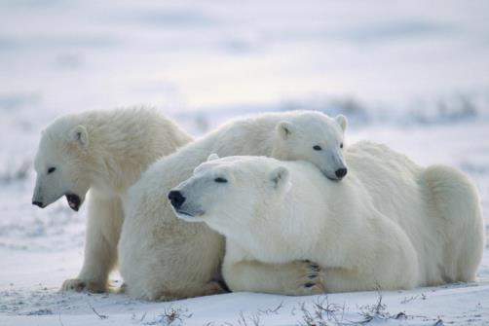
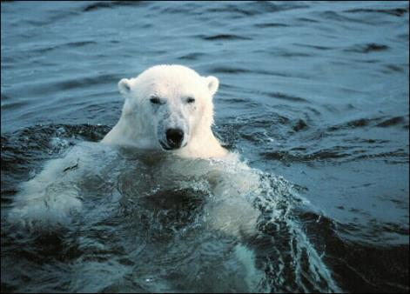
polar bear
Most polar bears are left-handed.

Slide 13
a Japanese | eats 54 hotdogs in 12 minutes
a girl in Britain | 4 years old, can’t talk with … but can talk with …
a man | makes a bus move with his ears
flower | the biggest, smells bad
music&vegetables | helps … grow faster and bigger
pyramid | millions of stones, 2000kg
panda | be born: 100g; grow up: 130kg
mouse | a kind of mouse in Africa eats cats
ostrich | the biggest bird, can’t fly
snail | sleep for 3 years, more than 10,000 teeth
polar bear | left-handed

Slide 14
A: Is there anything amazing in the world?
B: Yes, there is. A man can make a bus
move with his ears.
A: Oh, really?
B: Isn’t that surprising?
A: Yes, it is. Do you know the ostrich is a
kind of bird but it can’t fly.
B: How strange!

Slide 15
a Japanese | eats 54 hotdogs in 12 minutes
a girl in Britain | 4 years old, can’t talk with … but can talk with …
a man | makes a bus move with his ears
flower | the biggest, smells bad
music&vegetables | helps … grow faster and bigger
pyramid | millions of stones, 2000kg
panda | be born: 100g; grow up: 130kg
mouse | a kind of mouse in Africa eats cats
ostrich | the biggest bird, can’t fly
snail | sleep for 3 years, more than 10,000 teeth
polar bear | left-handed

Slide 16
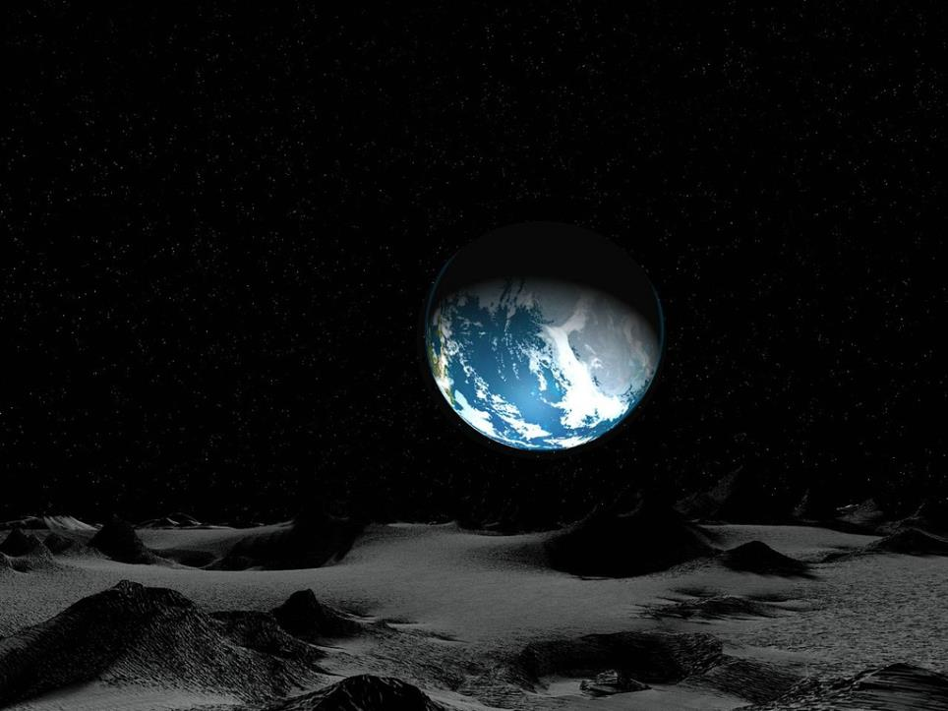
Listen and answer:
1.What does Eddie think it is in the sky?
He thinks it is a UFO.
2. Is it a real UFO?
No, it isn’t.

Slide 17
Homework:
1.Read the dialogue on page 60 and the
sentences on page 61.
2.Try to find some more amazing things
you like. Make a poster about it.
3.Complete the exercises.
Thank you!

Slide 18
Ostrich, an amazing animal
Ostrich is a kind of bird. Its head is very small. It runs fast. Ostrich is the biggest bird in the world but it can’t fly. How amazing!

