Slide 1
八年级 英语 上
Unit 3 A day out
Integrated skills
WWW.PPT818.COM

Slide 2
Talking about sports
Do you like sport?
Do you often watch basketball matches? Are you in the school basketball team? When and where do you usually do sports? Who do you do sports with?

Slide 3
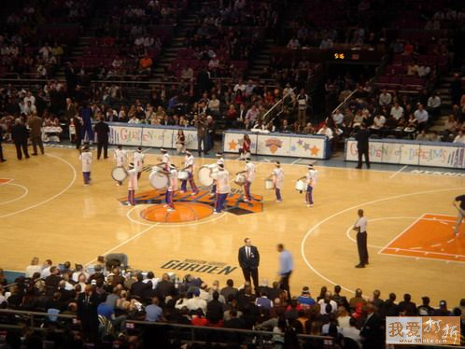
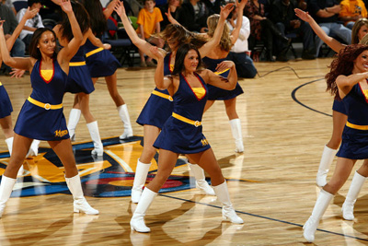
in the first half
half-time
at half-time
in the second half

Slide 4
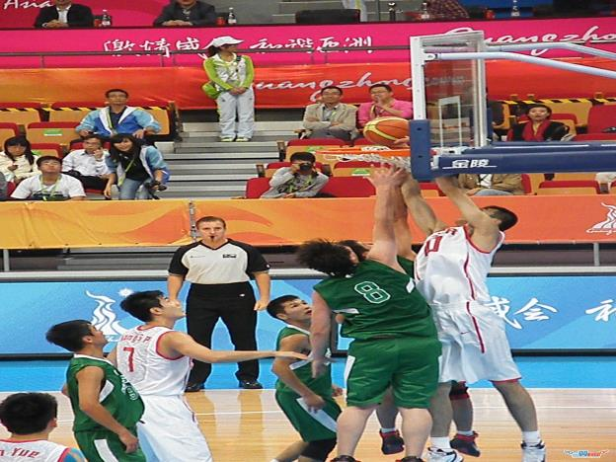
go to the final
be in the final

Slide 5
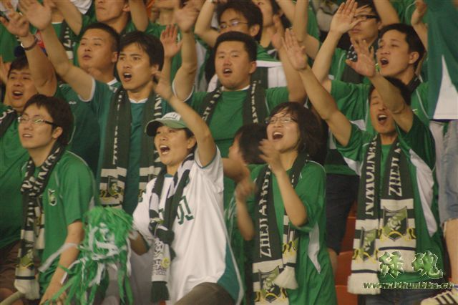
They are cheering for their team.
Their team needs their support.
They are supporters of their team.

Slide 6
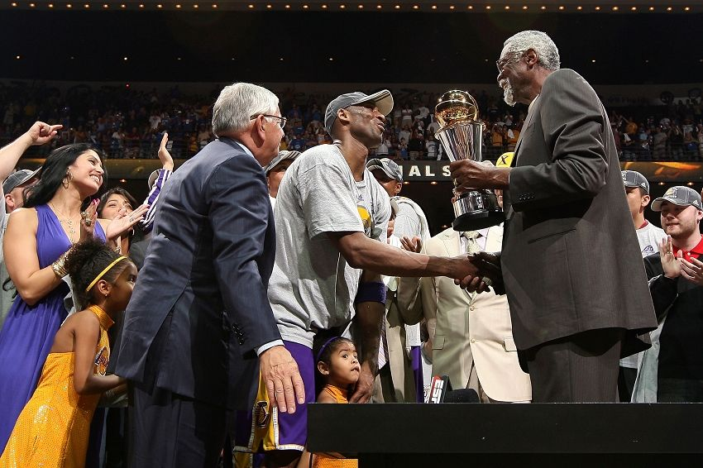
the presentation of cup and medals

Slide 7
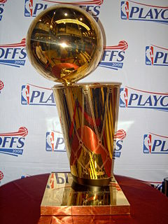
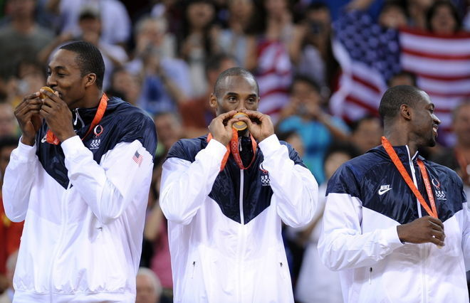
They have medals.
cup
They are the winners.

Slide 8
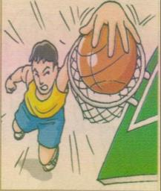
The basketball final
Beijing Sunshine Secondary School goes to the final!
Our school basketball team needs your support! It is in the final of the basketball competition! The match takes places on (1) , 17 October, at the (2) in Moonlight Town .
Come and cheer for our team!
Don’t forget to bring your friends!
With your support, we will win!
Listen and help Kitty complete the poster!

Slide 9
Listen again
(2) _________ Bus leaves.
(3) _________ Reach the Sports Centre.
Supporters go to their seats.
10.30 a.m. (4) ____________.
(5) _________ Half –time.
11.30 a.m. (6) ____________.
(7) _________ Bus leaves from the centre.
Have lunch at Moonlight Restaurant.
1:00 p.m. Get on the bus (8) _________the
restaurant.
1:30 p.m. Back to our school.
Cost of the trip ￥(9) _________per student
9.00 a.m. Meet at(1)_______________.

Slide 10
Ask and answer
If Linda wants to watch the final,
1.Where and when does she meet Kitty?
How long is the first half of the match?
Where will she have lunch?
How much does the trip cost?

Slide 11
True or False
Our school basketball team is in the final.
The match will take place at Moonlight Middle School in Moonlight Town.
We will go there by underground.
It will take us about half an hour to reach the Sport Centre.

Slide 12
True or False
5. Half-time is a 20-minute period ofr the players to rest.
6. We can buy food and drinks during half-time.
7. The match will finish before noon.
8. We will go back to our school after lunch.

Slide 13
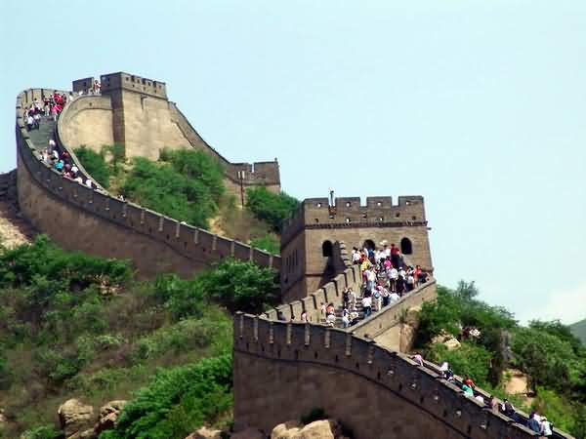
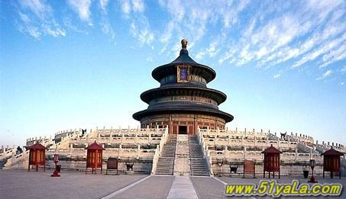
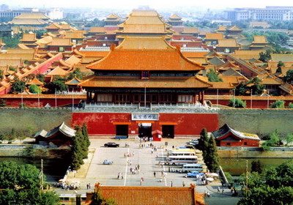
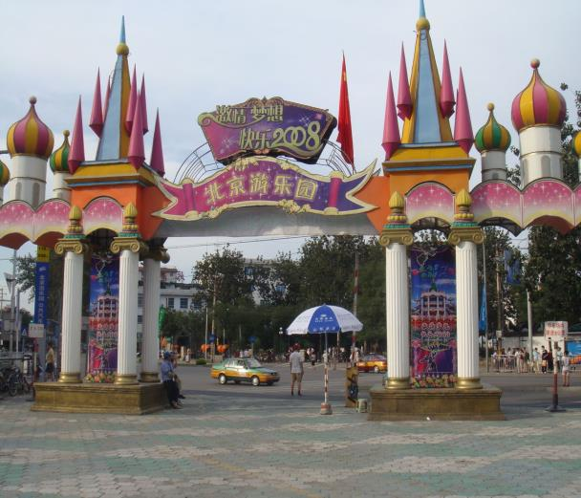
The places of interest in Beijing
the Temple of Heaven
Beijing Amusement Park
the Palace Museum
the Great Wall

Slide 14
How to make suggestions
Shall we …?
Let’s …
Would you like to …?
Why don’t you/we …?
Why not …?
What/How about…?
Good idea!
What a great idea!
That sounds great!
I’d love to, but......
I’m afraid it is not a good idea.

Slide 15
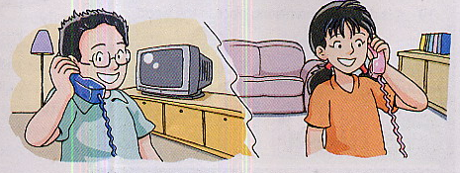
Speak up
Where are we going tomorrow?
The China Science and Technology Museum.

Slide 16
Make up your dialogues
Show Linda around your hometown
A: Where shall we go with…? Shall we…?
B: I’m afraid that’s not a good idea. …
A: Well, we could…
B: Yes, that’s a good idea, but it’s… I’d like to…
A: Sure. Why don’t we … too?
B: What a great idea! Let’s go to… and …

Slide 17
Homework
Plan a day out in China for the guest teachers.
Preview Task.

