Slide 1
Don't eat in class.
Section B 第1课时
WWW.PPT818.COM

Slide 2
go out
do the dishes
make one's bed
be strict with sb.
follow the rules
practice relax
read feel
remember keep
learn
kitchen
luck
hair
before dirty
more noisy
terrible

Slide 3
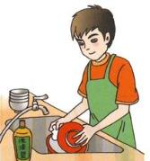
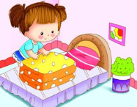
Look! Lily is practicing English.
Jim is doing the dishes.
Mary is making her bed.
practice /'præktɪs/ v.&n. 练习
dish /dɪʃ/ 盘子、碟子
do the dishes 清洗餐具
make one's bed 铺床

Slide 4
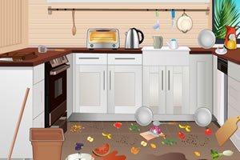
The kitchen is so dirty.
That makes me feel terrible.
Remember to clean it up.
kitchen /'kɪtʃɪn/ 厨房
dirty /'dɜːti/ 脏的
feel /fiːl/ 感受、觉得
terrible /'terəbl/ 非常讨厌的、可怕的
remember /rɪ'membə(r)/ 记住

Slide 5
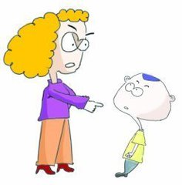
My mother is strict with me.
I can't go out on school nights.
I have to follow the rules.
strict /strɪkt/ 严格的
be strict with sb. 对某人要求严格
out /aʊt/ 外出
go out 外出
follow /'fɒləʊ/ 遵循、跟随
follow the rules 遵守规则

Slide 6
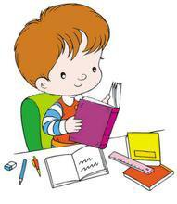
I learn math and read English before dinner.
After dinner I relax.
learn /lɜːn/ 学习
read /riːd/ 读、阅读
before /bɪ'fɔː(r)/ 在......以前
relax /rɪ'læks/ 放松、休息

Slide 7
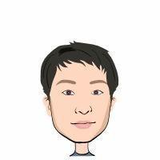
We have more rules.
Don't be noisy.
We have to keep our hair short.
more /mɔː(r)/ 更多
noisy /'nɔɪzi/ 吵闹的
keep /kiːp/ 保持
hair /heə(r)/ 头发

Slide 8
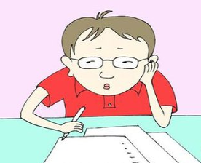
---We have a test tomorrow.
---Good luck to you!
luck /lʌk/ 运气、幸运
Good luck to you! 祝你好运！

Slide 9
根据首字母提示完成句子
1. Don’t stand o______. Come in please.
2. We must f________ the rules at school.
3. Can you r___________ your teacher's phone number?
utside
ollow
emember

Slide 10
完成句子
1. Our teacher _______________ us.
我们的老师对我们要求严格。
2. My mother ________________ every day.
我的妈妈每天清洗餐具。
is strict with
does the dishes

Slide 11
名 词
kitchen luck
hair
词 组
动 词
go out
do the dishes
make one's bed
be strict with sb.
follow the rules
practice relax
read feel
remember keep
learn
key words
其 它
before dirty
more noisy
terrible

