Slide 1


Unit4
Then and now
WWW.PPT818.COM

Slide 2

Enjoy a song
When I was young 当我年轻时
I’d listen to the radio 我喜欢听收音机
Waiting for my favorite songs 等待我最喜爱的歌
When they played I’d sing along 当他们演奏时我会跟着唱
It made me smile 令我笑容满面
Those were such happy times 那段多么快乐的时光
And not so long ago 就在不久以前
How I wondered where they’d gone 我是多么想知道它们去了哪儿
But they’re back again 但是它们又回来了
Just like a long-lost friend 像一位久未谋面的朋友
All the songs I love so well 那些歌我依旧喜欢
……
It’s yesterday once more 这是昨日的重现

Slide 3


Free talk
What did you do yesterday?
I…

Slide 4


Try to review
The changes of Mike’s family
 | Then(… years ago) | Now
could read and draw
couldn’t write
can do many things
wrote letters to friends
used the telephone at home and in the office
writes emails
has a mobile phone
reads and watches news on the Internet
reads e-books
listened to the radio
read newspapers
has e-friends from all over the world
does shopping on the Internet
made friends at school
bought things from shops

Slide 5


Read and learn
an e-book
a mobile phone
a newspaper
a radio
a telephone
a TV

Slide 6






Try to use
telephone
Twenty years ago, my mother used the ___________ at home. She couldn’t call people anywhere. Now she has a ______________________ . It is easy to take.
My father listened to the ______ and read ___________ for news in the past, but now he usually watches news on the Internet. Sometimes he reads newspapers. He also reads _______.
For me, ten years ago, I watched _______ at weekends, now I like playing the computer when I’m free. It’s fun.
mobile phone
radio
newspapers
e-books
TV

Slide 7
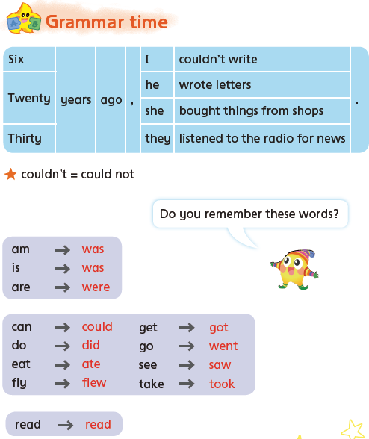
Try to read and remember

Slide 8

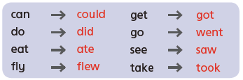

Try to think and say
不规则动词的过去式
What’s the same feature of them?
他们的共同点是什么?

Slide 9

Quick respond
is
is
was
…
…
Rules:
一人说出动词的原形或过去式，另一人快速说出相应的过去式或原形。

Slide 10

Say something about your past
…year(s) ago, I was…
I could…
I couldn’t…
I didn’t…
I …
Try to use the past tense correctly!
尽力正确使用过去式!

Slide 11
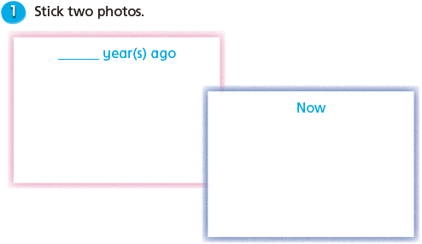
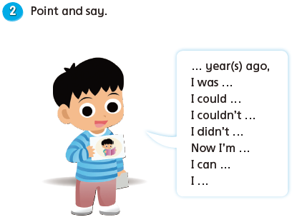
Make and say

Slide 12
Changes of our life
Shopping
Learning
购 物
学 习
Entertainment
Transportation
娱 乐
出 行
Choose a piece of paper, finished one part of the passage and read in your group.

Slide 13
Changes of our life
Shopping
购 物
went
Twenty years ago, our parents _________ to shops to buy things.
Now they _____ ________ on the Internet. They also can ____________ things from all over the world.
do
shopping
buy

Slide 14
Changes of our life
Learning
学 习
Thirty years ago, students ______their lessons in the classroom. They read books and _________ notes(笔记). There _________a blackboard in the classroom.
Now, students ________ their lessons in different rooms. There _______ a white board, too. We have computers and the Internet at school, too. Teachers _____ listen to music, watch cartoons and films for students in class.
had
wrote
was
have
is
can

Slide 15
Changes of our life
Entertainment
娱 乐
Thirty years ago, people only _____________ at home. Now, they can _________ to other cities.
Ten years ago, children ____________ TV and
__________ with their friends. Now, they _______ computer games.
were/stayed
go
watched
played
play

Slide 16
Changes of our life
Transportation
出 行
Thirty years ago, people ________ to work by bike. Now, some of them __________ cars.
Ten years ago, trains _________ fast. Now, high-speed trains _________ go faster.
went
drive
went
can

Slide 17
Changes of our life
Shopping
Learning
购 物
学 习
Entertainment
Transportation
娱 乐
出 行
_________years ago,__________________
Now________________________________

