Slide 1
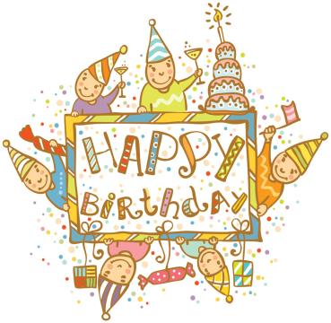
Unit 8
Birthdays
第一课时
WWW.PPT818.COM

Slide 2
Introduce
--When’s your birthday ?
--It’s on the ...of...

Slide 3
Words
your [jɔ:]
形容词性物主代词，后接名词，意为“你的...”。
eg： This is your pen. 这是你的钢笔。
小练习：用所给词的适当形式填空：
That is _____（you）school
大家还能背出人称代词表吗？
your

Slide 4
Words
buy [bai]
动词，意为“买...”。
固定搭配：buy sb. sth. = buy sth. for sb.买某物给某人。
I want to buy a card for my teacher.= I want to buy my teacher a card.
我想买一张贺卡送给我的老师。
eg：He buys some flowers for his mother.他买了一些花给他妈妈。
小练习：汉译英：
买一个洋娃娃给我。
buy a doll for me.

Slide 5
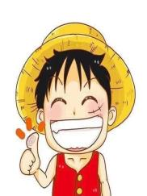
Words
fun [fʌn]
名词，意为“乐趣，享乐”。make fun of sb.意为“取笑某人”。
He always makes fun of us. 他经常拿我们寻开心。
eg： The party is great fun. 聚会太有趣了。
小练习：汉译英：
玩得很愉快
have a lot of fun = have lots of fun

Slide 6
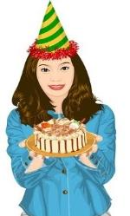
Expressions
We always have a party at home. 我们一直在家举行聚会。
have作动词，意为“做某事”。
固定词组：have a party 举办一场聚会
have to do sth. 不得不做某事
eg： We often have breakfast at home.我们经常在家吃早餐。
We have to go to school now. 我们现在不得不去学校了。
小练习：用所给词的适当形式填空：
He _____（have）an English lesson in the morning
has

Slide 7
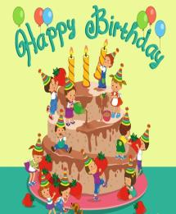
Expressions
Tim and I go to buy a birthday cake in the morning.
提姆和我上午去买了一个生日蛋糕。
go to do sth.为固定词组，意为“去做某事”
go to sp.为固定词组，意为“去某地”
eg： go to Beijing 去北京。
She goes to visit her parents. 她去看望她的父母。
小练习：用所给词的适当形式填空：
We often go to _____（worker）on a farm.
work

Slide 8
Dialogue
Miss Li: When’s your birthday, Mike?
李老师：迈克，何时是你的生日？
Mike: It’s on the eighth of April. We always have a party at home. Helen, Tim and I go to buy a birthday cake in the morning. Then, my friends come in the afternoon. We eat the birthday cake together and play some games. We have a lot of fun.
迈克：我的生日在四月八日。我们一直在家举行聚会。海伦，提姆和我上午去买了一个生日蛋糕。然后下午我的朋友都来了。我们在一起吃蛋糕玩游戏，我们玩得很愉快。

Slide 9
Expand
美国人过周末的几种主流方式
全家到外省旅行。当然，不可能是太远的地方，只要有新开放的游乐场，或是什么风景区，美国人民一定率先知道，拍马赶到，绝不落后。他们渴望刺激的情怀使他们的心态永远年轻，这是我们应该学习的地方。 二、全家公园野餐。美国的公园都非常大，景色怡人，有山有水，全家来此度周末，也是个绝佳选择。吃吃喝喝，弄点烧烤，在海上玩玩帆船，或是租艘快艇过把瘾，多么惬意。 三、全家出席音乐会或舞会；美国人周末的社交活动很多，一起high一下，也是乐事。 四、全家观看重要的棒球、篮球、橄榄球比赛；这三大球可谓美国人怕国球，周末各个赛事激战正酣，一家老小共同为热爱的球队加油，这是美国人民的最爱。

Slide 10
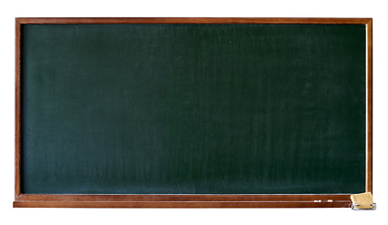
Summary
your
buy
fun
We always have a party at home.
Tim and I go to buy a birthday cake in the morning.

Slide 11
Exercise
根据句意将下列字母组合成新单词填在横线上。
1.We _____（a w l a s y）have a party at home.
2.Tom often goes to buy a ______（b r i t d h d y）cake.
3.We eat cake ______（t g o e t e h r）.
4.We have a lot of _____（f n u）.
5.My friends come in the ______（a t f e n r o n o）.
6.It’s on the _____（e g i t h）of April.
always
birthday
together
fun
afternoon
eighth

Slide 12
Exercise
从B栏中选出A栏中相应的答语，并连线。
When’s your birthday? a.Yes, it is.
Is your birthday on the first of April? b.It’s on the first of April.
How do you spend your birthday? c. We play games in the afternoon.
Do you have a good time? d.It’s Monday.
What do you eat on your birthday? e. OK,let’s go.
What day is it today? f.Some noodles.
Let’s go and have a look. g.Yes, we do.

Slide 13
Homework
Ask your best friends’ birthday.

