Slide 1
What can we do at home to protect the environment?
Unit 2 Topic3
Section A
WWW.PPT818.COM

Slide 2
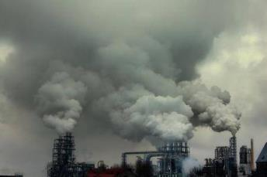
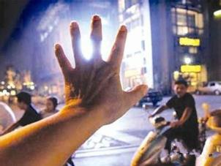
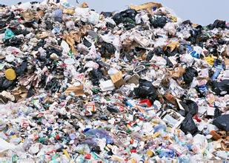
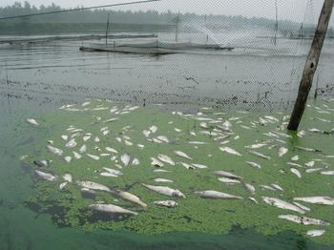
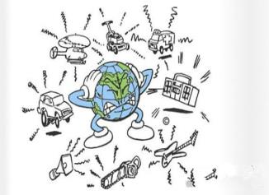
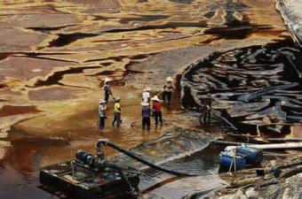
Do you know how these kinds of pollution affect our environment?

Slide 3
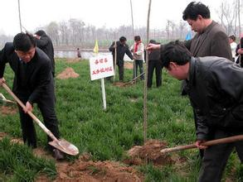
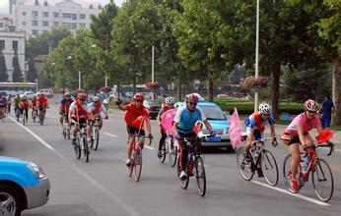
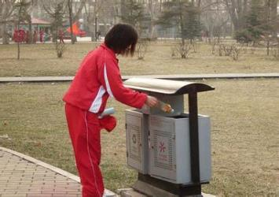
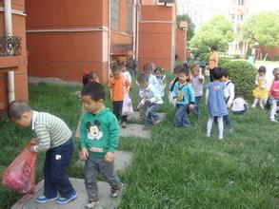
What should we do to improve our environment?

Slide 4
Are you a greener person?
What do they mean?
Which day is the World Environment Day?

Slide 5
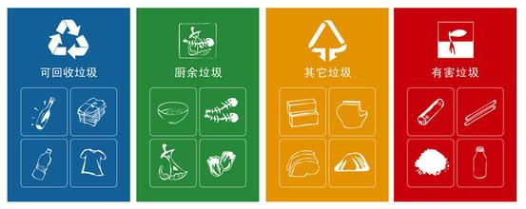
Can you sort the garbage?

Slide 6
What can we do at home to protect the environment?
We should reduce the waste we produce.
For example, we should use both sides
of paper and reuse plastic bags.

Slide 7
Listen to 1a again and answer the questions.
(1) Who is working for an organization that protects the environment?
Jane.
(2) What’s her main job?
Her main job is to help spread the message about protecting the environment.
(3) Should we use both sides of paper?
Yes, we should.
(4) Why is the recycling useful?
It can protect the environment, and it can save money, too.

Slide 8
1b Listen to 1a and complete the table.
An interview with Jane
where Jane works | in an ________________ to ______________________
what Jane is doing | helping ________________ about protecting the environment
what we can do at home | ________________ we produce
what students can do at school | collect __________ and soft drink cans
organization
protect the environment
spread the message
reduce the waste
waste paper

Slide 9
Key words
1.work for an organization
2.help spread the message
3.the three R’s ---reduce, reuse and recycle
4.reduce the waste
5.reuse plastic bags
6.recycle
7.encourage sb. to do sth.
8.sort
Retell it

Slide 10
1c Read 1a and complete the sentences.
The three R’s ---______, ______ and _______ --- are important.
At home, we can, for example, use both ______ of paper and reuse _____ bags.
At school, students are encouraged to _____ waste paper and ______________ because recycling can protect the ____________ and _______ money.
Then we _______ them ______ they can be recycled.
reduce
reuse
recycle
sides
plastic
collect
soft drink cans
environment
save
sort
so that

Slide 11
You can nod or shake the head! Nodding the head means agreement. Shaking the head means disagreement.
v.点头
n. 同意
(1) We should use plastic bags as few as possible.
(2) We should throw the garbage in the river.
(3) We should reduce the waste we produce.
(4) We should use both sides of paper.
(5) We should throw the plastic bags rather than reuse them.

Slide 12
(1) You nod your head and it means agreement.
(2) Hurry up, or you’ll miss the train.
(3) Water is important but some people don’t save it.
(4) Some people protect animals while others kill animals.
Discuss the words underlined

Slide 13
并 列 句
连词 or, and, but 和 while的用法
①表示并列关系，用and…
②表转折，用but, while…
③表选择，用or…

Slide 14
2 Combine the sentences with or, and, but or while, making some changes if necessary.
1. Noise is a kind of pollution. It’s harmful to our hearing.
Noise is a kind of pollution and it’s harmful to our hearing.
2. Work hard. You will fail the exam.
Work hard, or you will fail the exam.
3. Nodding the head means agreement. Shaking the head means disagreement.
Nodding the head means agreement while/but shaking the head means disagreement.
4. Hurry up. You will miss the bus.
Hurry up, or you will miss the bus.
5. He has failed several times . He never gives up.
He has failed several times, but he never gives up.
放弃

Slide 15
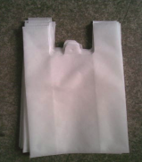
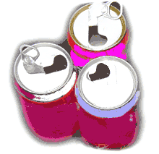
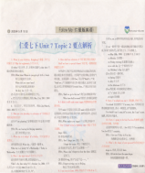
3a Read the table and write the correct letter under each picture. Then sort the garbage based on your own knowledge.
glass bottles
plastic bags
newspapers
paper cups
cans

Slide 16
3a Read the table and write the correct letter under each picture. Then sort the garbage based on your own knowledge.
3b Listen to the conversation and check your answers in 3a.
Type of garbage | Recycled | Reused | Reduced
plastic bags
paper cups
cans
newspapers
glass bottles
√
√
√
√
√

Slide 17
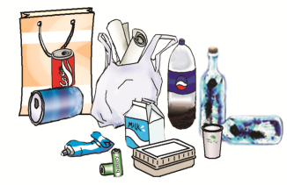
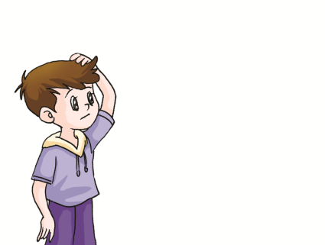
4 Suppose you will have a Clean-up Day. Work in groups and find out the garbage. Then sort them based on 3a and talk about them.
A: I think lunch boxes should be reused.
B: What about waste paper ?
A: I think…
Wow! We’ve got so much garbage! Soft drink cans, lunch boxes, plastic bottles, batteries, waste paper, paper bags and cups,…

Slide 18
Summary
We learn: 1.Some words: nod, agreement
2.Some phrases：give up
3. Some sentences:
(1) We should reduce the waste we
produce.
(2)Recycling can protect the
environment, and it can save money, too.
We can:1.Use the compound sentences with or, and, but
and while.
2.Talk about environmental protection.

Slide 19
Assignment
Read 1a.
Memorize the useful expressions and key sentences which we learn today.
Finish Section A in your workbook.
Preview Section B.

