Slide 1
Unit7 Communication
This is Jenny speaking.
WWW.PPT818.COM

Slide 2
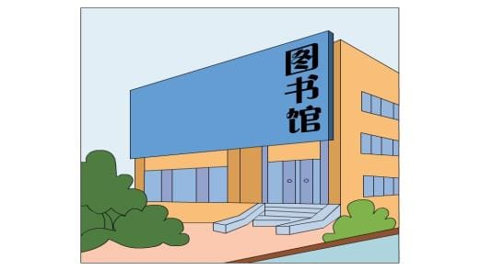
It’s sunny.
We can _____________ .
go to the library

Slide 3
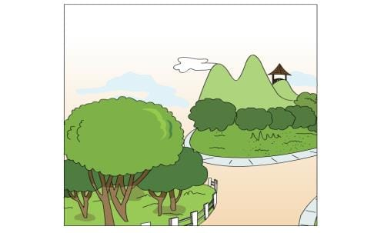
It’s sunny.
We can ____________ .
go to the park

Slide 4
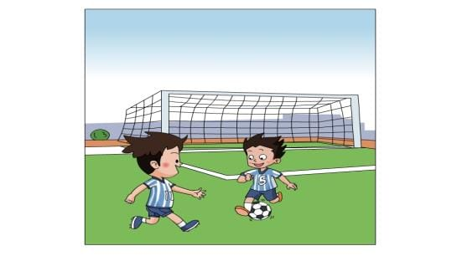
It’s sunny.
We can ___________ .
play football

Slide 5
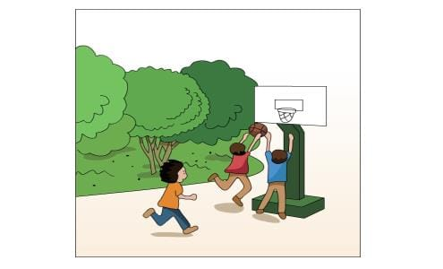
It’s sunny.
We can _____________ .
play basketball

Slide 6
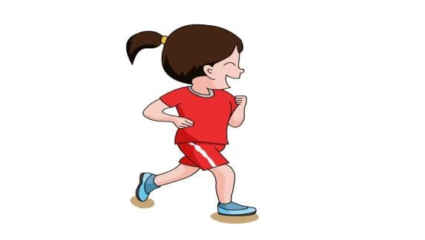
It’s sunny.
We can _____ .
run

Slide 7
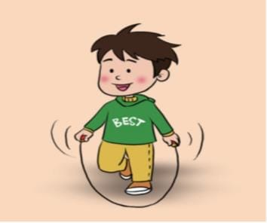
It’s sunny.
We can _____ .
skip

Slide 8
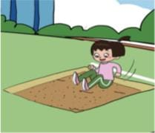
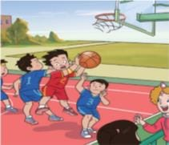
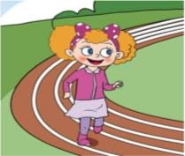
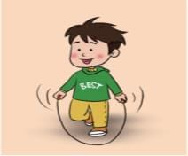
It’s sunny.
We can ….
do some training.

Slide 9
They like playing basketball.
They often do some ______ .
training

Slide 10
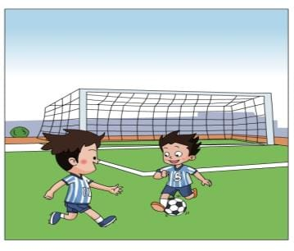
They like playing football.
They often_______________ .
do some training

Slide 11
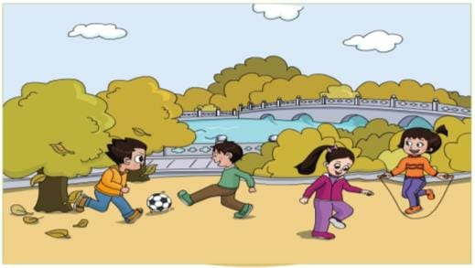
They often______________ in autumn.
do some training

Slide 12
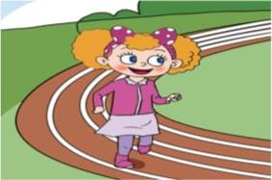
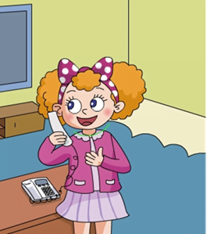
Jenny will do some training, too.

Slide 13
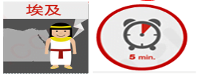
表现好，就可以得到卡片喽！！！
If you can do well， you will get a card.

Slide 14
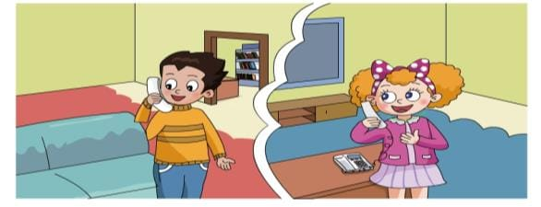
Watch and choose .
Who is Jenny calling？(Jenny 打电话给谁？)
A. Li Ming’s mother
B. Li Ming

Slide 15
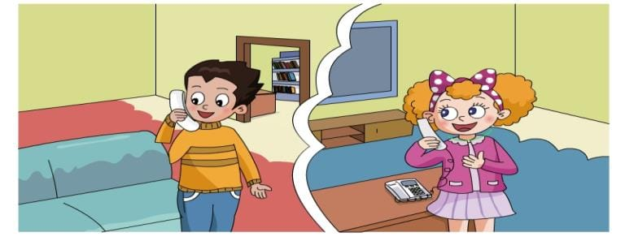
Watch and choose .
Who is Jenny calling？(Jenny 打电话给谁？)
A. Li Ming’s mother
B. Li Ming

Slide 16
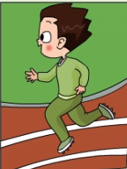
Jenny will do some training with Li Ming.

Slide 17
Listen and fill .
How does Jenny say？(Jenny 怎样说的？)
Hello! This is Jenny________.
speaking

Slide 18
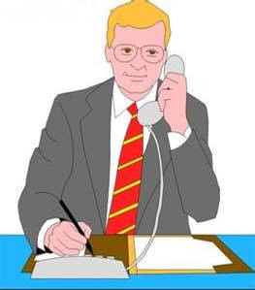
Hello! This is Tom speaking.

Slide 19
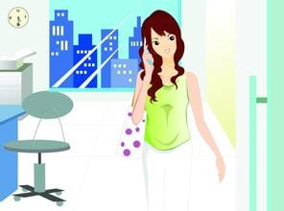
speaking
Hello! This is Lucy _______.

Slide 20
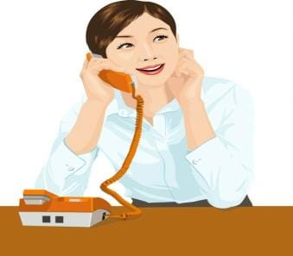
Hello! This is Anna _______. .
speaking

Slide 21
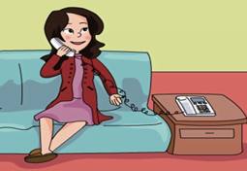
Listen and fill .
How does Jenny say？(Jenny 怎样说的？)
Hello! This is Jenny________.
speaking
May
I
____ __ speak to Li Ming?
Hold
on
_______ ___ , please.
calling
Li Ming, Jenny is_______ .
I’m coming.

Slide 22
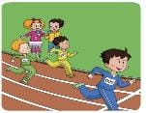
______ ____ is coming.
Let’s do some training
tomorrow.
Read and choose.
Sports
Day
Hi, Jenny.
A. Sports Day
B. Music Day

Slide 23
Let’s chant .
Calling，calling，who is calling？
Jenny，Jenny, Jenny is calling.
Speaking, speaking, who is speaking?
Li Ming, Li Ming, this is Li Ming speaking.

Slide 24
Listen and imitate

Slide 25
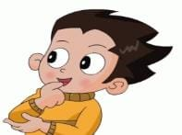
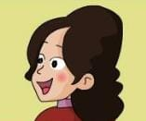

Slide 26
Dubbing show
(配音练习)

Slide 27
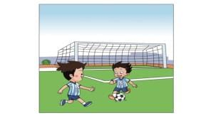
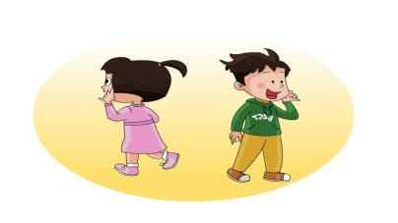
Let’s talk
Wang Hong
Guo Yang
A: Hello! This is __________speaking. May I speak to_________?
B: This is _________speaking.
A: Shall we_______________?
B: OK！
Guo Yang
go to the library

Slide 28
Weekend is coming. What will you do? Call your partner and make a decision.
（周末来了，你打算做什么？打给你的同伴，商量后作出决定）

Slide 29
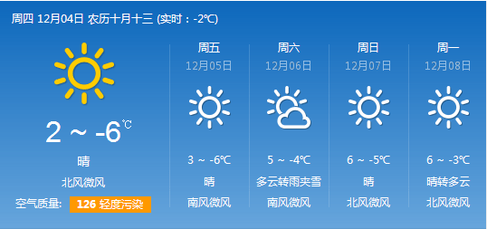
A: Hello! This is _____speaking. May I speak to_____？
B: This is _____ speaking.
A: It’s sunny today. How's the weather on_______?
B: It will(be)__________.
A:Weekend is coming. Let’s ______.
B: OK!

Slide 30
Summary
What do we learn today?
(今天学习了什么？)

Slide 31
不同国家有不同的电话习俗，我们来了解一下吧！

Slide 32
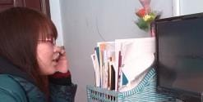
当英语学习遇到困难时，可以给老师打电话。
Tel: 15898750790
A: Hello! This is _____speaking. May I speak to Miss Wang？
B: This is Miss Wang speaking.
A: Can you tell me how to read/write ______?
B: OK! _______.
A: Thank you, bye!
B: Bye!

Slide 33
Homework
Listen and imitate P 76 for 5 times.
继续搜集了解其他国家的电话礼仪。

