Slide 1
Unit 2
His hobby is drawing
WWW.PPT818.COM

Slide 2
What’s your hobby?

Slide 3
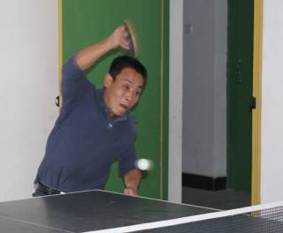
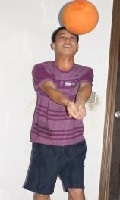
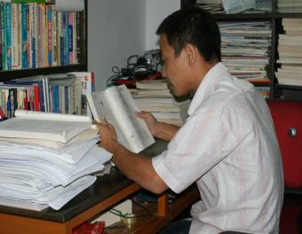
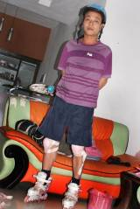
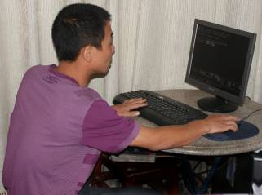
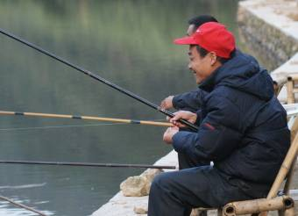

Slide 4
钓鱼图片
fishing

Slide 5
reading.

Slide 6
playing table tennis.

Slide 7
skating

Slide 8
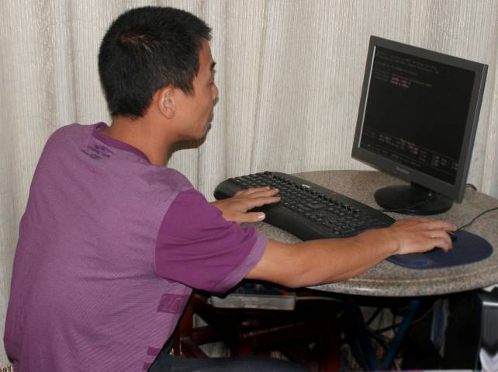
playing computer

Slide 9
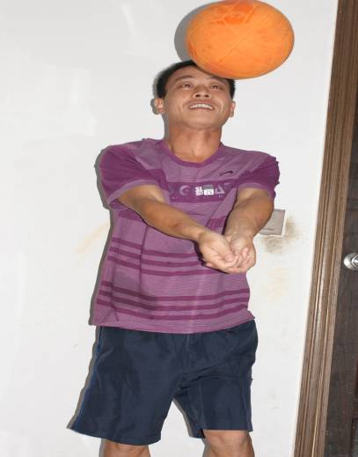
playing volleyball

Slide 10
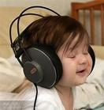
A:What’s her hobby?
B:Her hobby is listening to music.

Slide 11
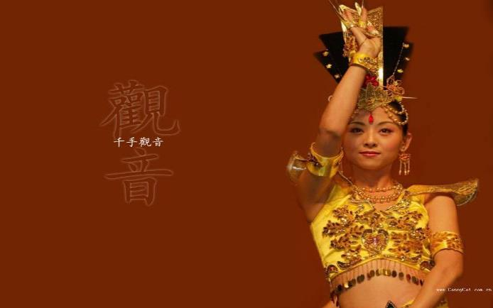
A: What’s her hobby?
B: Her hobby is dancing.

Slide 12
A: What’s her hobby?
B: Her hobby is going shopping.

Slide 13
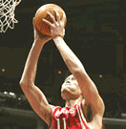
A: What’s his hobby?
B: His hobby is playing basketball.

Slide 14
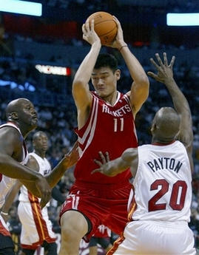
Yao Ming’s hobby is
playing basketball.

Slide 15
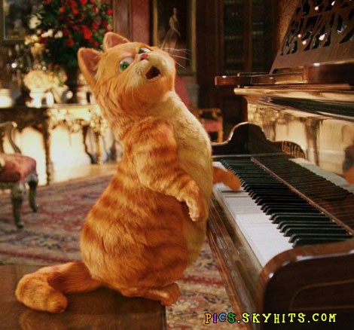
Mimi’s hobby is playing the piano.

Slide 16
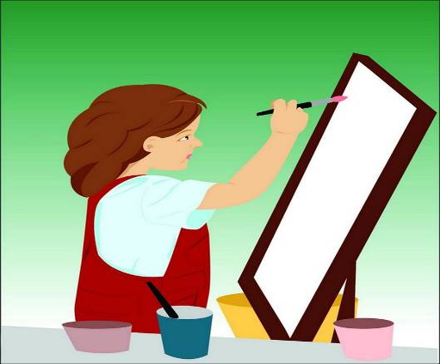

Slide 18
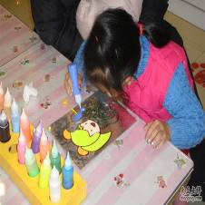
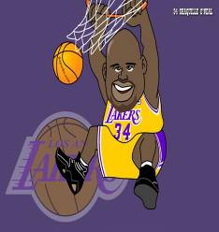
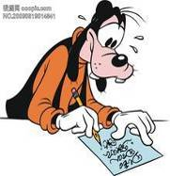
What are their hobbies?

Slide 19
Homework:
请您课后用英语采访身边的老师、家人、朋友等各自的是什么，然后用英语写一篇简短的调查报告（至少10人）。格式如：
Hobby
Hello! My name’s …… like……., ××× likes……., ××× loves……

Slide 20
Goodbye!

