Slide 1
Unit 3 Online tours
WWW.PPT818.COM

Slide 2
Learning targets:
1. To name the different parts of a computer.
2. To grasp and talk about the basic uses of computers.
3. To know the main topic of this unit.

Slide 3
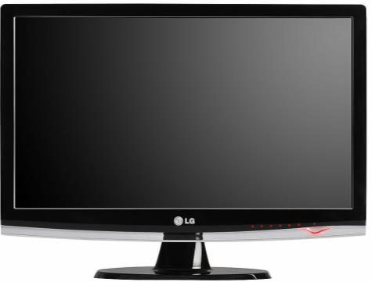
Let's learn some new words.
screen n. 屏幕，显示器

Slide 4
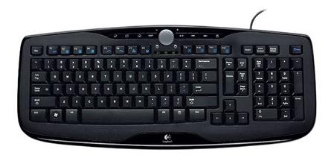
keyboard n. 键盘

Slide 5
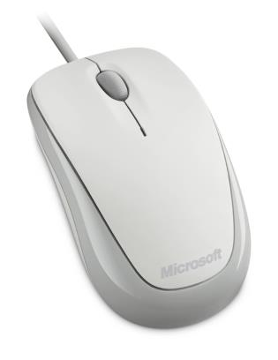
mouse n. (pl. mice或mouses) 鼠标

Slide 6
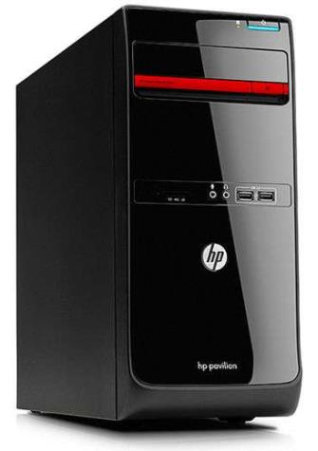
main unit
n. (电脑)主机

Slide 7
programme
n. 节目; 计划，
方案

Slide 8
channel n. 频道

Slide 9
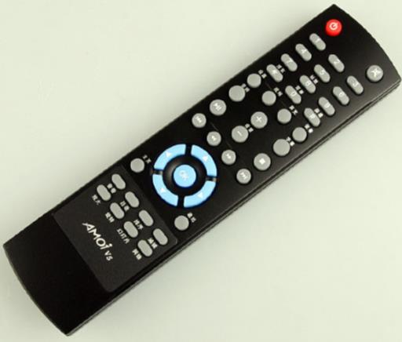
remote control
n. 遥控器

Slide 10
Let's read!
screen
keyboard
unit
main unit
mouse
programme
channel
remote control
屏幕，显示器
键盘
机件; 单位
主机
鼠标
节目
频道
遥控器

Slide 11
Free talk
What do you usually do when you are free?

Slide 12
Learning about computers
Annie, Simon’s cousin, wants to learn about the different parts of a computer. Look at the picture below and help her write the correct answers in the boxes.
keyboard main unit mouse screen

Slide 13
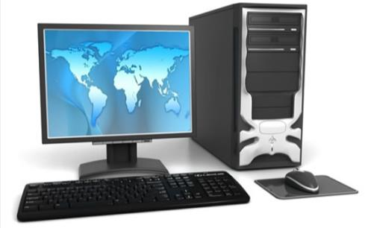
a computer
main unit
主机
screen 屏幕
mouse
鼠标
keyboard 键盘

Slide 14
Learn more about computers
What else can we do with a computer?

Slide 15
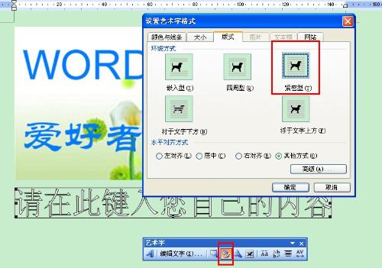
word processing 文字处理

Slide 16
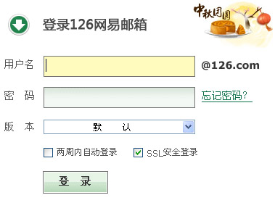
send and receive emails
收发电子邮件

Slide 17
watch programmes or videos
观看节目

Slide 18
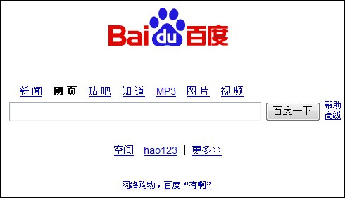
search for information 搜寻信息

Slide 19
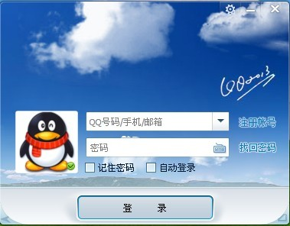
chat with friends 和朋友聊天

Slide 20
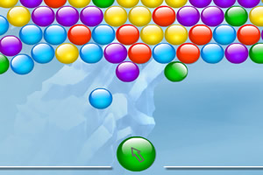
play games 玩游戏

Slide 21
Listen and answer.
What does Simon usually use his computer for? Why?
He usually uses it to search for information.
Because it’s fast and easy.

Slide 22
Simon and Daniel are talking about the different uses of computers. Work in pairs and ask each other what you use a computer for. The ideas in the box may help you. Use the conversation below as a model.
chat with friends do word processing
play games search for information
sending and receive emails watch videos

Slide 23
Let's practice!
A: What do you usually use your
computer for?
B: I usually use it to...
A: Why?
B: Because ...
A: How often do you use your computer
for this?
B: ...

Slide 24
Let's think!
Do Eddie and Hobo know well about computers?

Slide 25
Listen and answer the questions.
What do Eddie and Hobo think the computer look like?
Do you know what “the remote control” really is?
They think it looks like a TV.
It is a mouse.

Slide 26
Read the dialogue and
act it out!

Slide 27
Homework
1. Read the text book and learn the new
words and phrases by heart.
2. Do the exercises in the workbook.

