Slide 1
Unit 7
Lesson 3
How old are you?
WWW.PPT818.COM

Slide 2
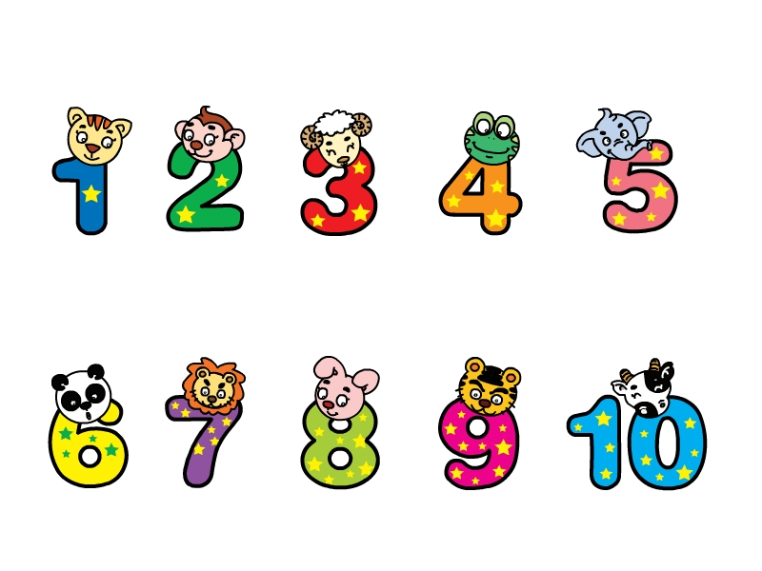
one
two
three
four
five
six
seven
eight
nine
ten

Slide 3
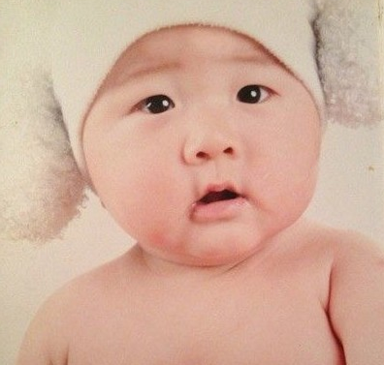
练一练
How old are you?
I’m one.
1

Slide 4
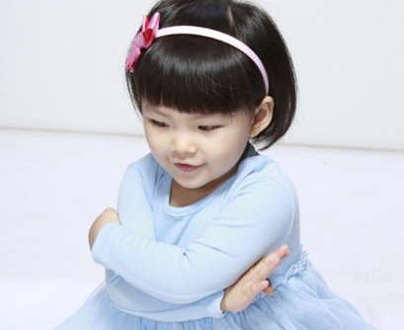
How old are you?
I’m five.
5

Slide 5
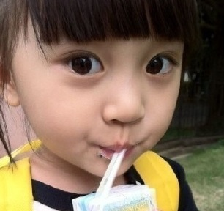
How old are you?
I’m three.
3

Slide 6
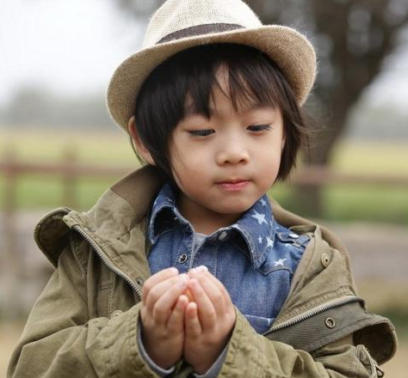
How old are you?
I’m four.
4

Slide 7
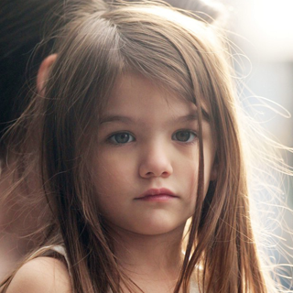
How old are you?
I’m seven.
7

Slide 8
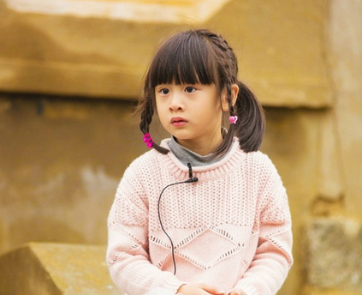
How old are you?
I’m six.
6

Slide 9
询问对方年龄：
How old are you?
回答：
I’m ...

Slide 10
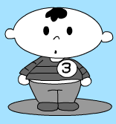
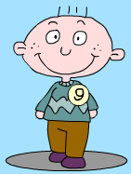
Read and act
How old are you?
I am nine.
9

Slide 11
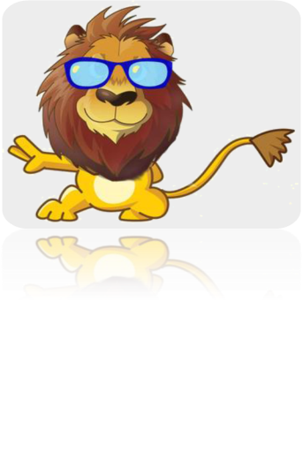
How old are you?
6
I am two.
2

Slide 12
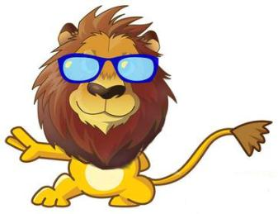
I am two .
2
How old are you?

Slide 13
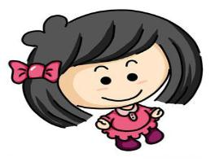
How old are you?
I am five .
5

Slide 14
Let’s learn letters!
Z
z
Yy
Xx

Slide 15
Homework
1. Copy the words and sentences.
happy birthday guess
How old are you?
2. Make a mini dialogue.

