Slide 1
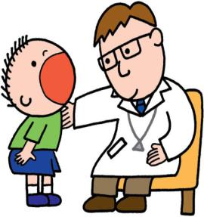
Unit 4
Seeing the doctor.
第二课时
WWW.PPT818.COM

Slide 2
Introduce
--What’s wrong with you?
--I / We have...
--What’s wrong with them?
--They have...
--What’s wrong with him / her / it?
--He / She / It has...

Slide 3
Words
eat [i:t]
作动词，意为“吃”。
eg：He eats many biscuits for breakfast every morning.
他每天早上都要吃很多饼干。
小练习：用所给词的适当形式填空：
Daddy wants ____（eat）some fish.
to eat

Slide 4
Words
Chinese [ˌtʃaɪˈni:z]
作形容词时，意为“中国的”。
eg：He is a Chinese boy. 他是一位中国男孩。
小练习：汉译英：一辆国产小轿车
a Chinese car
拓展：（1）Chinese作名词，意为“中国人”。单复数都一样。
eg:He is a Chinese, I am a Chinese. We are all Chinese.
（2）Chinese作名词，意为“中文”。
eg：I can speak Chinese.

Slide 5
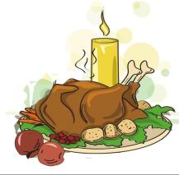
Words
chicken [ˈtʃikin]
名词，意为“鸡肉”。作食物讲，为不可数名词;意为“小鸡”,作动物讲时为可数名词。
eg： He likes eating chicken. 他喜欢吃鸡肉
小练习：汉译英：
一罐鸡肉 ____________
a tin of chicken

Slide 6
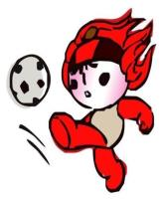
Expressions
Charlie is sitting on a beach. 查理正坐在海滩上。
此句为现在进行时的肯定句式，其句式结构为：主语+ be动词+动词的现在分词+其他。
eg： Eric is playing football in the playground. 艾利克正在操场上踢足球。
小练习：用所给词的适当形式填空：
My mother___________（cook）in the chicken now.
is cooking

Slide 7
Expressions
He’s going to China in March. 他将在三月去中国
此句为一般将来时的肯定句式，结构为：主语+be going to+动词原形+其他
eg： I am going to play computer games in the computer room.
小练习：用所给词的适当形式填空：
He_______________（study）in Nanjing next year.
一般疑问句的构成：把be (am, is, are) 放到句首，在句末加问号就构成了一般疑问句。
其答语为：Yes, 主语+ am/is/are. / No, 主语+ isn't/aren't.
is going to study

Slide 8
Expressions
特殊疑问句
由What引导的询问病情用语，其结构为：What’s wrong with+（人称代词宾格）？
回答分为两种情况：
（1）当主语为第三人称单数时其句式结构为：主语+has ...
（2）当主语为非第三人称单数时其句式结构为：主语+have...
eg： --What’s wrong with her? 她怎么了？
--She has a fever. 她发烧。

Slide 9
Expressions
4.由情态动词should引导的肯定句和否定句
由should引导的肯定句和否定句没有人称和数的变化。
其肯定句的结构为：主语+should+动词原形+其他。
eg： We should keep quiet here. 我们在这里应该保持安静。
其否定句的结构为：主语+should not+动词原形+其他。
eg： We should not smoke here.我们不应该在这里抽烟。

Slide 10
Dialogue
He’s going to China in March.
他将在三月去中国。
You have a fever. Your temperature is 102℉.
你发烧了，你的体温是102华氏度。
102？
102？
It’s 39℃.
39摄氏度。
Charlie is sitting on a beach.
查理正坐在海滩上。
Eating chicken for his lunch.
午饭吃着鸡肉。
He likes Chinese food very much.
他非常喜欢中餐。

Slide 11
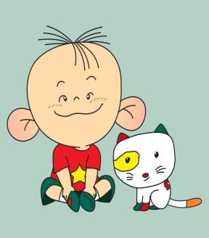
Expand
经典小故事
Tom is a little boy, and he is only seven years old. Once he goes to a cinema. It is the first time for him to do that. He buys a ticket and goes in. But after two or three minutes he comes out, and buys the second ticket and goes in again. After a few minutes he comes out again and buys the third ticket. Two or three minutes after that he comes out and asks for another ticket. But a girl asks him,” Why do you buy so many tickets? How many friends do you meet?” “No, I have no friends here, but a big woman always stops me at the door and cuts up my ticket.”

Slide 12
Expand
经典小故事
汤姆是个小孩， 他才7岁。 当他去电影院的时候。那时他第一次去。他买了张票进去了。 但没过两三分钟他就出来了，然后买了第二张票又进去了。 几分钟后他又出来买了第三张票。 接着两三分钟后他又出来买票。 一个女的问她，“你为什么要买那么多票啊? 你见到了几个朋友？" "没有， 我里面没朋友， 但是每当我进门的时候一位大的女人老把我的票给剪了"

Slide 13
Summary
eat
Chinese
Chicken
Charlie is sitting on a beach.
He’s going to China in March.

Slide 14
Exercise
I. 根据题意，补全句子
1.What’s wrong with her? She ___________________ .（牙疼）
2.What’s wrong with him? He_____________________.（发烧）
3.It’s so hot today. You should__________（脱掉）your coat.
4.It’s so cold today. Your should _________（穿上）your sweater.
5.Look at the sign. It means you should not_________（骑自行车）here.
has a toothache
has a fever
take off
put on
ride a bike

Slide 15
Exercise
II.将下列单词排序
1.wrong, is, what, with, you （？）
________________________________________
2.not, pick, we, the, should, flowers（.）
________________________________________
3.make, cake, a, birthday, for, mother, my, we, should, make, cake, a birthday for（.）
________________________________________
What's wrong with you?
We should not pick flowers
We should make a birthday cake for my mother.

Slide 16
Homework
尝试自己编写陈述句并变为一般疑问句。

