Slide 1
五年级 上册
We have new friends
WWW.PPT818.COM

Slide 2
Let’s sing!

Slide 3
Let’s talk!
I’m _______________.
I’m _______________.
I’m from _____________.

Slide 4
Let’s play and do!
Come here!
Come to the front!
Go back to your seat!

Slide 5
We have two new friends.
Bob
Eleven
Britain

Slide 6
Zhou Pei
Ten
Beijing

Slide 7
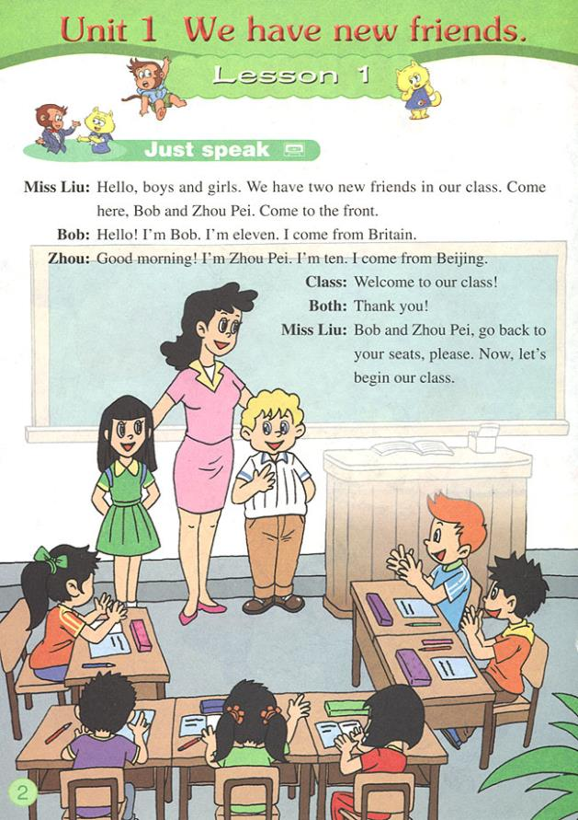
Let’s listen!

Slide 8
Listen to the dialogue and tick or cross.
( ) 1. Bob is an American boy.
( ) 2. Bob is ten years old.
( ) 3. Zhou Pei is from Beijin, China.
×
×
√

Slide 9
Read and answer.
1. How many new friends do you have?
We have two new friends.
2. Who are they?
They are Bob and Zhou Pei.
3. Is Bob from China?
No, he isn’t.

Slide 10
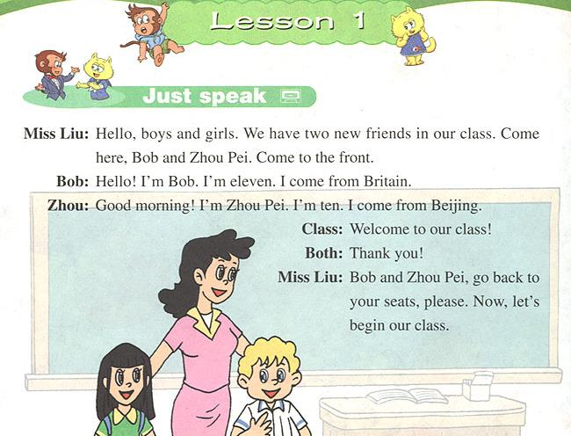
Let’s read!

Slide 11
根据对话内容选择正确的中文释义。
( ) 1. front A. 前面 B. 上面 C. 过来
( ) 2. Britain A. 法国 B. 英国 C. 美国
( ) 3. go back A. 返回 B. 前进 C. 走
( ) 4. seat A. 桌子 B. 椅子 C. 座位
( ) 5. begin A. 开始 B. 咱们 C. 成为

Slide 12
选择。
( ) 1. We have two new __________ in our class.
A. friend B. friends C. friendes
( ) 2. Come __________ the front.
A. to B. on C. in
( ) 3. I ________ Bob.
A. am B. an C. are
( ) 4. I __________ from Britain.
A. is B. are C. come
( ) 5. -- Welcome to our class! -- __________
A. Sorry! B. Hello! C. Thank you!

