Slide 1
Unit 4
Why don’t you talk to your parents?
R 八年级下册
第3课时
WWW.PPT818.COM

Slide 2
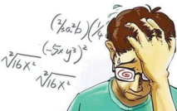
Lead-in
What problems do you have?
at school
too much homework.
too many examinations
can’t get good grades
can’t choose subjects we like

Slide 3
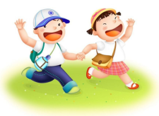
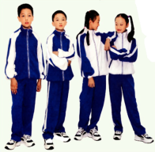
have to go to school early
have too much pressure
have to wear the school uniform
often fail in the exams
too many rules to obey at school

Slide 4
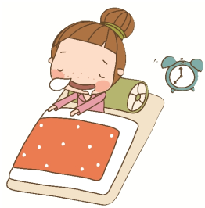
at home
have to get up too early
don’t have enough money
have no time to watch TV
argument between parents
have an argument with friends.
There is something wrong with my computer.
…

Slide 5
1a
What activities do you like to do to help lower your stress? Order them [1-8] with 1 being the most favorite thing you do to lower stress.

Slide 6
_____ play sports
_____ hang out with friends
_____ talk to parents or other family members
_____ spend time alone
_____ play computer games
_____ read books
_____ watch movies
_____ other: _______________
2
1
7
6
4
5
3

Slide 7
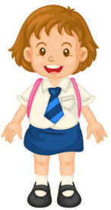
1b
Tell your partner about your answers in 1a.
What activities do you like to do to help lower your stress?
I hang out with my best friends.

Slide 8
What activities do you like to do to help lower your stress?
I play computer games.

Slide 9
Listen and check (√)the problems Wei Ming talks about.
1c
___ My parents give me a lot of pressure about school.
___ I don’t get enough sleep.
___ I don’t have enough free time.
___ I had a fight with my parents.
___ I have to compete with my classmates at school.
√
√
√

Slide 10
Listen again. What advice does Alice give to Wei Ming? Fill in the blanks.
1d
unhappy
1. Although you may be __________ with your
parents, you should talk to them. Ask them
why they give you so much __________.
2. Life shouldn’t just be about __________.
Free time activities like _________ and
hanging out with friends are important, too.
pressure
grades
sports

Slide 11
3. You shouldn’t _________ with your classmates
to get better grades. You should all be _______
each other to improve.
compete
helping

Slide 12
Language points
I have to compete with my classmates at school.
compete是动词，意为“竞争；对抗”，
compete for sth.是“为某事而竞争”；
compete with /against sb.是“与某人竞争”。
Thirty people had to compete for only ten openings.
三十个人必须只为十个名额来竞争。

Slide 13
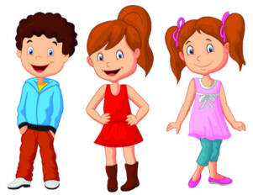
What is your advice for Wei Ming? Tell your partner and say why.
1e
Why?
I think Wei Ming should…
Because…

Slide 14
Exercise
根据汉语提示完成下列单词。
1. Many children are under too much ________
（压力）.
2. My parents ask me to ________（竟争）with
my classmates at school.
3. Tom is a _______（成员）of the basketball team.
pressure
compete
member

Slide 15
1. Teenagers _____ allowed to drive.
A. should not be B. should be not
C. not should be
2. Parents always like to _____ their children
_____ other children.
A. compare, with B. regard, as
C. compare, from D. compare, to
A
A

Slide 16
3. The young ______ respect the old.
A. would B. might C. should D. could
4. He has to make lots of money _____ he can buy his children nice food and clothes.
A. so that B. such that
C. that D. in order
C
A

