Slide 1
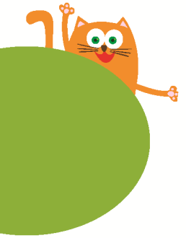
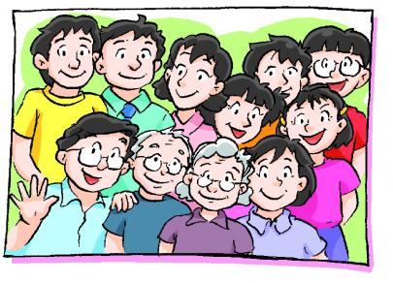
4
Do you have any cousins?
第二课时
WWW.PPT818.COM

Slide 2
Ask and answer
How many people are there in your family?
Who are they?
There are … people in my family.
They are …

Slide 3
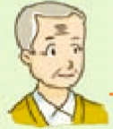
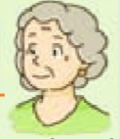
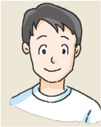
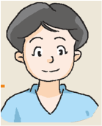
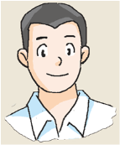
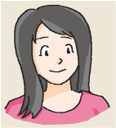
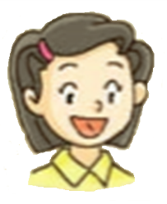
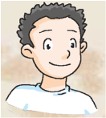
Jill’s family
There are seven people in my family.

Slide 4
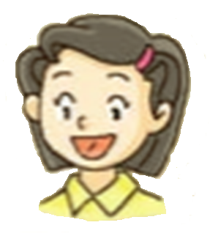
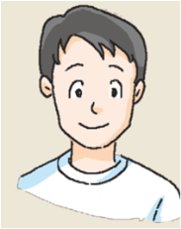
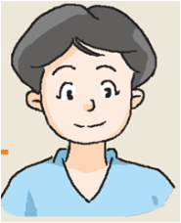
They are my parents.
parents
father
mother

Slide 5
They are ...
grandparents
grandfather
grandmother

Slide 6
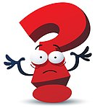
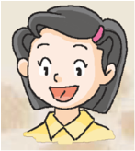
grandparents
grandfather
grandmother
parents
father
mother
Jill

Slide 7
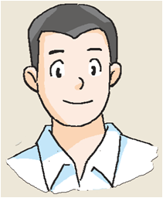
He is my …
uncle
Uncle John
(John)
under
umbrella

Slide 8
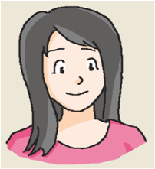
They are ...
aunt
Uncle John
Aunt Lily
(Lily)

Slide 9
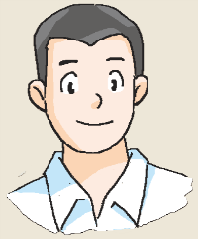
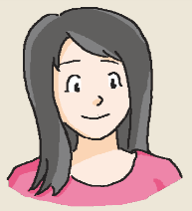
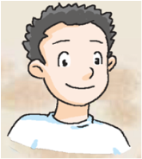
Uncle John
Aunt Lily
Dan

Slide 10
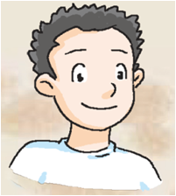
He is ...
touch
rough
cousin

Slide 11
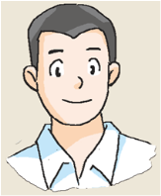
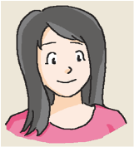
Uncle John
Aunt Lily
Cousin Dan
This is my cousin. His name is Dan. He’s Uncle John’s son.
This is my cousin. His name is Dan. He’s Aunt Lily’s son.

Slide 12
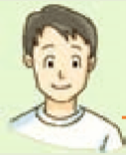
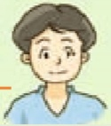
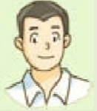
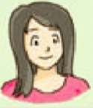
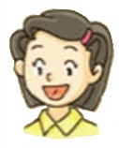
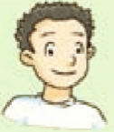
Look and read
My family
Hello, I’m Jill. This is my family. There are eight people in my family. Look, they are my grandparents. They are my parents. They are my uncle and aunt. And this is my cousin. His name’s Dan. He’s Uncle John’s son.
grandfather
grandmother
father
mother
uncle
aunt
(John)
(Lily)
Jill
Dan

Slide 13
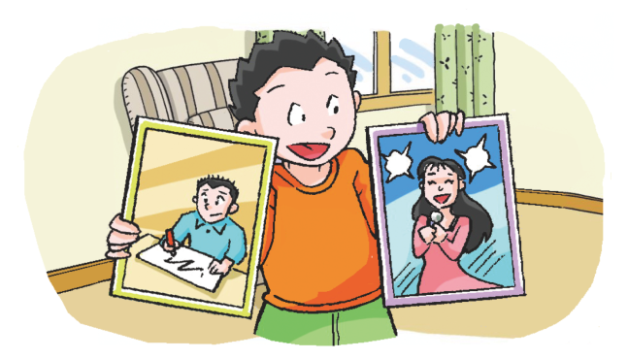
This is James.
He’s my cousin.
This is Linda.
She’s my cousin.

Slide 14
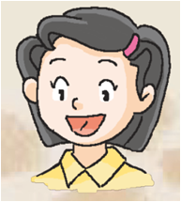
Look and say
He’s Dan.
He’s Jill’s cousin.
She’s Jill.
She’s Dan’s cousin.

Slide 15
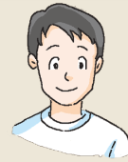
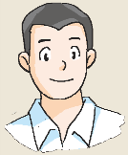
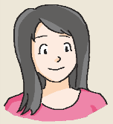
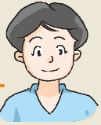
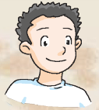
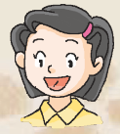
Look and say
Dan’s family
David
Linda
father
mother
Jill
Dan

Slide 16
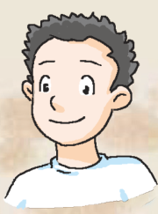
Read and complete
My family
Hello, I’m ___. This is my ____. There are _____ people in my family. Look, they are my ___________. They are my _______ They are my ____ and _____. And this is my _______. Her name is _____. She’s ____________’s daughter.

Slide 17
David
Linda
father
mother
Jill
Dan
A family tree

Slide 18
Think and do
About you
Make a family tree
Step 1
Step 2
Step 3
Draw
Write
Say

Slide 19
Look and read
Do you have any cousins?
Yes, I do.
No, I don’t.
Notes:
19

Slide 20
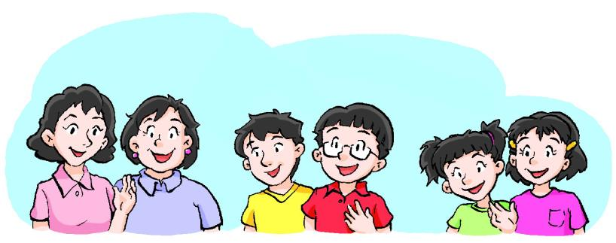
Ask and answer
About you
uncles
aunts
cousins
Do you have any ?
Yes, I do.
No, I don’t.
Notes:
20

Slide 21
Ask and answer
About Jill
Do you have any cousins?
Yes
Yes， I have one cousin.
, I do.
How many cousins do you have?
I have one cousin.
Notes:
21

Slide 22
Ask and answer
About Mark
Do you have any cousins?
Yes. I have one cousin.
Yes. I have two cousins.
Notes:
22

Slide 23
Look and read
Do you have any uncles?
Yes, I have one uncle.
Yes, I have two/three/… uncles.
No, I don’t have any uncles.
Notes:
23

Slide 24
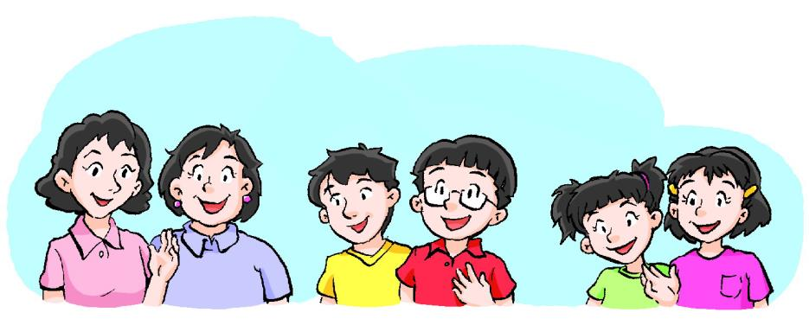
Ask and answer
About you
Do you have any …?
Yes, I have ...
No, I don’t have any ...
Notes:
24

Slide 25
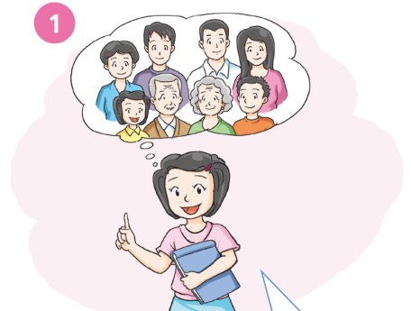
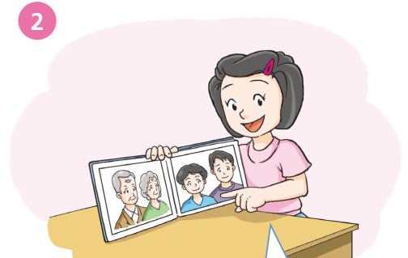
They’re my ________ and my _____________.
Hello, I’m Jill. I have ____ _______ ________.
parents
a
grandparents
big
family
Notes:
25

Slide 26
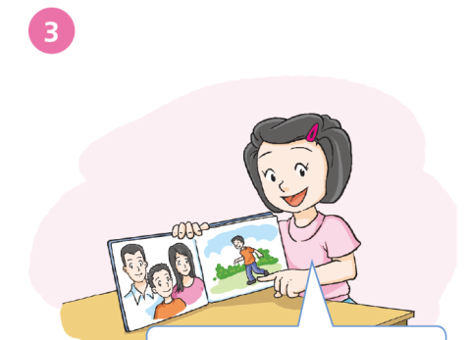
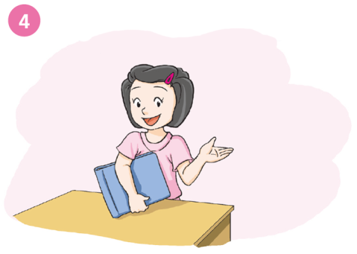
What about you? Do you _____ _____ ________?
have any cousins
This is ____ ________.
His name’s _____.
He’s _____ ______ ____.
my
cousin
Dan
Uncle John’s son
Notes:
26

Slide 27
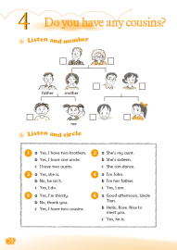
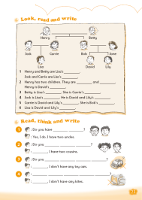
Homework
Listen to and read Student’s Book page 19 “Look and learn”.
Copy and recite the words in “Look and learn”.
Complete your family tree and introduce your family.

