Slide 1
Unit 7 Sports and Good Health
Stay Healthy!
WWW.PPT818.COM

Slide 2
Learning Targets
Key words & phrases:
remember, information, keep, brain, ping-pong, watch TV, listen to music, stay healthy, play sports, thinking skills
Key sentences:
1.Running helps us remember information.
2.Exercise can keep our brains young.

Slide 3
Lead in
Free Talk
How to stay healthy?
Do you have any good tips?
PPT模板：www.1ppt.com/moban/ PPT素材：www.1ppt.com/sucai/
PPT背景：www.1ppt.com/beijing/ PPT图表：www.1ppt.com/tubiao/
PPT下载：www.1ppt.com/xiazai/ PPT教程： www.1ppt.com/powerpoint/
资料下载：www.1ppt.com/ziliao/ 范文下载：www.1ppt.com/fanwen/
试卷下载：www.1ppt.com/shiti/ 教案下载：www.1ppt.com/jiaoan/
PPT论坛：www.1ppt.cn PPT课件：www.1ppt.com/kejian/
语文课件：www.1ppt.com/kejian/yuwen/ 数学课件：www.1ppt.com/kejian/shuxue/
英语课件：www.1ppt.com/kejian/yingyu/ 美术课件：www.1ppt.com/kejian/meishu/
科学课件：www.1ppt.com/kejian/kexue/ 物理课件：www.1ppt.com/kejian/wuli/
化学课件：www.1ppt.com/kejian/huaxue/ 生物课件：www.1ppt.com/kejian/shengwu/
地理课件：www.1ppt.com/kejian/dili/ 历史课件：www.1ppt.com/kejian/lishi/

Slide 4
play sports & exercise

Slide 5
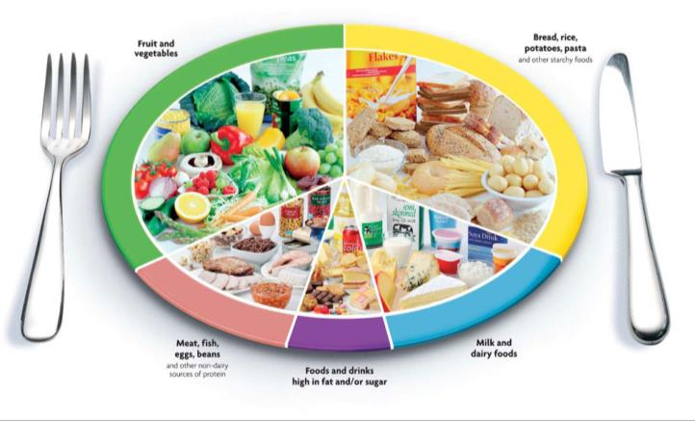
eat good foods

Slide 6
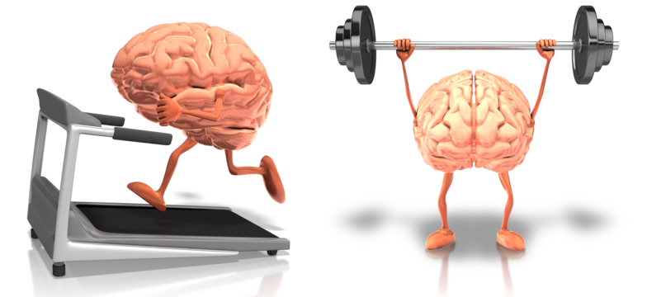
Exercise can keep our brains young!

Slide 7
exercise our minds

Slide 8
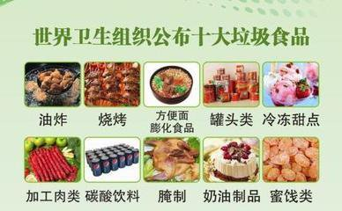
choose the right foods

Slide 9
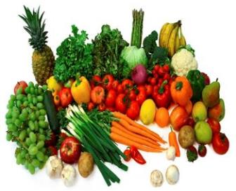
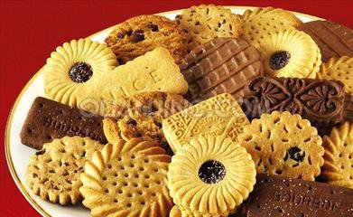
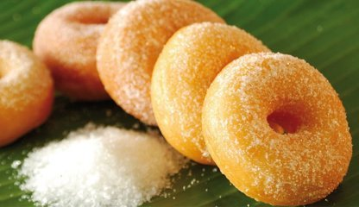
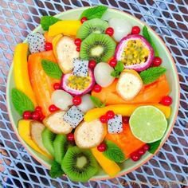
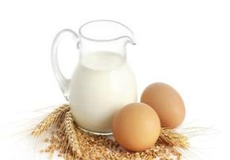
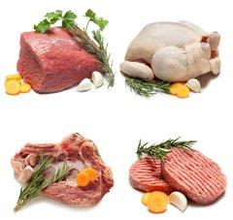
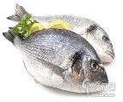
cookies
donuts
fruits and vegetables
salad
milk and eggs
meat and fish

Slide 10
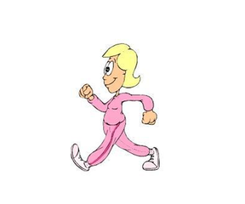
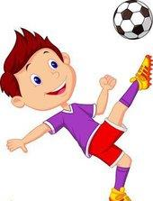
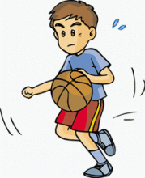
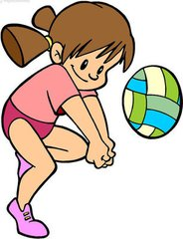
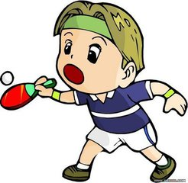
one hour of exercise every day
football
dancing
walking
basketball
volleyball
ping-pong

Slide 11
Words and expressions
v. 记得；想起
remember
keep
words
v.保持；保留
n. 消息
information
ping-pong
brain
n. 乒乓球
n. 脑；头脑

Slide 12
watch TV
listen to music
stay healthy
play sports
thinking skills
看电视
听音乐
保持健康
做运动
思维技能

Slide 13
Presentation
1
Listen to the statements and fill in the blanks. The first letter is given.
1.R_______ helps us remember information.
unning
2.W_______ can improve our thinking skills.
alking
3.E_______ can keep our brains young.
xercise
pples
4.A_______ help our brains stay strong.
ggs
5.E_______ and fish help our brains work faster.

Slide 14
2
Read the lesson and add some activities to the lists below.
Good for the Mind
Good for the Body
· reading
· playing ping-pong
· eating vegetables
· listening to music
· walking
· watching TV
· exercise
· climbing
· playing football
· dancing

Slide 15
3
Circle the correct words to complete the sentences.
1.Cookies and donuts are not (health/ healthy) foods.
2.To tell you the (true/ truth), I really want to improve my social skills.
3.It is a (true/truth) story! I read it in the newspaper.
4.You can find (a lot of / many) information on the Internet.
5.Eating (vegetable/vegetables) is good for us.

Slide 16
4
To stay healthy, teenagers need about one hour of physical exercise every day.Use the table below to make an exercise schedule for the week.
Task tips:You can do one hour all at once or do a few things throughout the day.
 | Monday | Tuesday | Wednesday | Thursday | Friday
before school | walk to school (15 min.)
during school | play basketball in P.E. class(25 min.)
after school | do some housework(20 min.)

Slide 17
proverbs & sayings
All work and no play makes Jack a dull boy.
只工作，不玩耍，聪明小孩也变傻。
Early to bed and early to rise make a man healthy, wealthy and wise.
早睡早起，令人健康、富有而且聪明。
An apple a day keeps the doctor away.
一天一个苹果，医生不来找我。

Slide 18
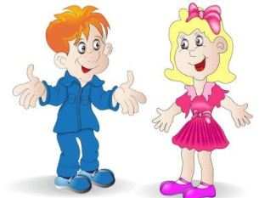
Happiness lies first of all in health.
幸福首先在于健康。
Walking is man’s best medicine.
步行是人的最佳良药。
A smile can make you ten years younger.
笑一笑 ，十年少 。

Slide 19
Language points
1．Running helps us remember information.
(1)动名词running在这里作主语。英语中单个动名词或动名词短语在句子中作主语时，谓语动词要用第三人称单数形式。如：Doing more exercise makes them healthy.多做运动使他们健康。
(2)remember作及物动词，意为“记住，记得，记起”。如：I remember what you told me.
我记得你对我说过的话。

Slide 20
【辨析】remember to do sth.与remember doing sth.
①remember to do sth.意为“记得去做某事”，强调事情还未发生。如：Remember to come to the meeting on time tomorrow.记住明天按时来参加会议。
②remember doing sth.意为“记得做过某事”，强调事情已经完成。如：I remember telling you about it once.我记得这事我曾经告诉过你。

Slide 21
(3)【辨析】information、message与news
① information 意为“信息”，是不可数名词，指的是情报、资料等。如：You can call us for more information.你可以打电话给我们询问更多的信息。
② message意为“消息，信息”，是可数名词，指口信、贺词、贺电等。如：Can I take a message for you？我能为你捎个口信吗？

Slide 22
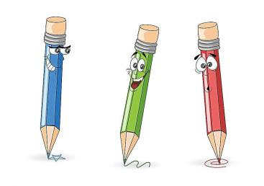
③ news 意为“新闻，报道”，是不可数名词，指的是通过广播、电视、报纸等向大众发布的各方面的最新消息，突出点在一个“新”字上。如：Is there any interesting news in today's newspaper？今天的报纸上有什么有趣的新闻吗？

Slide 23
2. Exercise can keep our brains young!
keep 动词，意为“保持，保留”，其过去式为kept。常用短语：keep+sb. /sth. +adj. 意为“使某人(物)保持某种状态”。
例如：We should keep our classroom clean. 我们应该保持教室干净。

Slide 24
【归纳拓展】
keep的用法小结
意思 | 用法
保持 | keep+ adj. 保持某种状态
 | keep doing sth. 一直做某事
 | keep sb./sth.doing sth. 使某人一直做某事

Slide 25
意思 | 用法
保管;保留 | 可代替borrow表示延续意义的“借”,常与一段时间连用。例:You can keep the book for two weeks.你能保管这本书两周。
饲养 | 与raise意思相近。例: My grandfather keeps lots of sheep on the farm.我爷爷在农场养了许多羊。

Slide 26
Exercises
一、用所给词的适当形式填空。
1. Many students like________ (listen) to music.
2. Mrs. Gao kept Li Ming ________ (stand) for an hour.
3. Please remember ________ (take) an umbrella with you when you go out.
4. We have many good ways to stay ________ (health).
5. Walking can improve our ________ (think) skills.
listening
standing
to take
healthy
thinking

Slide 27
二、单项填空。
1. My brother likes playing _________ ping-pong.
A. / B. a C. an D. the
2. —What do you like doing when you are free?
—I like singing songs and _________ music.
A. listening B. listening to C. listen D. hearing
3. —Could you help me find some information
_________ the Internet?
—Of course.
A. with B. in C. at D. on

Slide 28
4. Jenny often helps me __________ English.
A. learning B. learn
C. to learning D. learns
5. —Remember__________ your homework
tomorrow, Danny.
—I will.
A. bring B. to bring
C. bringing D. brings

Slide 29
Summary
1. Learned some new words and phrases：remember, information, keep, brain, ping-pong, watch TV, listen to music, stay healthy, play sports, thinking skills
2. Learned to talk about the ways of
staying healthy.

Slide 30
Homework
1. Review and recite the imporant
points of Lesson 38.
2. Write a short passage of how to stay healthy.
3. Preview Lesson 39.

