Slide 1
Unit 2 Lesson 8
Always Brush Your Teeth!
WWW.PPT818.COM

Slide 2
Revision
, , ,
and are all good for our health.
Breakfast
fruit
vegetables
sports

Slide 3
Let’s talk
When does Li Ming have breakfast?
He has breakfast at 7:00 in the morning.

Slide 4
Let’s talk
What does Li Ming do before breakfast?
He washes his hands and brushes his teeth before breakfast.

Slide 5
Let’s talk
What does Li Ming do after breakfast?
He goes to school after breakfast.

Slide 6
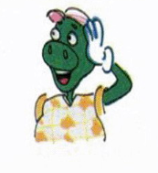
Let’s talk
Does Danny brush his teeth after dinner?
No. He never brushes his teeth after dinner.
That’s bad for his teeth.

Slide 7
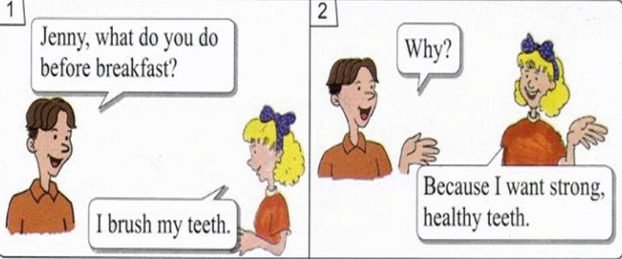
Let’s read

Slide 8
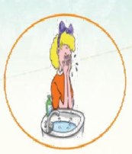
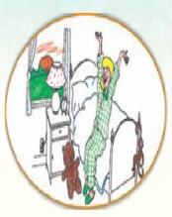
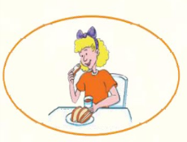
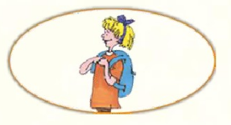
Let’s read
Read and order.
2
3
1
( )
( )
( )
4
5
( )
( )

Slide 9
Circle the key words you learn.
bad next
before after
teacher because

Slide 10
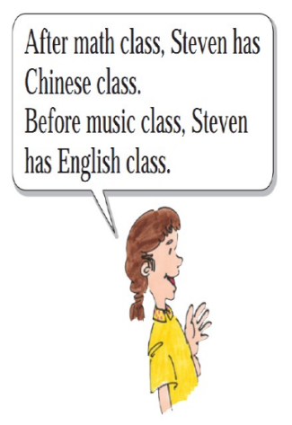
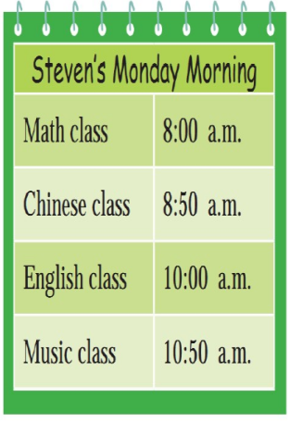
Look and say

Slide 11
Look and write
Jenny gets up at 7:00.

Slide 12
Look and write
washes her hands and face
brushes her teeth
First, she and .

Slide 13
Look and write
Next, she ,
Then she .
has breakfast
goes to school

Slide 14
Summary and Evaluation
What have you learned in this class?
A excellent B good C adequate D need improvement
内容 | 学生自评 | 小组互评
我能认真听老师讲课，听同学发言
遇到我会回答的问题主动举手了
活动中坚持使用英语来交际
我能积极参与小组讨论活动，能与他人合作。

Slide 15
Homework
1. Copy the key words three times.
2. Recite some key sentences.

