Slide 1
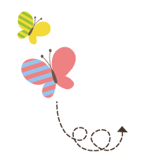
Unit 2 Good Health to You
六年级下册
Again, Please!
WWW.PPT818.COM

Slide 2
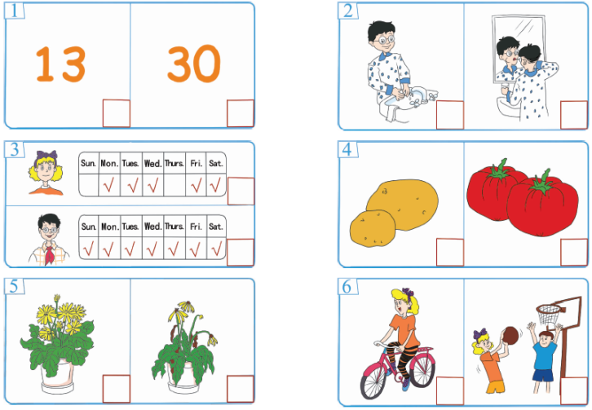
1. Listen and tick.
√
√
√
√
√
√

Slide 3
2. Listen and write.
My name is Jim. I am a ________boy. Every morning, I________ at 7 o’clock.________ I run for about ________ ________ in the park.________ I go to school, I have breakfast. I walk to school every day.________ helps make my body________. After school, I play football for about one________. Do you like to play sports?
healthy
get up
Next
thirty
minutes
Before
Exercise
strong
hour

Slide 4
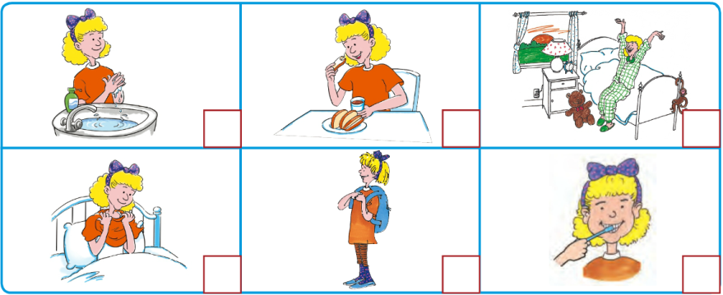
3. Listen and number.
4
5
1
2
6
3

Slide 5
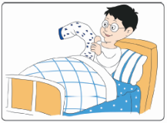
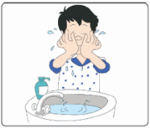
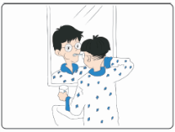
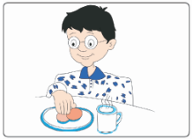
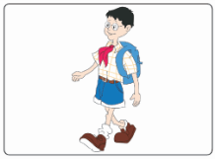
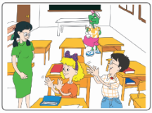
4. Look and write
Li Ming get up He _____________ He ______________
at 7:00 at 7:10 at 7:15
He ___________ He ____________ He ________________
at 7:20 at 7:40 at 8:00
washes his face
brushes his teeth
has breakfast
goes to school
has an English class
go to school have breakfast wash his face
Have an English class brush his teeth get up

Slide 6
5. Read and draw. Then write
Are these good to your health? Draw or .
I often help my mother.
I clean my room every morning.
I watch TV late into the night.
I often eat fruit.
I play computer games every night.
I always have breakfast.
I often go to bed late.
I brush my teeth twice a day.
I never eat vegetables.
I exercise for about an hour every day.
How can you be strong and healthy?

Slide 7
6. Read and follow the directions.
Healthy or Not?
Mr. Black is a very fat man. He always gets up very late in the morning. He never has breakfast. After he gets up, he sits in a chair and watches TV for about two hours. Next，he eats fast food for lunch. Then，he plays computer games in the afternoon. In the evening, he drives to buy some ice cream and cake for dinner. He never goes to bed before 2：00 in the morning.
Is he a healthy man?

Slide 8
6. Read and follow the directions.
Read and write.
a. ________ he gets up, he watches TV.
b. ________ he has lunch, he plays computer games.
c. ________ dinner, he drives to buy some ice cream and cake.
d. ________2：00 a．m., he goes to bed.
before after
After
After
Before
After

Slide 9
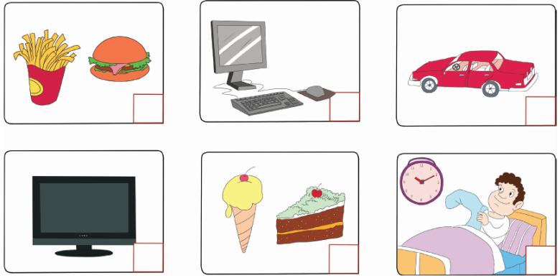
6. Read and follow the directions.
2. Read and number.
3
4
5
2
6
1

Slide 10
7. Think and talk.
·Do you always brush your teeth after dinner?
·How often do you brush your teeth?
·Do you often help your parents?
·How often do you have breakfast?
·How many minutes a day do you exercise?
Do you always brush your teeth after dinner?
Do you always brush your teeth after dinner

Slide 11
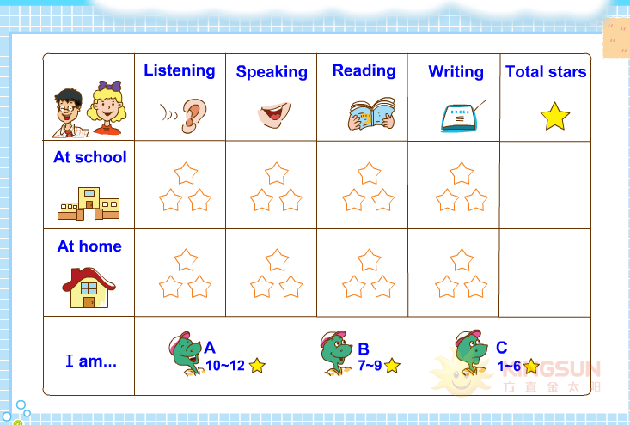
8. How am I doing?

