Slide 1
Unit 8 Culture Shapes Us
Supper with the Bradshaws
WWW.PPT818.COM

Slide 2
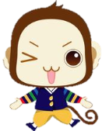
学习目标
1. To learn words about gift giving.
2. To know the Chinese tradition of gift-giving.
3. To learn about some tips of giving presents.
4. To practice the skills of reading, speaking and writing.

Slide 3
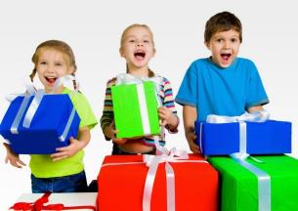
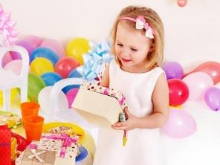
Warming up
When would you like to receive gifts?
What gifts would you like to get? Why?

Slide 4
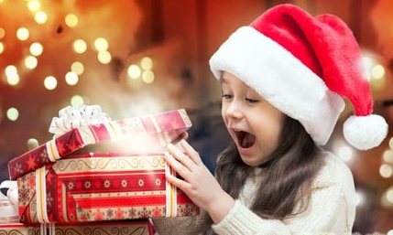
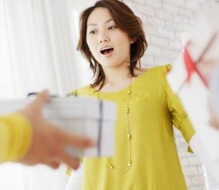
Talk about it
How do you react when you receive a gift you
don’t like?

Slide 5
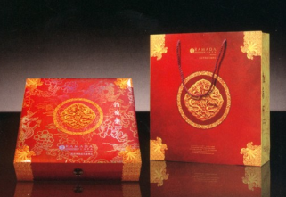
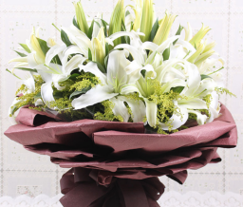
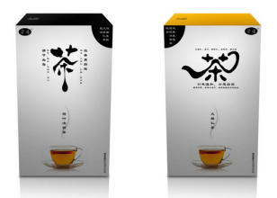
Talk about it
When your family visits another, what do you
usually take as a gift?

Slide 6
New words
chalk n. 粉笔
tradition n. 传统
reaction n. 反应
react v. 反应
officer n. 政府官员
gun n. 枪
doll n. 洋娃娃；玩偶

Slide 7
Reading
Read the lesson and write(T) or false(F).
1. Li Ming liked Mr. Bradshaw’s cookies. ( )
2. Li Ming accepted Mr. Bradshaw’s gift although he didn’t like it. ( )
3. Debbie liked the toy gun that Danny gave her as a Christmas gift. ( )
4. Danny is planning another trip to Chinatown. ( )
F
T
F
T

Slide 8
Reading
Turn one of the emails to a dialogue. You can make some changes if you like. Work in pairs and show your dialogues later.

Slide 9
Language points
1. I don’t know what we’ll do with them.
我不知道该如何处理它们。
do with意为“对付、处理”，多与疑问词what 连用，表示“如何对付、处理、安排”。
deal with也表示“对付、处理、安排”，多与疑问词how 连用。

Slide 10
Language points
2. I wish everyone here, especially Debbie, could learn some Chinese manners.
我希望每个人，尤其是黛比,要了解一些中国的礼仪。
当wish 是一般现在时的时候，后面的宾语从句要使用一般过去时，这是虚拟语气，用来表达某种愿望。

Slide 11
Writing
Write about one time when you receive a gift that you don’t like.
1. Who gave you the gift?
2. When did you get the gift?
3. Why didn’t you like the gift?
4. What was your reaction?

Slide 12
Cultural differences
送礼物
中国人注重礼品的实用价值； 中国人送的是礼品。 | 西方人往往注重礼品的纪念价值； 西方人送的是纪念品。

Slide 13
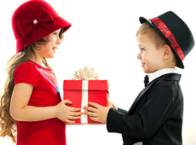
Cultural differences
收礼物
在中国，人们接受礼物时往往并不喜形于色，且不当面打开礼品。 | 在西方，人们接受礼物时,首先想到的是感谢，往往当面打开礼物,称赞一番，激动时还拥抱你一下。

Slide 14
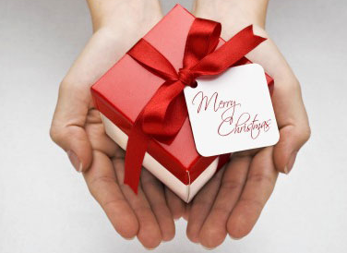
Project
Research about the tradition of gift-giving in one country outside China. Make a poster about it.

Slide 15
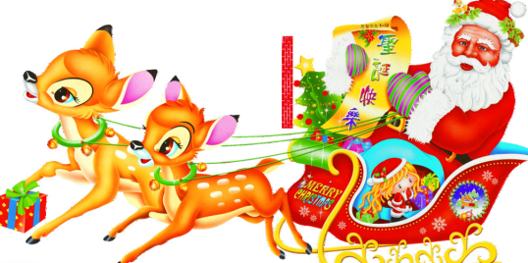
Project
What do you know about Santa Claus?
Where does he live?
What animals pull his sleigh?

Slide 16
Homework
1. Remember the words and important sentences.
2. Finish the exercises.

Slide 17
Thank You

