Slide 1
Starter Module 1
My teacher and my friends
Unit 3 This is my friend.
WWW.PPT818.COM

Slide 2
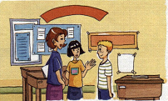
1. Listen and read
Conversation 1
Lingling: This is Miss Zhou. She’s my teacher. Hello, Miss Zhou.
Miss Zhou: Hello, Lingling.
Lingling: Miss Zhou, this is my friend, Tony.
Miss Zhou: Hello, Tony.
Tony: Hello, Miss Zhou.

Slide 3
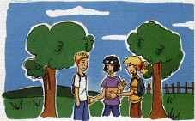
Conversation 2
Lingling: This is my friend. Her name’s Betty.
Tony: Hello, Betty.
Lingling: This is my friend. His name’s Tony.
Betty: Hello, Tony, nice to meet you.
Lingling: It’s time to go now. Goodbye, Tony.
Tony: Bye. See you tomorrow.

Slide 4
3. Match
1. This is my friend.
2. She is my friend.
3. Hello.
4. It’s time to go now.
a) His name’s Tony.
b) Goodbye.
c) Nice to meet you.
d) Her name’s Betty.

Slide 5
4. Number
a) Goodbye. See you tomorrow.
b) Hello, Daming. This is my friend, Amy.
c) It’s time to go now. Goodbye.
d) Hello, Amy, nice to meet you.
e) Hello, Daming, nice to meet you too.
5
1
4
2
3

Slide 6
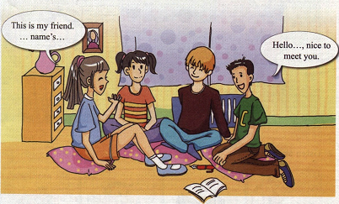
6. Work in groups. Say.
This is my friend.
… name’s …
Hello…, nice to
Meet you.

Slide 7
7. Write.
His
This is my friend. ______ name’s Tony.
This is my ______. Her ______ Betty.
Nice to _______ you.
It’s time to go now. _______.
Goodbye. See you _________.
friend
name’s
meet
Goodbye
tomorrow

Slide 8
Language points

Slide 9
重点句型:
This is my friend. His/Her name’s … 用于把自己朋友介绍给别人时候
2. It’s time to go now. 是时候该走了。
e.g.
It’s time to go home. 是回家的时候了。
It’s time to have supper. 吃晚饭时候到了。

Slide 10
Practice

Slide 11
name
1. --What’ your _______?
-- My name is Linda.
-- _____ are you?
-- Fine, thanks.
2. -- Nice to ______ you,
-- ______ to meet you, _____.
3. It’s ______ to go to school.
How
meet
Nice
too
time

Slide 12
Homework
Introduce your friends to
your classmates and know
more new friends.

Slide 13
Good bye!

