Slide 1
Unit 6
I'm going to study computer science
Section B
WWW.PPT818.COM

Slide 2
选词填空。
when what where how who
1. -- ________ are you going?
-- I am going to the Great Wall.
2. -- _______ are they going to school?
--They go to school by school bus.
3. -- ________ are you going to the museum?
-- Tomorrow afternoon.
4. -- ________ are we going to buy?
-- We are going to buy some fruit.
5. -- _______ is she going with?
-- She is going with her mum.
Where
How
When
What
Who

Slide 3
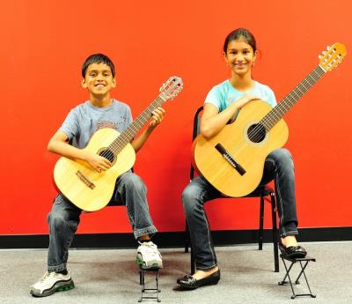
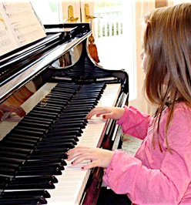
What are you going to do next year?
take guitar lessons
learn to play the piano

Slide 4


What are you going to do next year?
PPT模板：www.1ppt.com/moban/ PPT素材：www.1ppt.com/sucai/
PPT背景：www.1ppt.com/beijing/ PPT图表：www.1ppt.com/tubiao/
PPT下载：www.1ppt.com/xiazai/ PPT教程： www.1ppt.com/powerpoint/
资料下载：www.1ppt.com/ziliao/ 范文下载：www.1ppt.com/fanwen/
试卷下载：www.1ppt.com/shiti/ 教案下载：www.1ppt.com/jiaoan/
PPT论坛：www.1ppt.cn PPT课件：www.1ppt.com/kejian/
语文课件：www.1ppt.com/kejian/yuwen/ 数学课件：www.1ppt.com/kejian/shuxue/
英语课件：www.1ppt.com/kejian/yingyu/ 美术课件：www.1ppt.com/kejian/meishu/
科学课件：www.1ppt.com/kejian/kexue/ 物理课件：www.1ppt.com/kejian/wuli/
化学课件：www.1ppt.com/kejian/huaxue/ 生物课件：www.1ppt.com/kejian/shengwu/
地理课件：www.1ppt.com/kejian/dili/ 历史课件：www.1ppt.com/kejian/lishi/
get good grades
get a lot of exercise

Slide 5
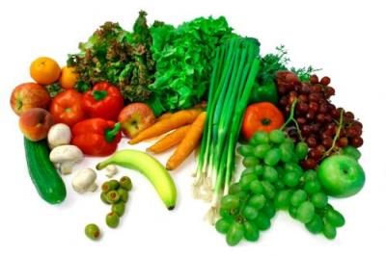
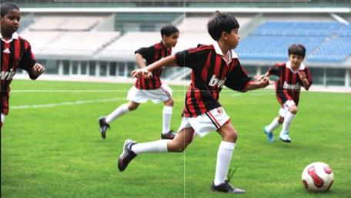
What are you going to do next year?
eat healthier food
make the soccer team

Slide 6

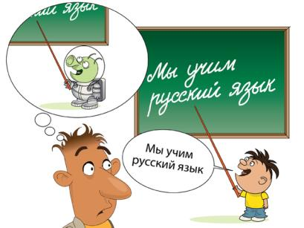
What are you going to do next year?
learn a foreign language

Slide 7


New Year’s Party

Slide 8

What is New Year’s resolutions?

Slide 9

The plans you make for yourself on New Year’s Day are called New Year’s resolutions.

Slide 10
1a
New Year’s resolution
1. learn to play the piano
2. make the soccer team
3. get good grades
4. eat healthier food
5. get lots of exercise
2
1
5
4
3

Slide 11
New Year’s resolution
He is going to … next year.

Slide 12

1b
Pair work
A: What are you going to do next year?
B: Well, I’m going to take guitar lessons. I really love music.
A: Sounds interesting. I’m going to learn another foreign language.
B: Are you? Great! But foreign languages are not for me.

Slide 13
Pair work
What things are you going to do next year?
A: What are you going to be?
B: I’m going to be …
A: What are you going to do next year?
B: I’m going to …
A: Sounds interesting. I’m going to …

Slide 14
1c
Listen and circle the resolutions you hear in 1a.

Slide 15
Listen again. Write how the people are going to make their resolutions work.
1d
 | How are they going to do it?
Lucy | She’s going to take piano lessons
Kim
Mike
study hard
She’s going to ________ _______and ___ ____ __________every day.
do her homework
practice
He’s going to _________really hard, and this summer he’s going to go to a______ _____.
soccer camp

Slide 16
A: I want to be a teacher.
B: How are you going to do that?
A: Well, I’m going to study hard and get good grades.
B: Sounds like a good plan. I want to get a lot of exercise.
Group work

Slide 17
2a
Discuss the questions with your partner.
1. Did you make any resolutions last year?
2. Were you able to keep them? Why or why not?

Slide 18
Read the passage and match each paragraph [1-3] with its main purpose in the box. Underline the words and phrases that helped you decide.
2b
___________ To question the idea of making resolutions
___________ To give the meaning of resolution
___________ To discuss the different kinds of resolutions
Paragraph 3
Paragraph 1
Paragraph 2

Slide 19
Mark T (True) or F (False).
T
1. The resolution is a kind of promise.
2. Many resolutions have to do with other people.
3. The writer thinks the resolutions may be difficult keep.
F
T

Slide 20

2c
Which paragraph in the passage do you think each sentence goes in? Write the letters [A–D] in the correct places in the passage.

Slide 21
A. These are about making yourself a better person.
B. For example, a student may have to find more time to study.
C. There are good reasons for this.
D. The start of the year is often a time for making resolutions.

Slide 22
1. Do you know what a resolution is? It’s a kind of promise. I’m going to tidy my room when I get back from school.”) However, promises you make to yourself are resolutions, and the most common kind is New Year’s resolutions. ____________ When we make resolutions
at the beginning of the year, we hope that we are going to improve our lives. Some people write down their resolutions and plans for the coming
year. Others tell their family and friends about their wishes and plans.
D

Slide 23
2. There are different kinds of resolutions. Some are about physical health. For example, some people promise themselves they are going to start an exercise program or eat less fast food. Many resolutions have to do with
self-improvement. __________ Some people might say they are going to take up a hobby like painting or taking photos, or learn to play the guitar. Some resolutions have to do with better planning, like making a weekly plan for schoolwork. ____________
A
B

Slide 24
3. Although there are differences, most resolutions have one thing in common. People hardly ever keep them! ___________ Sometimes the resolutions may be too difficult to keep. Sometimes people just forget about them. For this reason, some people say the best resolution is to have no resolutions! How about you-will you make any next year?
C

Slide 25
Answer the questions with short sentences.
2d
1. What is a resolution?
_______________________________________
2. When do people usually make resolutions?
_______________________________________
_______________________________________
3. Why do people usually make resolutions?
_______________________________________
It’s a kind of promise that you make to yourself.
People often make resolutions at the beginning of the year.
They hope that they are going to improve their lives.

Slide 26
4. How can people remember their resolutions?
________________________________________
________________________________________
________________________________________
5. How many kinds of resolutions does the writer talk about?
________________________________________
________________________________________
________________________________________
________________________________________
Some people write down their resolutions and plans.
Some people tell their family and friends about their wishes and plans.
The writer talks about three different kinds of resolutions: physical health, self-improvement (which includes taking up a hobby) and better planning.

Slide 27
6. Why do you think resolutions may be difficult to keep?
_________________________________________
7. Do you think the best resolutions is to have no resolutions? Why or why not?
_________________________________________
Answers will vary.
Answers will vary.

Slide 28
2e
Find these phrases in the passage. Then write your own sentences with them.
have to do with ___________________________
make promises ___________________________
have … in common ________________________
write down _______________________________
for this reason ____________________________
take up __________________________________

Slide 29
Language points
1. discuss v. 讨论；商量
Let’s discuss how to deal with this problem.
让我们讨论一下如何处理这个问题。
discuss 的名词是discussion
All we need now is action, not discussion.
我们现在需要的是行动，不是讨论。

Slide 30
The students in Class 2 are having a _______ (discuss) about how to achieve a balance between study and play.
Our teacher often asks us ______ questions in groups.
A. discuss B. to discuss
C. discussing D. discussed
discussion
B

Slide 31
2. promise n. 承诺；诺言
v. 许诺；承诺；答应
He promised to help me.
他许诺过要帮助我。
Once you make a promise, you should keep it, and you shouldn’t break it.
一旦你许下诺言，你就得遵守你的诺言，而不应当违背你的诺言。
I promised you not to stay that.
我答应你不说那件事。

Slide 32
--- I will buy you a new bike if you learn how to swim this summer.
--- Is that a ______? I’m sure I’ll get the bike.
A. chance B. promise
C. trick D. treat
B

Slide 33
(2​0​1​4​年​河​南​省​中​考) — You may go to Milan for a free trip.
— It’s a very kind _____, but I really can’t accept it.
A. excuse B. offer
C. promise D. decision
B

Slide 34
The boy promised _________ late for school again.
A. to not be B. not to be
C. not being D. being not
答案：选B
点拨：promise not to do sth. 许诺不干某事

Slide 35

归纳小结
make a promise 许下诺言
keep a promise 遵守诺言
break a promise 违背诺言
promise sb. to do sth. 许诺某人干某事

Slide 36
3. have to do with 关于；与……有关系
这个句型表示与某事某人有牵连，有关系，有瓜葛。
The book has to do with computers.
那本书与计算机有关。
What does that have to do with it?
那跟这有什么关系?
Harry said he didn’t want to have anything to do with the new comer.
哈利说他不想与那新来的扯上关系。

Slide 37
4. take up （尤指为消遣）学着做；开始做
I'd be happy to take up a new hobby.
我很乐意开始一种新嗜好。
When did you take up Japanese as a second foreign language?
你什么时候开始选修日语作为第二语言?

Slide 38
People along the river didn’t allow them to _______ a factory so as not to pollute the water.
A. set up B. give up
C. take up D. look up
Jacky’s mother was surprised to see her son _______ all the food on the table quickly.
A. eat up B. look up
C. take up D. give up
A
A

Slide 39

take a photo / picture拍照; 照相
take a hand in 参加, 插手
take a seat 就座, 入座
take a shower 洗淋浴
take a walk 散步
take a train 乘火车
take care of 照顾
take away 拿走
take out 取出

