Slide 1




Subjects
第二课时
WWW.PPT818.COM
Notes:
1

Slide 2

Let’s guess.
What lessons does Peter have in Beijing today?

Slide 3

Watch and think.
1. What lessons does Peter have in the morning?
2. What lessons does he have in the afternoon?
3. What do they have from 11:20 a.m. to 1 p.m.?

Slide 4
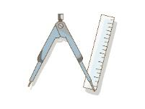


Watch and think.
1. What lessons does Peter have in the morning?
2. What lessons does he have in the afternoon?

Slide 5


Watch and think.
3. What do they have from 11:20 a.m. to 1 p.m.?
?
a lunch
break

Slide 6
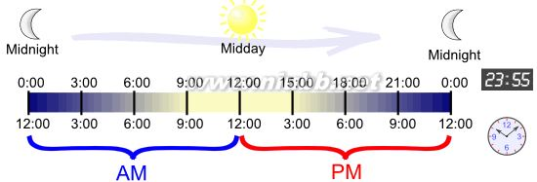

Slide 7
Watch and think.
3. What do they have from 11:20 a.m. to 1 p.m.?
From 11:20 a.m. to 1 p.m. , we have a lunch break.

Slide 8
Let’s try.
Your timetable!!

Slide 9
Read in pairs.
What subjects does Peter like?
How do you think Peter feels in art class?

Slide 10

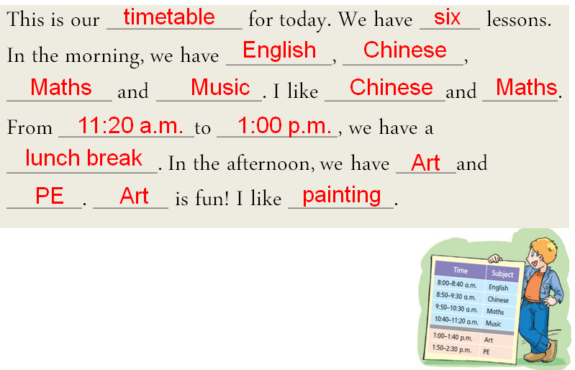

Slide 11

Guessing game
useful
this morning
numbers
It’s Maths.
happy

Slide 12
Guessing game
fun
this afternoon
do many things
It’s ICT.
excited,
computers

Slide 13
Guessing game
Your riddles!!

Slide 14
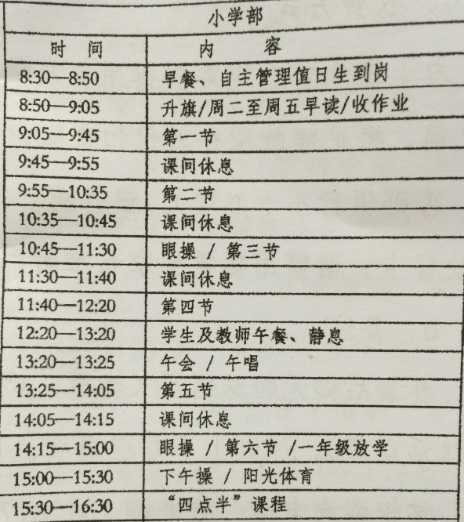

Slide 15


Ask & main speaker
S1
Answer & take notes
S2
Answer & check
S3
Answer& keep the time
S4
Answer & organize
S5

Slide 16
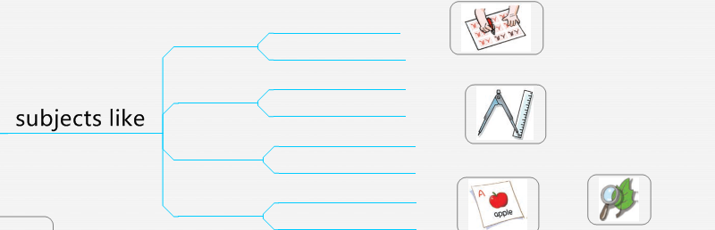
Step 1: Tell 2 subjects you like and reasons.
Maths, fun
Peter
PE, can play

Slide 17
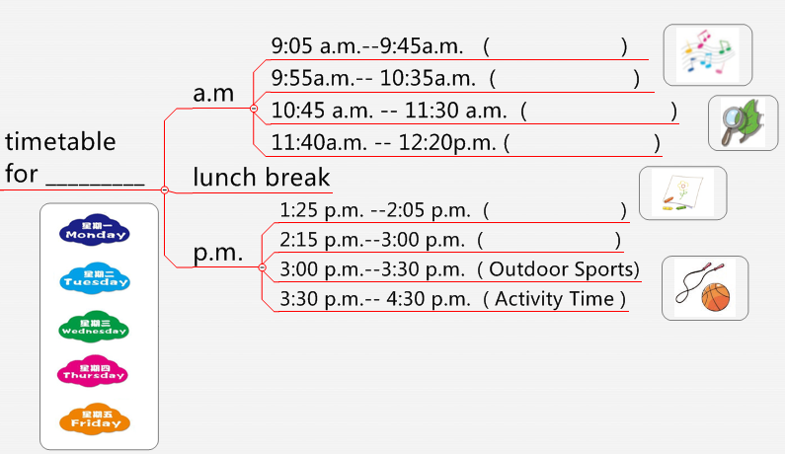
Step 2: Make a timetable for one weekday.
Maths

Slide 18
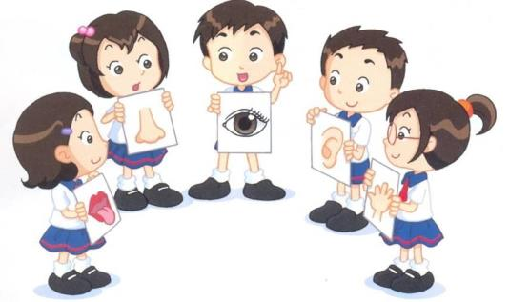
Step 3: Give a report.

Slide 19
Rules:
Make study and play a balance.
Write neatly and briefly.
English only.
5 minutes

Slide 20

Let’s show.

Slide 21
 | Monday | Tuesday | Wednesday | Thursday |  | Friday
9:00-9:30 | Guided Reading 指定阅读 | Guided Reading 指定阅读 | Guided Reading 指定阅读 | Guided Reading 指定阅读 |  | Guided Reading 指定阅读
9:30-10:15 | Literacy 英语 | Literacy 英语 | Philosophy 哲学（思维训练） | Literacy 英语 |  | Big Writing 写作
10:45-11:45 | Numeracy 数学 | Numeracy 数学 | Numeracy 数学 | Numeracy Investigation 数学调查 |  | Numeracy 数学
11:45-12:45 | Lunch time 午餐 | Lunch time 午餐 | Lunch time 午餐 | Lunch time 午餐 |  | Lunch time 午餐
12:45-1:00 | Phonics 语音 | Phonics 语音 | Phonics 语音 | Phonics 语音 |  | Phonics 语音
1:00-2:15 | Science 科学 | Topics/Geography 专题/地理 | Drama/Music 戏剧/音乐 | Fine Arts 美术 |  | Circle Time 交际技巧
2:15:3:00 | Topics/RE，PHSE 专题/宗教，公民意识与道德 | Science 科学 | Topics/History 专题/历史 | PE 体育 |  | ICT 信息技术
3:00-3:15 | Story time 故事时间 | Songs 唱歌时间 | Story time 故事时间 | Songs 唱歌时间 |  | Golden time 自由时间

Slide 22

We should keep an open mind and learn from each other.
我们应该保持开放心态，互相学习。

Slide 23

What did you learn today?
Notes:
23

Slide 24

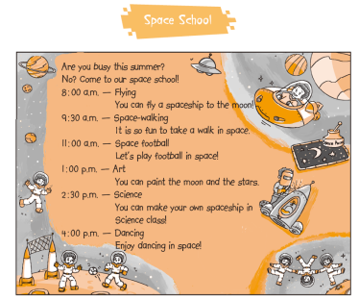
Homework
1. Listen to and read Page 20.
2. Read “Space School”
and draw a mind map.
3. Look up the timetables
in another 2 foreign countries.

