Slide 1
Unit 2
Neighbours
Grammar
WWW.PPT818.COM

Slide 2
They will take them to the shopping mall.

Slide 3
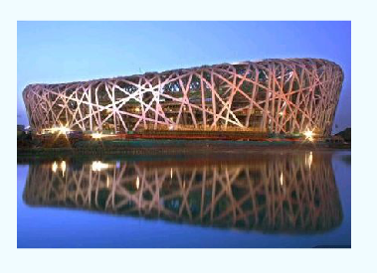
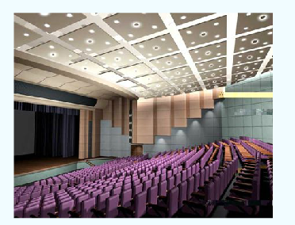
They will take them to the sports centre.
They will take them to the cinema.

Slide 4
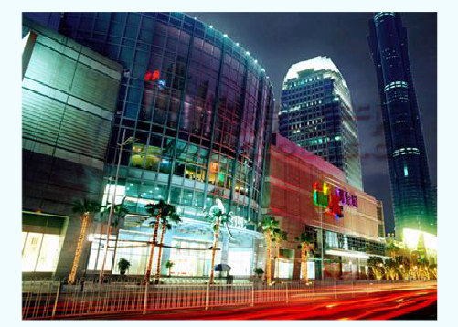
Will they take them to the shopping mall?
Yes, they will .

Slide 5
Will they play badminton at the cinema?
No, they won’t.

Slide 9
We make positive and negative sentences using the simple future tense like this.
I/We | will (not) / shall (not) | go.
He/She/It/You/They | will (not)
We ask questions using the simple future tense like this:
Will/Shall | I/We | go?
Will | He/She/It/You/They
We answer questions using the simple tense like this:
Yes, | I/we | will/shall.
 | he/she/it You/they | Will.
No, | I/we | will not/shall not.
 | he/she/it You/they | will not.

Slide 10
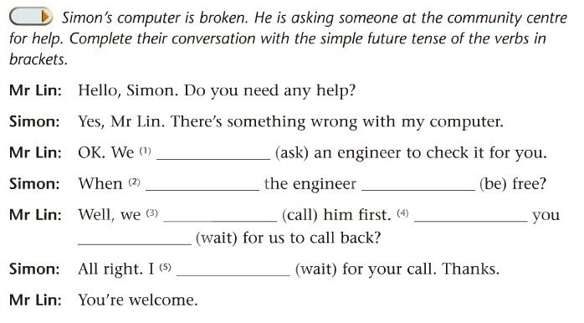
will/shall ask
will be
will/shall call
Will
wait
will/shall wait

Slide 11
will/shall + do通常用来谈论未来会发生的事或是 正在制定的计划。
will not = won’t
shall not = shan’t
I will / shall = I’ll
will用于一切人称，shall只用于第一人称(I/we)。Shall we/I用于提出建议或请求。
Shall I go home now? (请求）
Shall we take different routes? (建议）

Slide 12
Discussion
If I cannot find the way, what shall I do?
If your mother is tired, what’ll you do?
If you are ill, what’ll your best friend do?

Slide 13
I am going to visit the Great Wall.
= I will visit the Great Wall.

Slide 14
What is your mother going to do?
She’s going to visit the Summer Palace.

Slide 16
Talking about the future with “be going to”
We can use “be going to” when we talk about：
1、fixed plans for a certain time in the near future.
I’m going to take another route.
She is going to visit her grandmother next Friday.
谈论在一个较近的未来某一时间计划好要发生的事情
2、things that will probably happen.
It’s so cloudy. I think it’s going to rain.
We are going to win the game. The other team is not strong at all.
谈论有依据判断的未来很有可能发生的事情

Slide 17
We ask and answer questions with ‘be going to’ like this:
Am | I | Going to | see the doctor tomorrow?
Are | You/we/they
Is | he/she/it
Yes, | I | am.
 | You/we/they | are.
 | he/she/it | is.
No, | I | am not.
 | You/we/they | are not/aren’t
 | he/she/it | is not/isn’t.

Slide 18
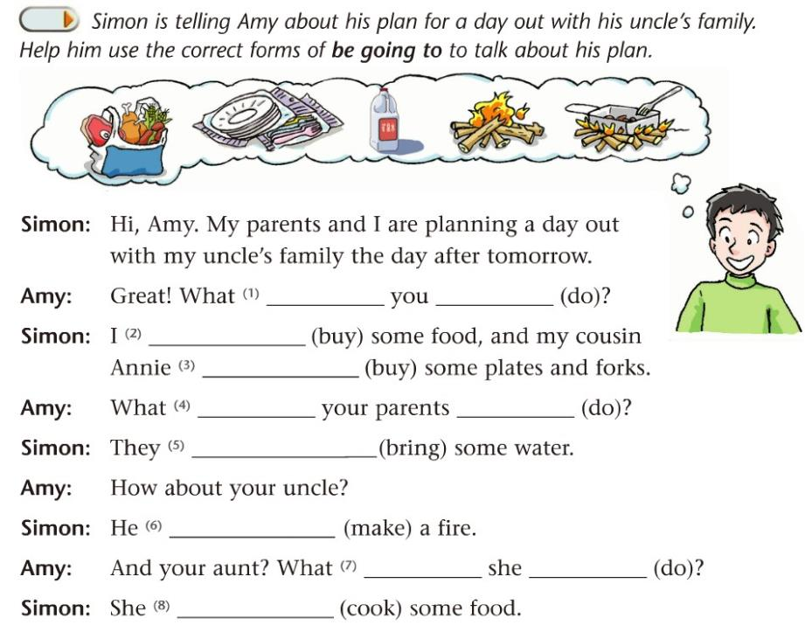
are going to do
am going to buy
is going to buy
are going to do
are going to bring
is going to make
is going to do
is going to cook

Slide 19
Language points
Amy is going to bring water.
take和bring
take v.“拿走”指把某物从说话人所在的地方取走，带走。
bring v.“带来”指把某物带到说话人所在的地方,如：

Slide 20
【结论】
1). take和bring都是动词，都有“拿、带”的意思，都可以与介词 ___ 连用，表示“把……带（拿）到……”。
2). take常与第____人称、副词“___________”一起使用。
3). bring常与第____人称、副词“___________”一起使用。
to
三
away/ there
一
here

Slide 21
【运用】
请根据句意用bring或take填空。
1). ______ your brother here tomorrow, please.
2). The teacher asks Paul to ____ those books away.
3). ____ this yellow jacket there and _____ me that blue one.
Bring
take
Take
bring

Slide 22
Work in pairs
What are you going to do for old people this Sunday?
What’s your father / mother / going to do for your neighbours tomorrow?
What are you going to do for poor children the day after tomorrow?
What’s your father / mother to do for your community next week?

Slide 23
Read the table below and ask and answer questions in group of four.
Name | Activity
All of them | Have a big dinner together
Daniel | Buy a computer magazine
Sandy | See a film
Kitty and Millie | Visit some old people near the school

Slide 24
Discussion
Are you going to have any activities this weekend? Please discuss this in group of four and complete the table.
Name | Activity
S1
S2
S3
S4

Slide 25
一般将来时
THE SIMPLE FUTURE TENSE

Slide 26
一、一般将来时的意义： 用来描述一个即将要发生的动作；谈论未来的计划和打算。
二、一般将来时的基本结构：
will/shall＋动词原形
be going to＋动词原形

Slide 27
三、常见时间状语：
next Tuesday
next week
the coming Sunday
next year
this afternoon
tomorrow
tonight
in a few minutes
in the future
in five years

Slide 28
四、一般将来时在使用中的一些注意事项：
1、will用于一切人称，shall只用于第一人称(I/we)。但现代英语倾向于所有人称都使用will而不用shall，shall主要出现在非常正式的英语场合中，或用于口语提出建议或请求。如：
Shall I go home now? (请求）
Shall we take different routes? (建议）

Slide 29
四、一般将来时在使用中的一些注意事项：
2、will/shall+do通常用来谈论未来会发生的事或是正在制定的计划；而be going to ＋do通常用来谈论在一个较近的未来将要发生的计划中的或是有可能发生的事。如：
They will see us if we go out at the moment.（未来会发生的事）
They will take different routes to the same destination.（正在制定的计划）
My uncle is going to visit us next month.（在一个较近的未来将要发生的计划中的事）
I think it’s going to rain.（有可能发生的事）

Slide 30
四、一般将来时在使用中的一些注意事项：
3、will /shall do相对较为正式，常用于书面语，表示一个相对较远的未来；be going to do常用于口语中，表示一个相对较近的未来。如：
I’m going to Beijing tomorrow.(较近未来）
There’ll be no living things on the earth if people don’t protect the environment. (较远未来）

Slide 31
四、一般将来时在使用中的一些注意事项：
4、be going to do 用于表示计划、打算去做某事（强调主观意愿）；还可以表示根据事实情况极有可能发生的事。如：
I’m going to take another route.(计划）
It’s so cloudy. I think it’s going torain.
(根据事实极有可能发生）

