Slide 1
Unit 7
International charities
WWW.PPT818.COM

Slide 2
Passive Voice

Slide 3
Translate the following sentence into Chinese.
1. The plane is also used as a training center.
2. Also, local doctors and nurses are invited on board to learn about eye operations.
3. 150 patients are operated on.
is/are + done(过去分词)

Slide 4


被动语态的基本用法
None of the books is taken away.
没有一本书被拿走。
The toy is designed for children.
这款玩具是为孩子们设计的。
当不知道主语是谁或强调动作常用被动语态。

Slide 5
Mr Lin organizes activities for the Computer Club.
主语
谓语
宾语
Activities are organized by Mr Lin for the Computer Club.
主语
谓语
宾语
谓语由主动变被动时，在被动结构后加by

Slide 6
On the plane, volunteer doctors do operations.
On the plane, operations are done by volunteer doctors.
ORBIS doctors improve the lives of patients.
The lives of patients are improved by ORBIS doctors.

Slide 7

The Class 1, Grade 8 students are talking about the different things people can do for the poor. Look at the pictures and help them complete their notes using the words in brackets and the passive voice. Add the word by when necessary.

Slide 8


What they do every year
1. Charity activities _________________________ (plan/to help the poor).
are planned to help the poor

Slide 9
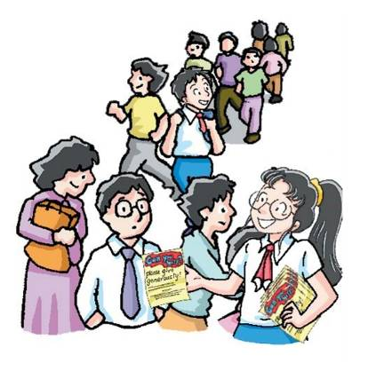

Leaflets _______________________ ___________________________ (hand out/to people in the street/ volunteers).
are handed out to people
in the street by volunteers

Slide 10
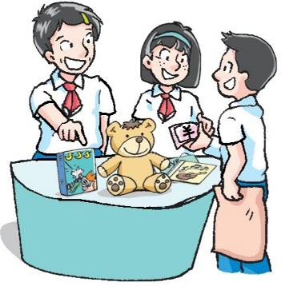

Toys and CDs _____________________
(sell/to raise money).
are sold to raise money

Slide 11
被动语态的基本用法
His eye problem was cured last month.
他的眼睛问题上个月治愈了。
Many blind people were helped by
ORBIS doctors.
许多盲人得到奥比斯医生帮助。
was/were + done(过去分词)

Slide 12

Nancy Jackson designed that CD-ROM.
主语
谓语
宾语
The CD-ROM was designed by Nancy Jackson.
主语
谓语
宾语
把主动变成被动需注意什么？
主动和被动时态一致原则

Slide 13
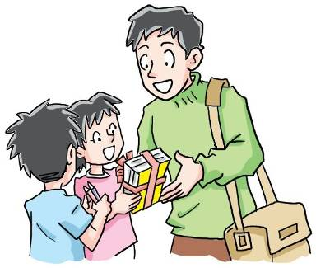

What they did last week
New books _________________________ __________________________________ (send/to children in poor areas/the Class 1, Grade 8 students).
were sent to children in poor
areas by the Class 1, Grade 8 students

Slide 14
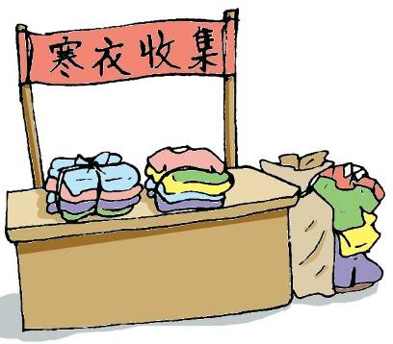

Warm clothes __________________________ (collect/for poor people).
were collected for poor people

Slide 15


A charity show _____________________________ (hold/the Students’ Union).
was held by the Students’ Union

Slide 16

一般现在时
am/is/are+过去分词
被动语态
一般过去时
was/were+过去分词

Slide 17


Amy and Daniel are talking about charities. Complete their conversation with the words in brackets using the passive voice.
Amy: I’m reading a book about Oxfam.
Daniel: Really? Please tell me about it.

Slide 18
was set up
Amy: OK. Oxfam ___________ (set up) in the UK in 1942, and the first Oxfam shop __________ (open) in 1948. Now it has about 15,000 shops in all over the world. A lot of things _________ (sell) in Oxfam shops, including books. The money _______ (use) by Oxfam to help poor people.
was opened
are sold
is used

Slide 19


Daniel: That’s good. There are also some charity projects in China. One of them ________ (call) Project Hope. It __________ (start) in 1989. With its help, millions of poor children all over the country __________ (give) basic education.
is called
was started
are given

Slide 20

Amy: Yea. Many schools __________ (build) in poor areas each year.
are built

Slide 21

1. Today English _______ all over China.
A. teach B. teaches
C. is taught D. are taught
2. The meeting _______ two weeks ago.
A. hold B. was held
C. were held D. is held
3. The thief ________ by the police last night.
A. caught B. is caught
C. was caught D. were caught

Slide 22
4. The photos _______ when I was young.
A. were taken B. was taken
C. are taken D. is taken
5. Millie is my best friend. I ___ often ____ to her party.
A. is invited B. am invited
C. are invited D. was invited
6. Last year Beijing ____ by a big sandstorm.
A. is hit B. were hit
C. will be hit D. was hit

Slide 23

7.You can go out if your homework ______.
A. is done B. will do
C. will be done D. are finished
8.We found the ground ____ snow.
A. cover with B. is covered with
C. was covered with D. was covering

Slide 24
. 用动词的被动语态填空:
English ____________(speak) by many people.
The trees _______________(plant) by them last year.
build) two years ago.
This kind of That building __________( computers ________(make) in China.
is spoken
were planted
was built
is made

Slide 25
5.--Why didn’t you go to Jim’s birthday party?
--Oh. I______________(not invite)
6.--What do you want, sir?
--Could you tell me if computers_______
(sell) in this shop ?
--When ______ the bridge ______(build)?
--Two years ago.
wasn’t invited
are sold
was built

Slide 26
主被动句型转换
1. I bought a computer last week.
A computer was bought by me last week.
2. The whole cake was eaten by Eddie yesterday.
Eddie ate the whole cake yesterday.

Slide 27
3. Many trees are planted by students and teachers every year.
Students and teachers plant many tress every year.
4. She takes good care of the children.
The children are taken good care of by her.

Slide 28
1. Review the contents of this lesson.
2. Finish the exercises in the workbook.

Slide 29
Fill in the blanks with the Passive Voice.
1、Tea _______ (grow) in Fujian.
2、Chinese __________ (speak) in China.
3、The bed __________ (use) for sleeping.
4、Our classroom _________ (clean) every day.
5、The cars ________ (make) in Beijing.
is grown
is spoken
is used
is cleaned
are made

