Slide 1
Unit 8
Is there a post office near here?
R 七年级下册
第5课时
WWW.PPT818.COM

Slide 2
Review
1.post office __________________
2.next to __________________
3.in front of __________________
4.on the right/left __________________
5.look like __________________
邮局
挨着，靠近
在……前面
在右边 / 左边
看起来像

Slide 3
6.between…and… __________________
7.be free __________________
8.watch sb. doing sth. __________________
9.enjoy reading __________________
10.警察局 __________________
11.付费电话 __________________
在……和……之间
免费/有空
观看某人正在做某事
喜欢阅读
police station
pay phone

Slide 4
12.在……对面 __________________
13.打扰了，劳驾 __________________
14.离……远 __________________
15.向右/ 左转 __________________
16.沿着……走 __________________
17.花时间 __________________
across from
excuse me
far from
turn right/left
go along
spend time

Slide 5
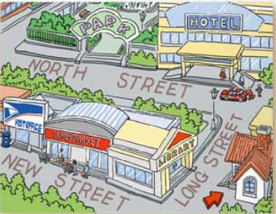
Look at the map of Cindy’s neighborhood and fill in the blanks.
3a
My house is across from a
___________ on Long Street.
I usually go shopping at a
___________ near my house.
It is between a ___________
and the ___________. On
library
supermarket
post office
library

Slide 6
weekends, I like to play in the ___________. To get there, I go along Long Street and turn left on North Street. It is on the
right, next to a ___________.
park
hotel

Slide 7
Draw a map of your neighborhood and write about it. These questions may help you.
3b
1.Where do you live?
2.What is your favorite place in your neighborhood?
Why?
3.How do you get there from your home?

Slide 8
思路点拨：
1.先画好地图，标明主要的街道及建筑物。
2.尽量运用there be 句型。
3.正确使用方位介词及指路的短语。
4.叙述要有条理。

Slide 9
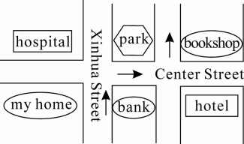
范文欣赏：
Look! This is a map of my
neighborhood. My house is
across from a bank on Xinhua
Street. There is a park, a hospital and a bookshop near my house. I usually take a walk at the park. It’s between the hospital and the bookshop.

Slide 10
My favorite place is the bookshop. It’s very quiet and I enjoy reading there. On weekends I usually buy books and read at the bookshop.
To get there, I walk along Xinhua Street and turn right at the first crossing. Then walk along Center Street and turn left at the second crossing. The bookshop is on the right.

Slide 11
Self Check
1. Complete the passage with the words in the box.
spend free climb enjoy
I am very busy on school days，but I have some _______ time on weekends. I like to spend time with my grandparents on Sundays. My grandma makes
free

Slide 12
spend free climb enjoy
enjoy
the foods I like. And I _______ playing Chinese chess with my grandpa. He’s very good at it! We also like to sit and talk. We sometimes watch the neighbors’ cats _______ the trees. It’s relaxing to _______ weekends like this. I love my grandparents!
climbing
spend

Slide 13
2. Write five sentences about your school using there is/are.
There are some trees in my school.
________________________________________________
________________________________________________
There is a park next to my school.
There are some pay phones in front of my school.

Slide 14
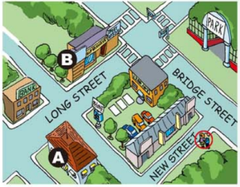
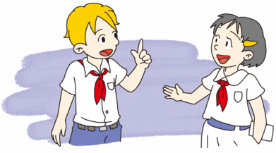
3. Imagine you are one of the people in the picture on page
46.A person asks you how to get to the supermarket or
library. Write a conversation.

Slide 15
Yes. How can I help you?
Hi, excuse me.
Is there a supermarket neat here?
Yes, there is. Go along…

Slide 16
Exercise
1. 这附近有餐馆吗？ 是的，邮局的前面有一个。
— ______ there ______ restaurants near here?
— Yes, ______ one ______ ______ ______ the post office.
2.公园在哪里？ 它在银行对面，旅馆的后面。
— _________ the park?
— It’s ______ ______ the bank, ______ the hotel.
Are any
there’s in front of
Where’s
across from behind

Slide 17
3.沿着新街走。在第一个十字路口向右拐。
Go ______ New Street. Turn right _______ _______
_______ ________.
4.我喜欢看猴子们爬来爬去。
I love ______ ______ the monkey ________ around.
along
at the
first crossing
to watch climbing

Slide 18
5.要去公园的话，你只要穿过中心街就到了。
To ______ ______ the park, you just ______ ______
______ Center Street.
6.当我读书时，时间过得飞快！
______ I read books, time ______ ______!
get to have to
cross
When goes quickly

