Slide 1
初中英语外研版七年级下
Module4 Life in the future
Unit 2
Every family will have a small plane
WWW.PPT818.COM

Slide 2
Warm-up
1
Presentation
2
Language Points
3

Slide 3
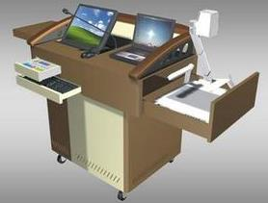
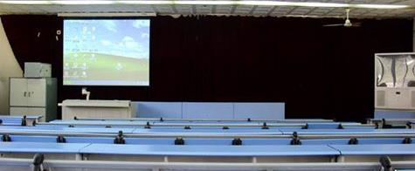
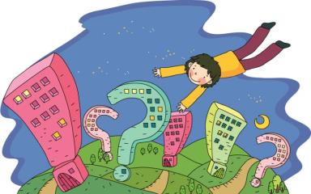
Warm-up
讨论一下十年后咱们学校的样子吧：

Slide 4
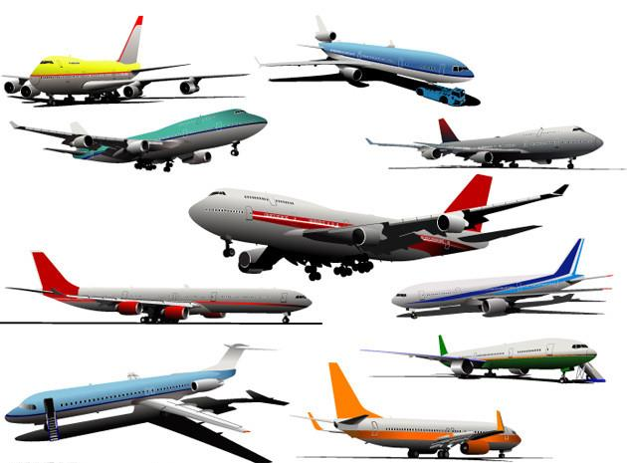
小组活动——展开联想的 ~翅膀~
讨论一下人手一架小飞机的样子吧：

Slide 5
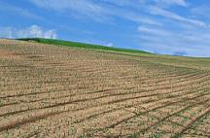
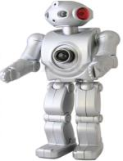
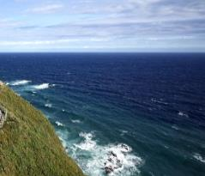
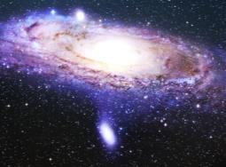
Presentation
air n. 天空；
空中；空气
rain n.雨；
雨水 v.下雨
land n. 陆地
space n. 太空；
空间
robot n. 机器人
sea n. 海；海洋

Slide 6
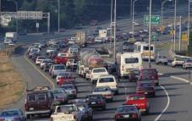
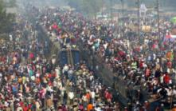
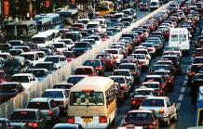
traffic n. 交通
jam n. 堵塞；
拥挤
traffic jam
交通堵塞
true adj. 真的；真实的
come true (希望、梦想等)实现，成真

Slide 7
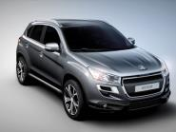
bike(= bicycle)
n. 自行车
car n. 汽车；轿车
wind n.风
hour n.小时

Slide 8
Look at the pictures and describe what you see. Use the words and expression from the box to help you.
air land job machine rain robot sea space traffic jam wind

Slide 9
Read the passage and match the pictures in Activity 1 with the paragraphs
B
A
C
D

Slide 10
Match the paragraphs with the headings.
B
Weather [ ]
2. Clothes [ ]
3. Jobs [ ]
4. Travel [ ]
A
D
C

Slide 11
Check (√ ) the true sentences.
( ) 1. People have to change clothes in hot
weather.
( ) 2. The weather will be warm in spring.
( ) 3. A lot of people will travel by plane so
maybe there will be traffic jams in the air.
( ) 4. People will have long holidays
because machines will do heavy work.
×
√
√
√

Slide 12
Complete the passage with the correct form of the words from the box.
air cheap everywhere
into rise true

Slide 13
Will travel in the future be expensive?
No, it’ll be (1) _______. We’ll travel (2)
____________ by plane. We’ll be able to
(3) _____ over the traffic jams on the
land, and we’ll be able to go (4) _____
space. But maybe there’ll be traffic jams
in the (5) ____ too. What do you think?
Do you think this idea about life in the
future will come (6) _____?
cheap
everywhere
rise
into
air
true

Slide 14
Match the words with their opposites. Use the passage in Activity 2 to help you.
easy expensive hot large light long warm
cheap cold cool difficult heavy short small

Slide 15
Pair Work
Talk about life in the future.
— I think everyone will have a
small plane so travelling will be easy.
— Yes, but I think there will be traffic
jams in the air.

Slide 16
Language points
here is/are... （用于介绍某人或某物）“下面”
如果后面跟的是复数名词，就用 is, 如后面跟
的是单数名词，就用 are。常常翻译成“这儿是......”或“这儿有......”。例如：
Here is a pen. 这儿是一支钢笔。
Here are some students. 这儿有一些学生。
注意单数时与 This is a ... 的差别，试比较：
Here is a pen. 这儿是一支钢笔。
This is a pen. 这是一支钢笔。

Slide 17
not only ... but also ... 不仅......，而且......
当 not only … but also 连接的两个成分作
主语时，谓语动词要与其最近的主语在人
称和数方面保持一致。例如：
Not only the students but also the teacher likes the sea.
Not only the teacher but also the students like the sea.

Slide 18
not only ... but also ... 不仅......，而且......
小贴士：
1. not only … but also 中的 not only 不能分开使用，but also 可以。
2. not only … but also 连接两个并列成分时，可以省略 but 或 also，也可以把 but also 都省略掉。

Slide 19
The sea level will rise as well.
海平面也会升高。
句中的 “as well”表示“也，又”，常用于句子末尾。例如：
The little girl sings, and plays the piano as well. 这个小女孩既会唱歌，又会跳舞。
He can speak English, and speak Chinese as well.
他既会说英语，又会说汉语。

Slide 20
Writing
Look at the sentences, complete the sentences with so.
例：
Working hours will be short. People will have long holidays.
Working hours will be short so people will have long holidays.

Slide 21
1. Everyone will have a plane so ...
2. The weather will get hot so ...
3. Machines and robots will do the
heavy and difficult jobs so …

