Slide 1
Unit 2 Topic 1
You should see a dentist.
Section B
WWW.PPT818.COM

Slide 2
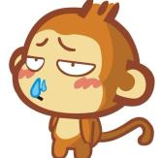
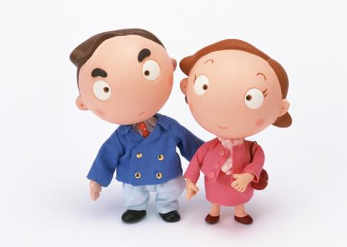

Ask and answer
He has a cold.
What’s wrong with him?
He should drink more water.

Slide 3
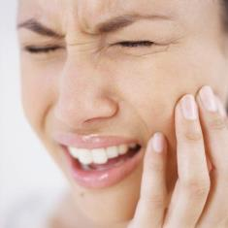
Ask and answer
She has a toothache.
What’s wrong with her?
She shouldn’t eat too much chocolate.

Slide 4
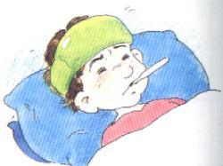
Ask and answer
He has a fever.
What’s wrong with him?
He had better see a doctor.
最好做某事

Slide 5
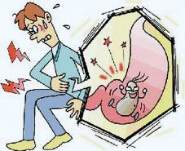
Ask and answer
He has a stomachache.
What’s the matter with him?
He ____________ drink cold water.
had better not
最好不要做某事

Slide 6
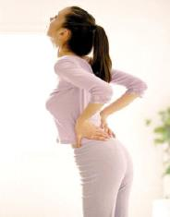
Ask and answer
She has a backache.
What’s the matter with her?
She ____________ lift heavy things.
had better not

Slide 7
Pair work
For example:
A: What’s wrong with you?
B: I have a headache. /...
A: You should/shouldn’t/
had better/had better not ...

Slide 8


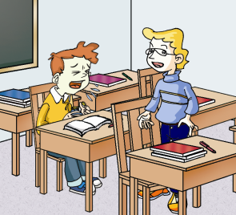
1a
Look, listen and say.
A: Hey, Bruce. You don’t look well. What’s the matter?
B: Well, I’m feeling terrible! I have a headache and a cough.
A: I’m sorry to hear that. How long have you been like this?
B: Two days.
A: You may have the flu. You’d better take
some medicine.
B: I think I will.
A: Shall I take you to the hospital?
B: No, thank you. I’ll go home and
have a rest.

Slide 9



1b
Listen to 1a and choose the correct
answers.
1. —What’s wrong with Bruce?
— He has _____.
A. a toothache B. a fever C. a headache and a cough
2. What’s Steve’s suggestion？
A. Seeing a doctor.
B. Taking some medicine.
C. Going home and rest.

Slide 10
1c
Listen again and mark T(True)or F(False).
Steve looks well. ( )
Bruce has been ill for two days. ( )
Steve will take Bruce to the hospital. ( )
Bruce will take some medicine. ( )
T
T
F
T

Slide 11
Read 1a and fill in the blanks.
A: Hey, Bruce. You don’t look well. What’s the _______?
B: Well, I’m feeling terrible! I have a _________ and a ______.
A: I’m sorry to hear that. ____ _____ have you been ____ this?
B: Two days.
A: You may have the flu. You’d ______ take some medicine.
B: I think I will.
A: Shall I ______ you to the hospital?
B: No, thank you. I’ll go home and have a rest.
matter
headache
cough
How
long
like
better
take

Slide 12
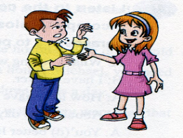
Number the sentences to make up a conversation similar to 1a.
2
1
How are you feeling, Nick?
I have a terrible cold. I cough day and night.
Not so well. I don’t feel like eating.
OK. Thank you.
I’m so sorry to hear that. Why don’t you have a good rest? You’d better not go to school today.
What’s wrong?
4
2
6
5
3

Slide 13

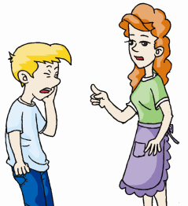
3
Pair work
Make conversations after the example.
Example:
What’s wrong/the matter with you?
I have a toothache.
You shouldn’t eat too much candy. / You should brush your teeth twice a day.

Slide 14


I have He/She has | the flu. a fever. a toothache. a stomachache. a backache.
New words and phrases can be learnt better if you make your own meaningful sentences with them.
You He/She | had better should had better not shouldn’t | lie down and rest. see a dentist. drink lots of boiled water. drink cold water. work too long. eat too much candy. eat hot food.

Slide 15
Find the right advice.
Practice
I have a sore throat.
1. You should eat hot food.
2. You’d better drink cold water.
3. You’d better drink hot tea with honey.

Slide 16
Practice
Find the right advice.
I have a toothache.
1. You’d better work too long.
2. You’d better see a dentist.
3. You should drink lots of boiled
water.

Slide 17
Practice
Find the right advice.
I have the flu.
1. You’d better not drink boiled
water.
2. You’d better see a dentist.
3. You should lie down and rest.

Slide 18
Practice
Find the right advice.
He has a fever.
1. He’d better drink lots of boiled
water.
2. He’d better see a dentist.
3. He should not drink lots of
boiled water.

Slide 19
Practice
Find the right advice.
She has sore eyes.
1. She’d better eat hot food.
2. She should not work on the
Internet so long.
3. She should drink lots of cold water.

Slide 20
Practice
Find the right advice.
She has a stomachache.
1. She’d better drink cold water.
2. She should not eat hot food.
3. She should brush her teeth
twice a day.

Slide 21
Read the pairs of words and pay attention to the difference between /i:/ and /eI/.
4a
/i:/-- /eI/
fever----favor
feel----fail
see----say
week----wake

Slide 22
4b
Listen to the conversation, paying attention to the weak form and incomplete plosion. Read after the tape and imitate, then use the phrases in 3 to practice.
A: What’s wrong with you?
B: I have a fever.
A: How long have you been like this?
B: Abou(t) two days.
A: You’(d) better lie down an(d) have a rest.

Slide 23

Exercises
Fill in the blanks according to the pictures.
You shouldn’t eat so much candy.
I have _________.
a toothache
You _________ brush your teeth twice a day.
should/had better

Slide 24
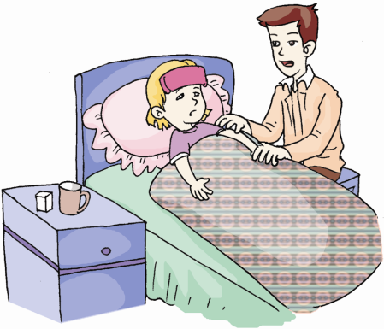
should/had better
You _________________ stay in bed and have a good rest.
I have a fever.
You _________________ drink lots of boiled water.
should/had better

Slide 25
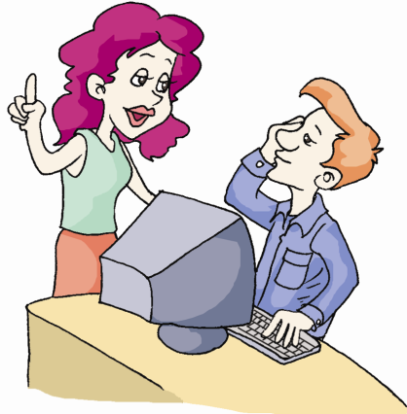
shouldn’t/
had better not
You ____________ work on the Internet so long.
I have sore eyes.
You _________________ take good care of your eyes.
should/had better

Slide 26
Summary
Give advice:
1. should do
You should have a good rest.
2. had better do
You had better go to see a doctor.
3. shouldn’t do
You shouldn’t eat too much candy.
4. had better not do
You’d better not work too long.

Slide 27
Exercise
单项选择
C
1. — _________, young man?
— I have got a cough.
A. What’s the matter to you
B. What’s wrong you
C. What’s the matter
D. What have you get
2. — Do you like drinking ____ water?
— Yes, I think it’s good for health.
A. boil B. boils C. boiled D. to boil
C

Slide 28
3. You’d better ___ to bed early.
A. going B. goes C. go D. to go
4. You give me _____ help.
A. much too B. quite too
C. to D. too much
5. You shouldn’t read _____. It’s bad for your eyes.
A. to too long B. for too long
C. at too long D. about too long
6. I have _____ flu. I should see a doctor at once.
A. a B. / C. the D. an
C
D
B
C

Slide 29
Homework
Make more sentences with “should/shouldn’t /had better/had better not”.

