Slide 1
Unit 3 Look at my nose.
精通版·三年级上册
WWW.PPT818.COM

Slide 2
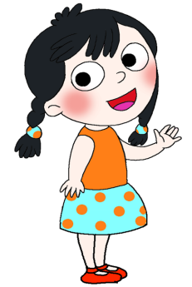
Lead-in
Do you know?
eye
nose
mouth
ear

Slide 3
head
neck
hand
arm

Slide 4
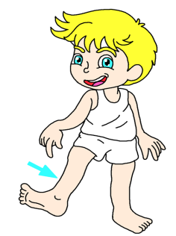
New words
leg
腿

Slide 5
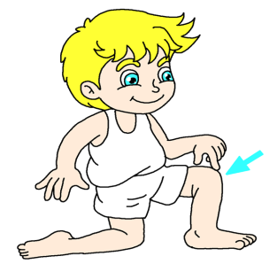
knee
膝盖

Slide 6
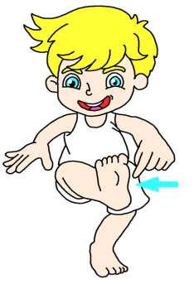
foot
脚

Slide 7
Let's chant
Leg, leg, touch your leg.
Knee, knee, look at my knee.
Foot, foot, this is my foot.

Slide 8
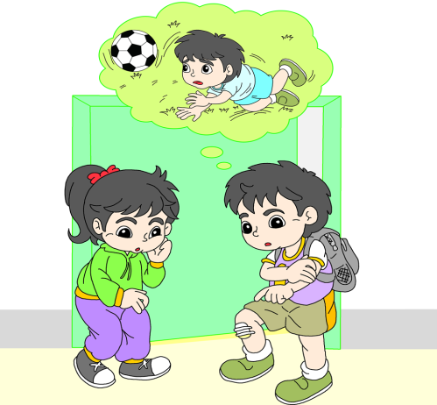
Just talk
Not so well. Look at my leg!
How are you, Gao Wei?
Oh no! I’m sorry!

Slide 9
Groupwork(小组活动)
1、朗读对话。 四人小组分角色朗读对话，分工明确、表演出色的小组为本组赢得一枚小贴画。
2、表演对话。四人小组分角色表演对话，分工明确、表演出色的小组为本组赢得两枚小贴画。

Slide 10
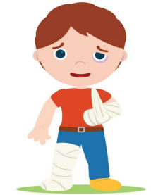
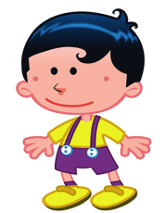
Play roles
Not so well. Look at my arm and leg!
How are you?
Oh no! I’m sorry!

Slide 11
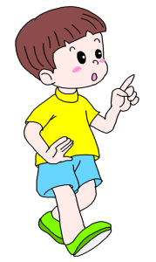
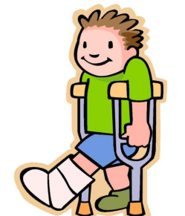
How are you?
Not so well. Look at my foot!
Oh no! I’m sorry!

Slide 12
Groupwork(小组活动)
创编对话：
小组运用 How are you? Not so well.Look at my ___.句型询问答他人身体状况。分工明确、表演出色的小组为本组赢得三枚小贴画。

Slide 13
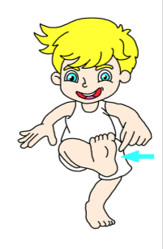
Can you guess?
Which part of body is it?
foot

Slide 14
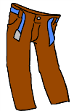
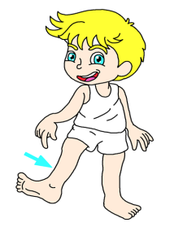
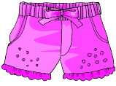
leg

Slide 15
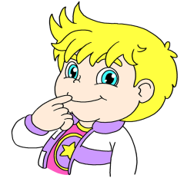
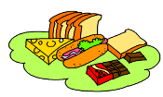
mouth

Slide 16
Homework(作业)
1、把今天所学的对话读给爸爸、妈妈或同学听。
2、读会单词：leg, knee和foot。

