Slide 1
连加连减及
加减混合
WWW.PPT818.COM

Slide 2
连加 连减
5 + 2 + 1
= 8
7

Slide 3
8 - 2 - 2
= 4
6

Slide 4
先摆一摆，再填数。
?
1
8
5
2
4 + 3 + =
10 - 3 - =

Slide 5
1.
2 + 3 =
5
5 + 4 =
9
9
2 + 3 + 4 =

Slide 6
2.
4
2
9
3 + + =

Slide 7
3.
3 + 4 + 1 =
2 + 2 + 4 =
4 + 3 + 2 =
8
8
9
7 + 2 + 1 =
6 + 4 + 0 =
5 + 0 + 3 =
10
10
8

Slide 8
4.
8 辆
2
2
8 - 4 - =

Slide 9
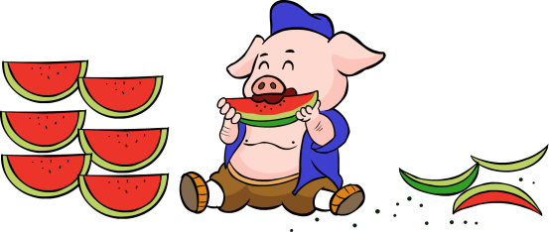
10 块
1
6
10 - 3 - =

Slide 10
5.
8 - 5 - 3 =
9 - 5 - 4 =
10 - 6 - 2 =
0
0
2
5 - 2 - 1 =
10 - 2 - 7 =
8 - 0 - 6 =
2
1
2

Slide 11
6. 填上数，使横行、竖行的三个数相加都得 9。
1
2
3

Slide 12
加 减 混 合
4 + 3 - 2
= 5
7

Slide 13
4 - 2 + 3 =
5
2

Slide 14
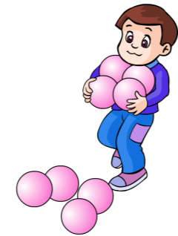
7 - + =
3
4
8

Slide 15
1.
+
-
6 =
3
4
5

Slide 16
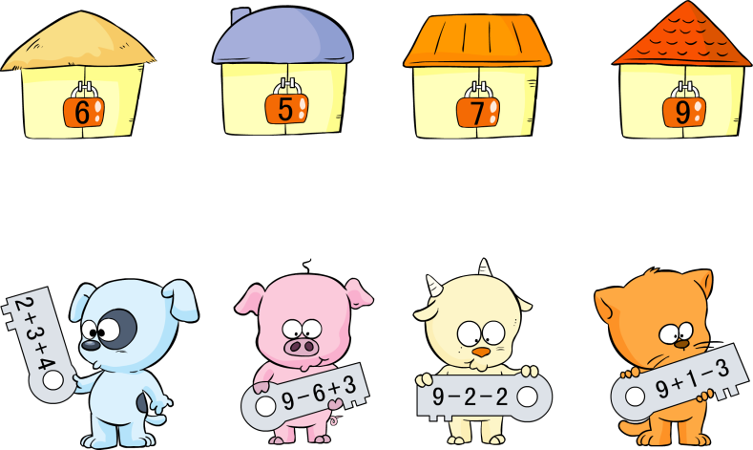
2.

Slide 17
3.
1 + 4 + 5 =
10 - 4 - 4 =
7 - 6 + 5 =
10
2
6
2 + 7 + 1 =
8 - 1 - 3 =
2 + 6 - 4 =
10
4
4

Slide 18
4.
4 + 3 + =
2
9
6 - + =
2
3
7

Slide 19
5. 横行、竖行上的三个数相加，各得多少?
3
( )
( )
( )
1 | 6 | 3
4 | 2 | 2
3 | 1 | 5
2
1
5
( )
4
( )
( )( )( )

Slide 20
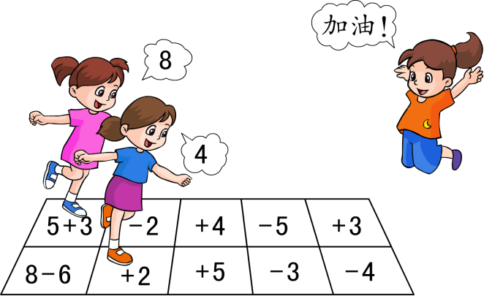
6.

Slide 21
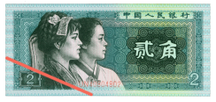
要拿出 8 角钱，你能想出几种拿法?
2 角+ 2 角+ 2 角+ 2 角= 8 角
5 角+ 1 角+ 1 角+ 1 角= 8 角
5 角+ 2 角+ 1 角= 8 角
······

