Slide 1
Unit2 This is my pencil.
人教精通版三年级上册
WWW.PPT818.COM

Slide 2
Let’s sing
Warm-up

Slide 3
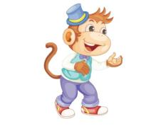
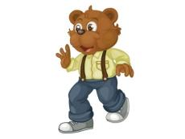
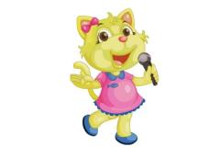
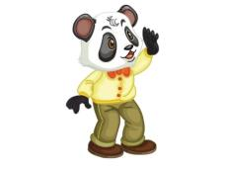
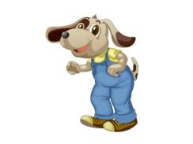
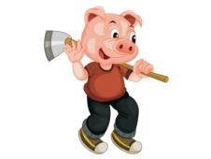
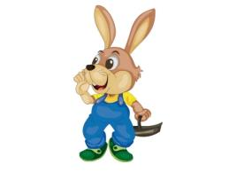
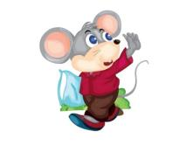
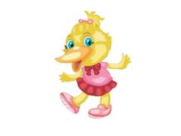
Review
你能说出下列动物的英文表达吗？

Slide 4
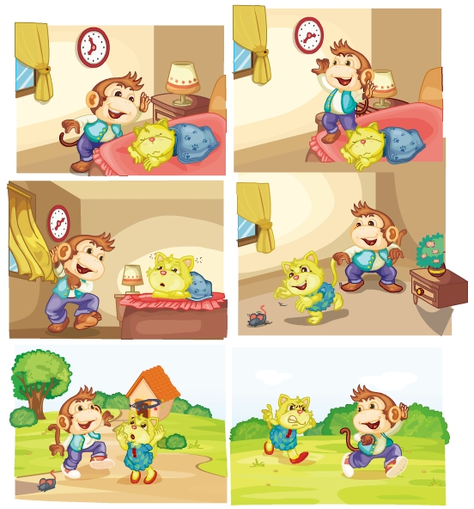
Review
Let’s act!
Hi! Good morning, Cat!
Hello! Good afternoon, Cat!
Good evening, Cat!
Look! A mouse!
Oh, a mouse!
Ha-ha! Good morning!
Who are you?
I’m Monkey! Goodbye!

Slide 5
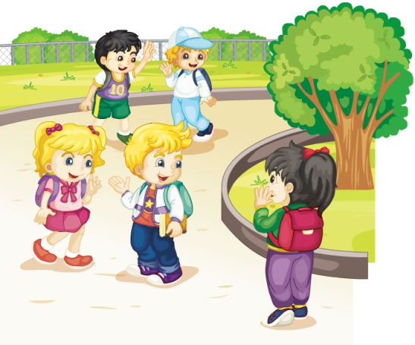
Presentation
Look and say
Who are they? Do you know their names?
(他们是谁？你知道他们的名字吗？)
Kate
Peter
Li Yan

Slide 6
Presentation
Look, listen and think
Peter是如何介绍 Kate给Li Yan的？
Hi, Li Yan. This is Kate.

Slide 7
Presentation
Look, listen and think
Kate 和 Li Yan分别说了什么？
—Glad to meet you.
—Glad to meet you, too.

Slide 8
Presentation
Listen and imitate
Glad to meet you.
Hi, Li Yan. This is Kate.
Glad to meet you, too.

Slide 9
Show time
三人一组，练习对话并表演，其他同学评价。
 | 模仿录音中的语音语调，有感情地朗读。
 | 可以脱离课本，适当改动其中部分，语音地道。
 | 适当添加内容，意思完整，有创新，表演生动。
Good
Great
Excellent

Slide 10
Presentation
Just learn
book
This is a book.

Slide 11
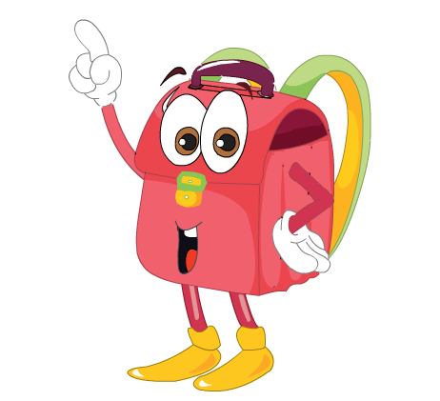
Presentation
Just learn
bag
This is a bag.

Slide 12
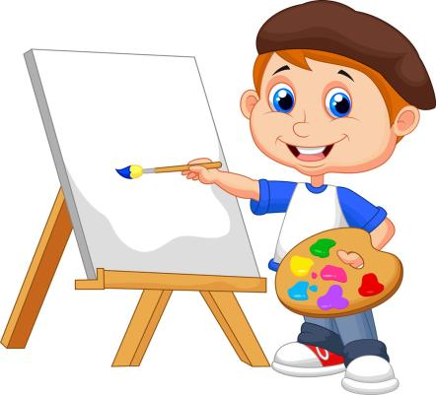
Practice
Draw and write

Slide 13
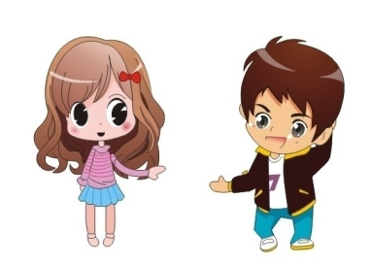
Practice
I say you do
Show me your bag.
Show me your book.

Slide 14
Practice
Let’s sing and play

Slide 15
Summary
本课学到的学习用品类单词有:
book
bag

Slide 16
Summary
如何介绍别人并相互问候？
—Hi, Li Yan. This is Kate.
—Glad to meet you.
—Glad to meet you, too.

Slide 17
Homework
1. 跟读Just talk部分的课文录音，注意语音、语调。
2.将本课所学的Let’s sing and play部分的歌谣唱给父母听。
3. 预习Lesson 8。
Close

