Slide 1
精通版三年级上册
Unit 3 Look at my nose.
WWW.PPT818.COM

Slide 2
The ABC Song

Slide 3
Unit 3 Look at my nose.
head
hands
hand
arm
legs
body
arms
leg
foot
feet

Slide 4
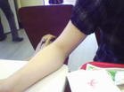
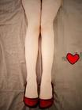
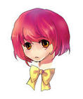
Unit 3 Look at my nose.
legs
arm
hand
foot
head

Slide 5
火眼金睛识单词
leg
head
arm
body
foot
hand

Slide 6
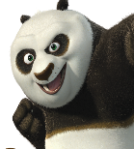
Look and answer the question:
What is it？
It`s a panda.

Slide 7
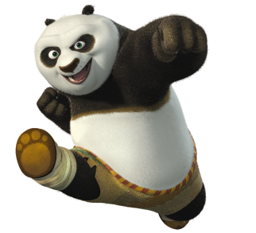
answer the question:
He is Panpan.
head
arm
hand
body
foot
leg
This is his ____.

Slide 8
Pairwork time:
This is my ____.
This is my ____.
This is ____ ____.
This is ____ ____.
This ____ ____ ____.
This is me.

Slide 9
Chant and Point:
Body, body, body. This is my body.
Head, head, head. This is my head.
Arm, arm, arm. This is my arm.
Leg, leg, leg. This is my leg.
Hand, hand, hand. This is my hand.
Foot, foot, foot, This is my foot.
STEP
05
STEP
STEP
01
04
STEP
STEP
02
03

Slide 10
Let`s review and
do action.

Slide 11
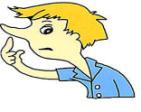
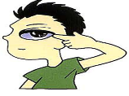
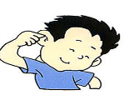
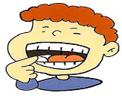
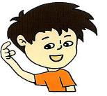
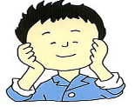
Touch your nose.
Touch your eye.
Touch your ear.
Touch your face.
Touch your mouth.
Touch your head.

Slide 12
Let`s sing!
Head and hands, arms and legs, feet and body.
Head and hands, arms and legs, feet and body.
Head and hands and arms and legs.
Head and hands, arms and legs, feet and body.

Slide 13
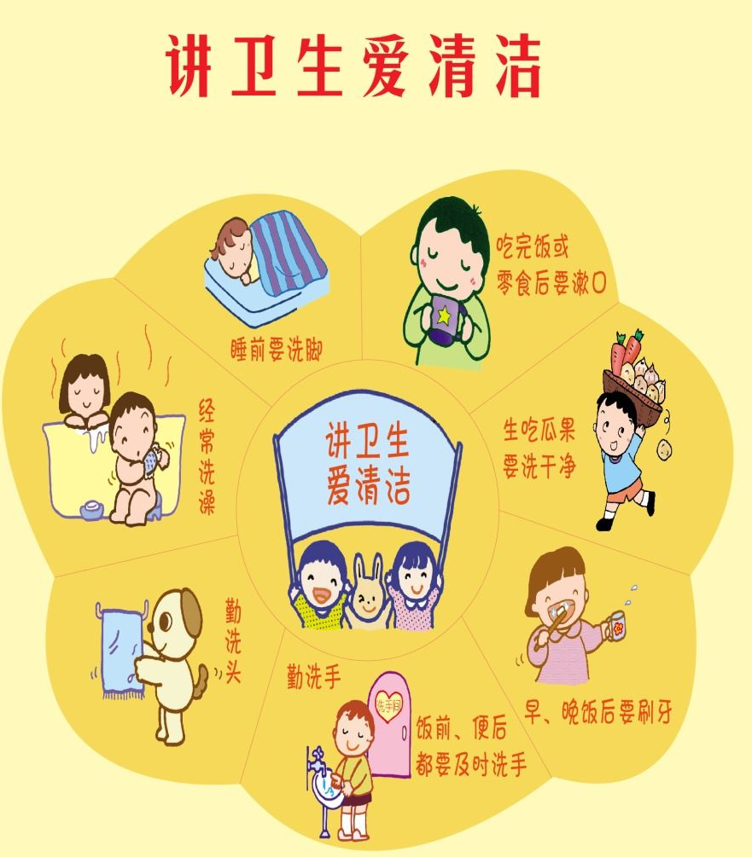
To be a healthy baby.

Slide 14
Homework:
Draw a picture of an animal and write
the parts of its body.
画一副动物图片，并且标出它的身体部位。

Slide 15
Thank you

