Slide 1
初中英语外研版八年级
Module6 Animals in danger
Unit 2 The WWF is working hard
to save them all.
WWW.PPT818.COM
Notes:
1

Slide 2
学习目标
1.通过限时快速阅读，能将标题与段落相匹配。
2.通过慢速扫读获取详细信息，完成阅读要求。
3.通过再次慢速扫读，完成本课思维导图，根
据思维导图复述课文。
4.模仿Activity2的文章，能写一篇关于一种濒危
动物的文章。

Slide 3
Play a guessing game
Notes:
3

Slide 4
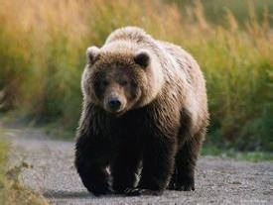
I live in the woods. I’m very big and furry. I have a big nose, a little tail and four legs. I like to eat fish and berries. I am a... ?
bear
Notes:
4

Slide 5
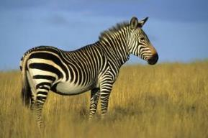
I look like a house, but my body is covered by black and white stripes.
zebra
Notes:
5

Slide 6
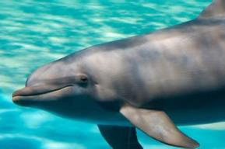
I am not a fish but look like a large fish and live in the sea. I am a warm-blood mammal.
dolphin
Notes:
6

Slide 7
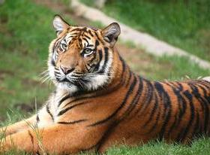
It’s the king of the animal world. It has yellow fur and black stripes(条纹) on its body.
tiger
Notes:
7

Slide 8
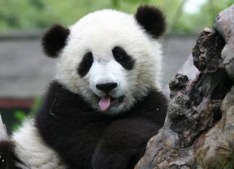
My favourite wild animal is very lovely. It looks like a bear. It likes eating bamboo. Most of them live in China. What it is?
panda
Notes:
8

Slide 9
Culture corner
It is the symbol(标志) for the World Wide Fund for Nature. It is an important environmental organization. It aims to build a future where people live in harmony with nature. It works on around 1,300 projects in over 100 countries, and has 5 million supporters.

Slide 10
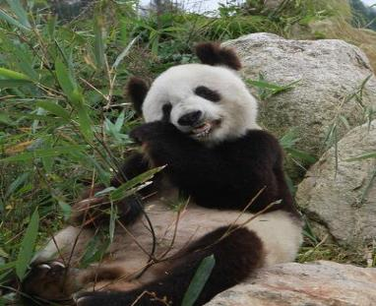
Say what you know about pandas.
habitat
problems
food

Slide 11
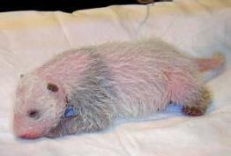
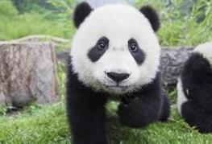
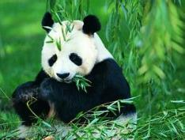
Pre-reading
Pandas live in the southwest of China. They look like white mice when they’re born. In the beginning, they drink milk. Six months later, they begin to eat bamboo. They live mainly on bamboo. Sadly, pandas face serious problems in the wild. They’re in danger. We must take action to protect them right away.
Notes:
11

Slide 12
Skimming
Match the headings with the paragraphs.
Paragraph 1
a) Nature parks for pandas
Paragraph 2
b) WWF and animals in danger
Paragraph 3
c) The panda’s home
Paragraph 4
d) An animal in danger
Notes:
12

Slide 13
Task1: Careful reading(Para.1&2)
Task1: Read Para.1&2 and answer.
1. How many pandas are there in the world?
2. What problems are scientists doing research to solve?
3. Where do pandas live?
4. Why are pandas losing their home?
There are about 1,940 pandas.
Pandas do not have many babies and baby pandas often die.
Pandas live in the forests and mountains of Southwest China.
Because each panda needs to eat a lot of bamboo every day and the bamboo forests are getting smaller.

Slide 14
What actions does the government take to protect pandas in the wild?
Notes:
14

Slide 15
Task2: Careful reading (Para.3)
Read Para.3 and fill in the blanks.
The government is_________________________ ____________________________________.
2. The nature parks will be_______ and there will be ___________________________.
3. Pandas born in zoos may_____________________ ___________________________________.
setting up nature parks and
developing other plans
big
more bamboo to feed the pandas
go back to live in
the nature parks
Notes:
15

Slide 16
Task3: Careful reading (Para.3&4)
Read Para.3&4 and do “F” or “T”.
1. The panda is the symbol of all animals in danger everywhere.
2. Pandas born in the wild may live in zoos in the future.
3. The WWF is working hard to save panda only .
T
in zoos
the natural parks
F
all animals
F
Notes:
16

Slide 17
Task4: Fill in the blanks.
Some information about pandas
Habitat(栖息地)
Food
Amount
Situation
Solutions
in the forests and mountains of Southwest China
bamboo
1,600 pandas live in the wild and 340 are in the zoos and research centres
difficult— less bamboo and few babies
set up nature parks and develop other plans
Notes:
17

Slide 18
Task5: Complete the mind map
Pandas are _________.
The situation is _______.
in dander
difficult
Babies:_________
___________
Home:_________________
_______________
not many
in the southwest China
Retell the passage according to the mind map.
often die
getting smaller
Research:__________________
_______________________
Government:__________
_____________________
set up nature
parks and develop plans
help produce more babies
help baby pandas live

Slide 19
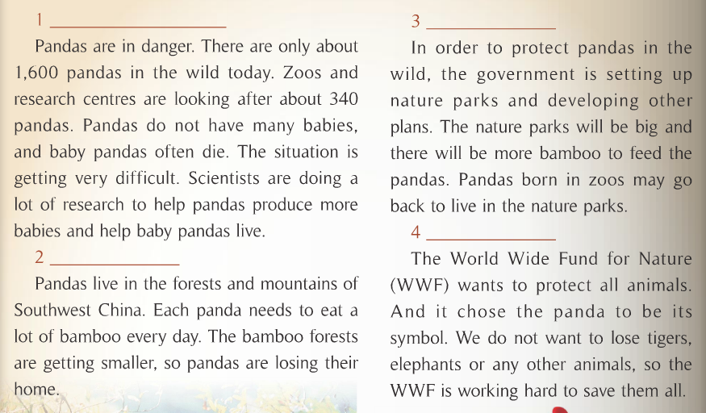
Post-reading
Please find out the infinitives as object complements and adverbials of purpose.
不定式作目的状语
不定式作宾语补足语

Slide 20
3 Complete the sentences.
Pandas eat bamboo to live.
Scientists do a lot of research _______________ _______________________________________.
The government is setting up nature parks ___________________________.
The WWF chose the panda ________________.
The WWF is working hard __________________.
to help pandas
produce more babies and help baby pandas live
to protect pandas in the wild
to be its symbol
to save all the animals

Slide 21
4 Complete the passage with the words in the box.
baby government nature produce save
Scientists situation symbol
Zoos and research centres protect animals. (1) _________ do a lot of research to help pandas (2) _______ more babies. Very few (3) _______ pandas are born outside zoos. Many people are worried about the panda’s (4) ________. Luckily, the (5) ___________ is developing plans to (6) ______ pandas, and is setting up (7) ______ parks to protect them.
People all over the world love pandas, and the panda has become a (8) _______ of China.
Scientists
produce
baby
situation
government
save
nature
symbol

Slide 22
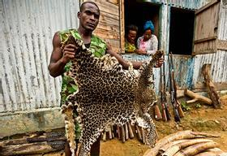
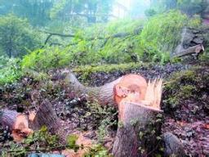
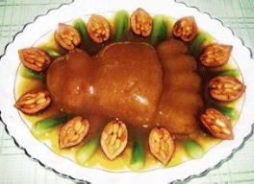
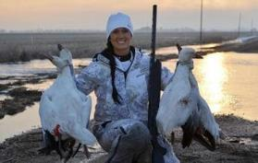
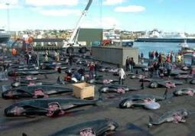
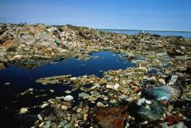
Discussion
Discuss: What do you think of the pictures?
What can we do to help them?

Slide 23
Writing
5 Choose an animal in danger and answer the questions.
What is the animal?
Where does it live?
What does it feed on ?
Why is it in danger?
How difficult is the situation?
What can we do to save it?
Notes:
23

Slide 24
Write a passage about an animal in danger. Use your answers in Activity 5 and the following example to help you.
Pandas live in Southeast China. They are in danger and the situation is getting very difficult. First, pandas do not have many babies, and baby pandas often die. Second, pandas eat bamboo, but the bamboo forests are getting smaller. So the government is setting up nature parks with a lot of bamboo to help protect pandas.
Notes:
24

Slide 25
Possible answer:
The tiger is an animal in danger. First, there are very few in the wild now. Second, the forests where tigers live are disappearing. Third, people are killing tigers. So tigers need forests to live in, and people need to stop killing them.
Notes:
25

Slide 26
Homework
1. Remember the key words and phrases.
2. Read the passage in Activity 2 and retell it.
3. Write a passage about an animal in danger.
Notes:
26

