Slide 1
Unit 4 Did You Have a Nice Trip?
Lesson 23 An Email from Li Ming
WWW.PPT818.COM

Slide 2
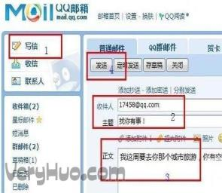
Warming up
Let’s chant!
Guess the action
fly a kite
write an email

Slide 3
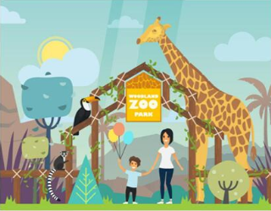
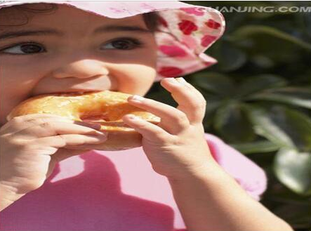
walk to school
go to the zoo
eat the donuts

Slide 4
Leading in
轮流回答问题：
1.Where did Li Ming take the pictures?
In Beijing.
2.Did Li Ming have a good time in Beijing?
Yes, he did.
3.Which picture is for Danny?
The picture of the panda.
复习巩固一般过去时的构成和用法。

Slide 5
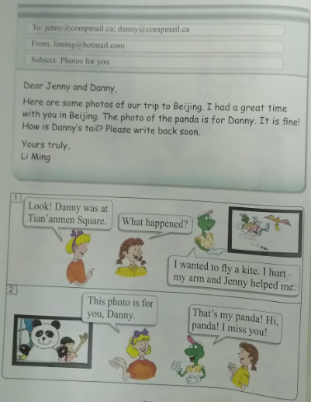
Presentation
Li Ming’s email
Can Danny fly kites very well?

Slide 6
连线题。
Place
Jenny
The thing that happened to Danny
At Tian’anmen Square.
The person who helped Danny
He hurt his arm.
讨论：
使用词语：picture, time, panda, tail, write

Slide 7
Listen and repeat.

Slide 8
Consolidation and extension
阅读并讨论。
1.What did you do?
2.谈论他们对话的内容。

Slide 9
Summing up
重点句型：
have a great time
write back
fly a kite
hurt my arm

Slide 10
Evaluation
内容 | 学生A | 学生B | 学生C | 学生D
积极发言
乐于合作
完成情况

Slide 11
Homework
1.用英语写一封电子邮件，介绍自己的旅行情况。
2.完成Let’s do it!中的联系。

Slide 12
答案:
1.Some photos of their trip to Beijing.
2.He wanted to fly a kite, but he hurt his arm.
3.Yes, he did.

