Slide 1
Unit 8
Natural Disasters
Reading (1)
WWW.PPT818.COM

Slide 2
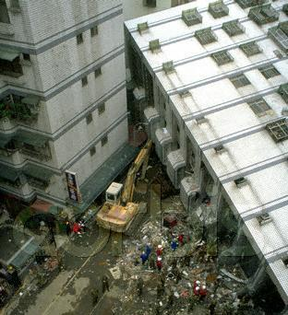
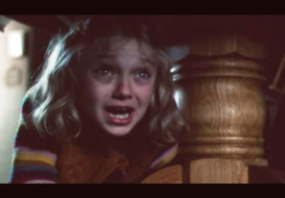
Brainstorm
shake
bombs
fall down
earthquake
run wildly
frightened
in fear
scream = shout loudly
run in all directions
/di‘rekʃn/

Slide 3
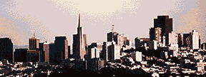
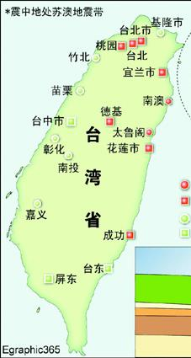
The Taiwan earthquake
Time: 1999
Timmy
Situation:
1. 12,000 buildings fell down.
2. 100,000 people became
homeless.(无家可归)
3. Over 1700 people died.

Slide 4
Task One Skimming
Tip: Read quickly and
quietly, and then catch the key words.
What was Timmy doing when the earthquake
started ?
2. How did people save Timmy at last?
He was sleeping.
They quickly moved away the bricks and stones.

Slide 5
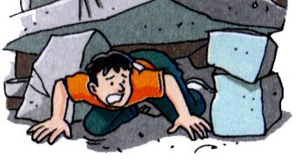
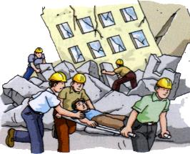
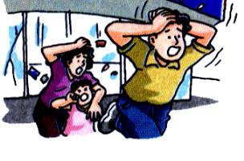
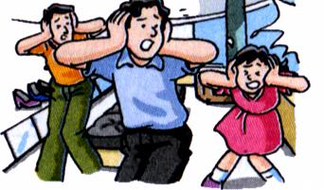
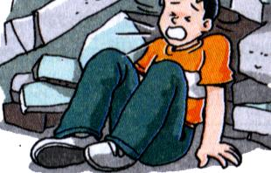
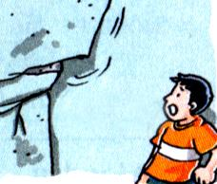
Task Two
Was it thunder?
I was trapped.
Help came.
I screamed for help.
People ran out of
the Shopping center
The wall came down.
Help! Help!

Slide 6
Task Three
when the earthquake came
(Para. 1-2)
The Taiwan earth-quake
after the earthquake
(Para.3-5)

Slide 7
Group work
Para.1-2
When the earthquake came, what did Timmy …?
feel
a slight shake
a loud noise like thunder bombs
scream in fear
fall down
run in all directions wildly
try his best to run out
hear
see
do

Slide 8
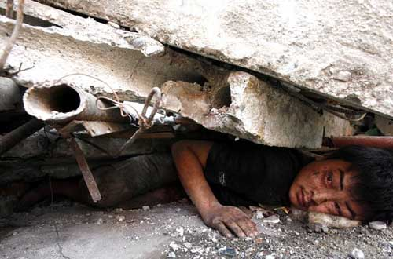
Task Three
be trapped
/æ/

Slide 9
What did Timmy do to save himself after he was trapped?
Para3-5
He told himself to calm down.
He shouted for help.
He started to pull himself slowly through the dark.
He tried to find his way out.
He screamed when he heard some noise above him.
brave
clever
＋
others’
help
bright
daylight
＝

Slide 10
Task Four
Make an interview!
Reporter: Good morning. You were so
lucky to survive the earthquake.
What were you doing when it started?
Timmy: I ...
Reporter: What did you hear at first?
Timmy: I heard…
Reporter: …
Timmy: …
Reporter: Oh, You are so brave and clever.
Thank you for your time!
Tip
Talk with feelings.
What did you see/hear/do when…?
How did you feel when…?

Slide 11
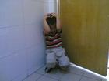
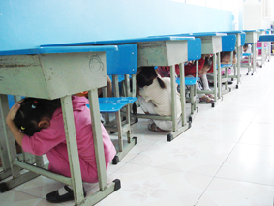
What can you do to protect yourself when there is an earthquake?
1.You can run to the street quickly.
2. You can hide under the desk.
3.You can stay in the corner.
Remember : the most important thing
is to protect your head.

Slide 12
If you are trapped in the earthquake:
Calm down.
Don’t eat your things quickly if you have.
Try to find your way out.
Shout for help.

Slide 13
No matter what terrible disasters you are facing,
Don’t give up easily!
Everyone is willing to help you!

Slide 14
Homework
1.Write a report about Timmy.
2.Try to finish the exercises on P95-96.

