Slide 1
Unit2 Travelling
Reading 2
WWW.PPT818.COM

Slide 2
Listen to the tape .
2.Read the article quickly.
3.Answer my questions and retell Kitty’s trip.

Slide 3
Who visited Disneyland ?
2. How long did they stay in Disneyland?
3. What did Kitty think of Hong Kong
Disneyland?
4.What did they do first?
Kitty and her parents.
About twelve hours \ a whole day.
It was fantastic.
They had fun on Space Mountain.

Slide 4
5.Why couldn’t Kitty stop taking photos with Disney characters?
6.What was the best part of the day?
7.What did they do after the parade?
8.What did they watch at the end of the day?
Because they all looked cute
The parade of Disney characters
They watched a 4-D film.
They watched fireworks in front of Sleeping Beauty Castle.

Slide 5
Retell the trip:
A whole day in Hong Kong Disneyland--- a famous theme park

Slide 6
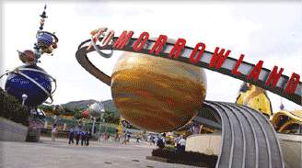
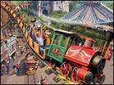
First
went to Space Mountain
an indoor roller coaster
had fun on Space Mountain
move at high speed
scream and laugh through the whole ride

Slide 7
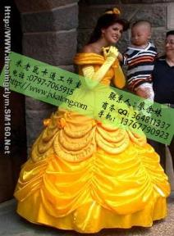
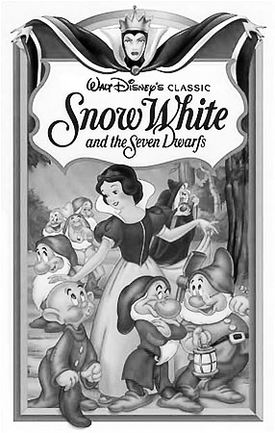
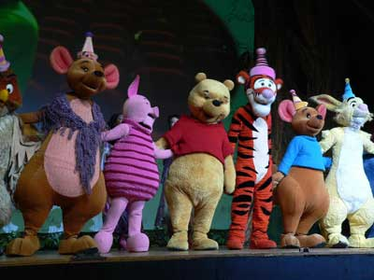
Next
had a quick lunch at a restaurant
met some Disney characters :
1. Sleeping Beauty
2. Snow White
3. Mickey Mouse

Slide 8
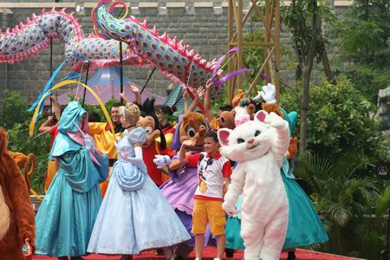
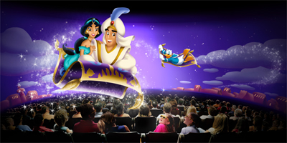
Fantasyland
Later in the afternoon :
parade
Watched a parade of Disney characters,
ran after them / take photos with...
Next
had a quick lunch at a restaurant
met some Disney characters :
1. Sleeping Beauty
2. Snow White
3. Mickey Mouse
after the parade
watch a 4-D film
be like magic: smell the apple pie , feel the wind
look nice and cute

Slide 9
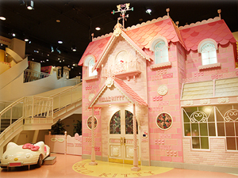
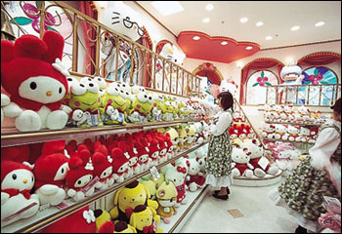
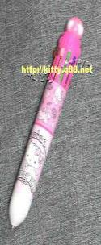
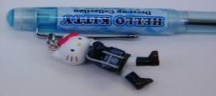
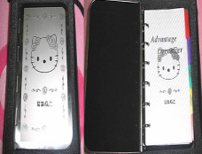
do some shopping:
a couple of key rings

Slide 10
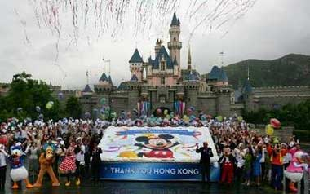
at the end of the day
watch fireworks in front of the Sleeping Beauty Castle
look bright and beautiful

Slide 11
Complete the story
has been to
Kitty___________ Hong Kong for two days. She and her parents had a good time there. They spent the whole day in __________. They got to Disney from their hotel ______________. then they went to ________________.They took the roller coaster, it moved ____________. Later in the afternoon, there was a parade . They couldn’t stop . They watched after the parade. They also did some shopping . At the end of the day,they
in front of Sleeping Beauty Castle .The castle looked .
Disneyland
by underground
Space Mountain
at high speed
taking photos
a 4-D film
watched the fireeworks
bright

Slide 12
Some phrases:
have a fantastic time 过的极开心
an indoor roller coaster 一个室内的过山车
at high speed 高速地
hurry to a restaurant 匆匆赶到一家饭店
have a quick meal 快速地吃了饭
such as 比如
a parade of... .....的游行
later in the afternoon在傍晚时候
run after... 追赶......
can’t stop taking photos忍不住拍照

Slide 13
11. a couple of key rings 几串钥匙扣
12. at the end of... 在......的末尾
13. watch the fireworks 看烟火
14. let me have a look 让我看一看
15. through the ride 在乘坐过程中

Slide 14
1. Finish the exercises in the paper.
2. Read the text carefully.

Slide 15
Thank you!
Bye - bye!

