Slide 1
Unit 5 Let’s celebrate! Comic strip and Welcome to the unit
WWW.PPT818.COM

Slide 2
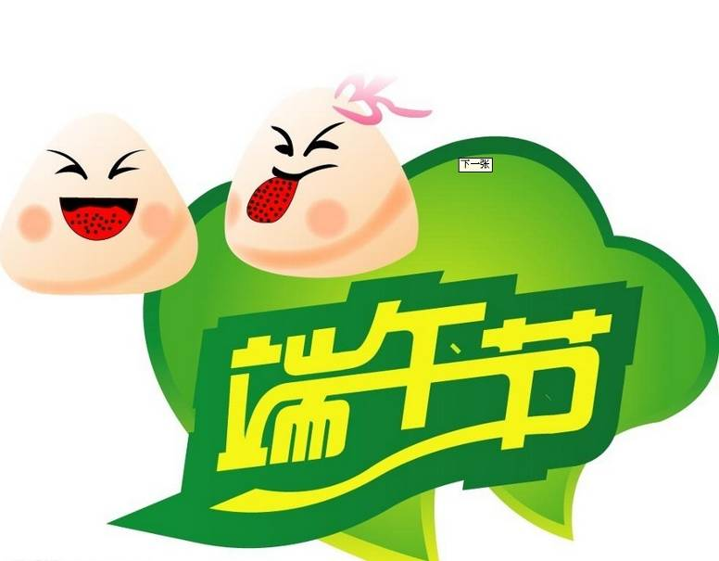
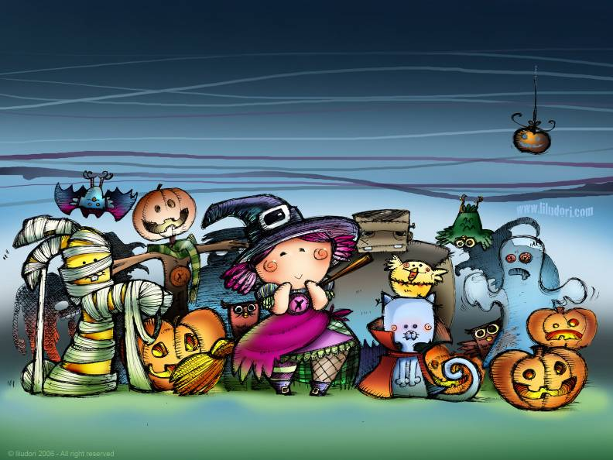
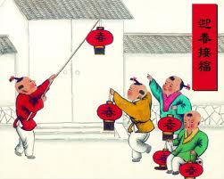
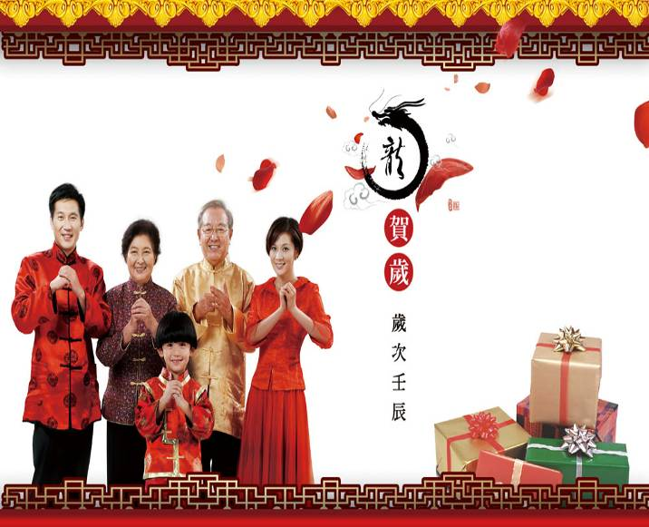
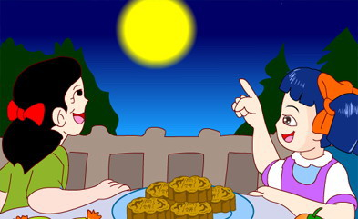
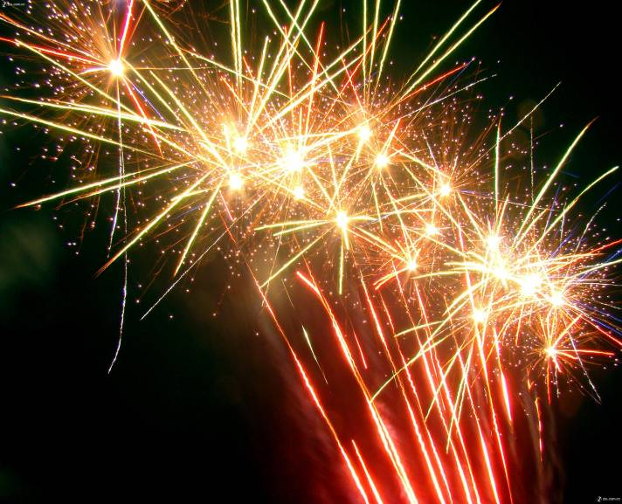
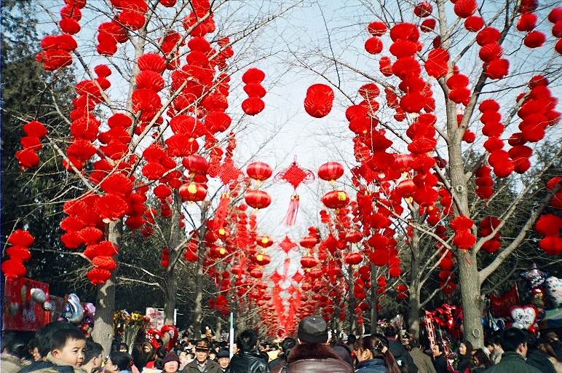
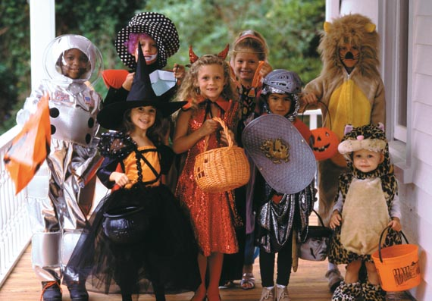
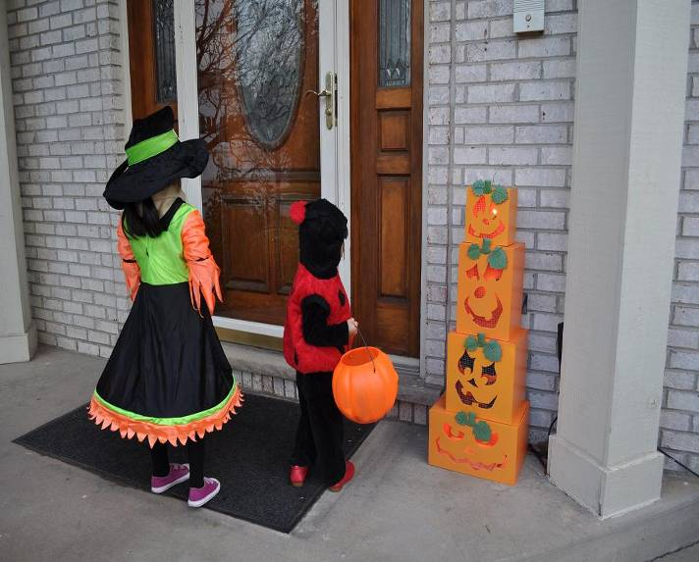
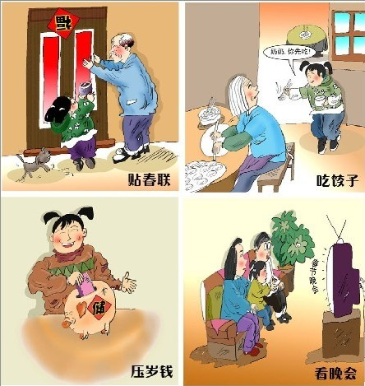
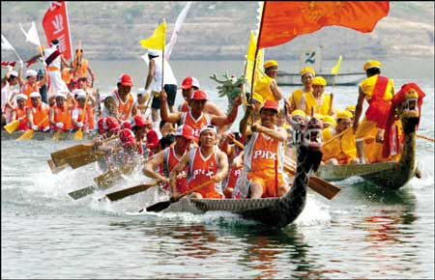
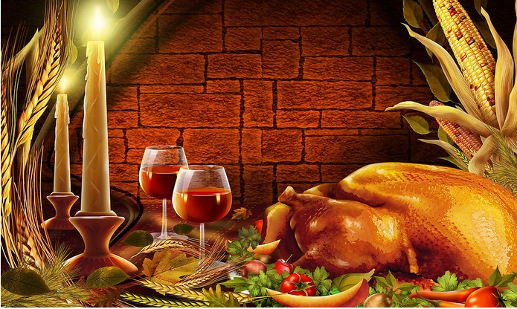
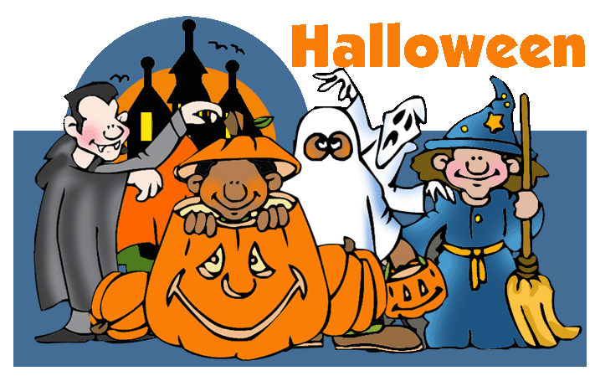
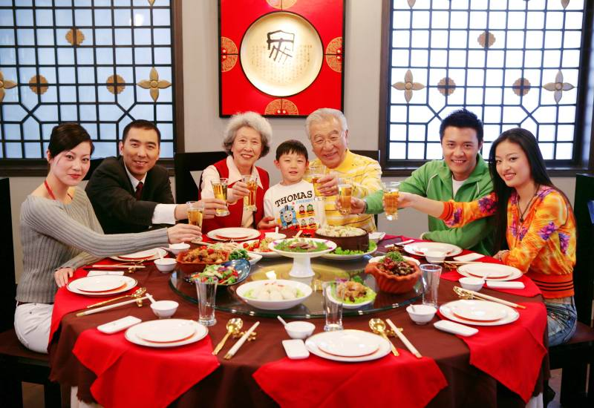
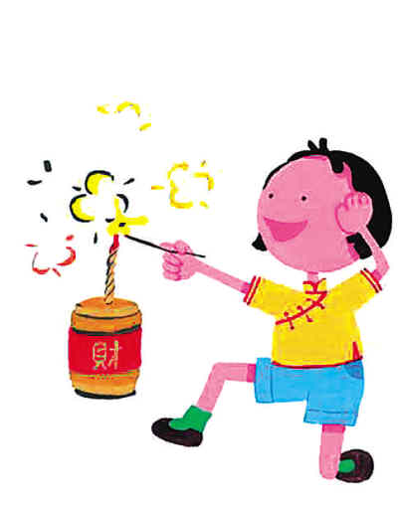
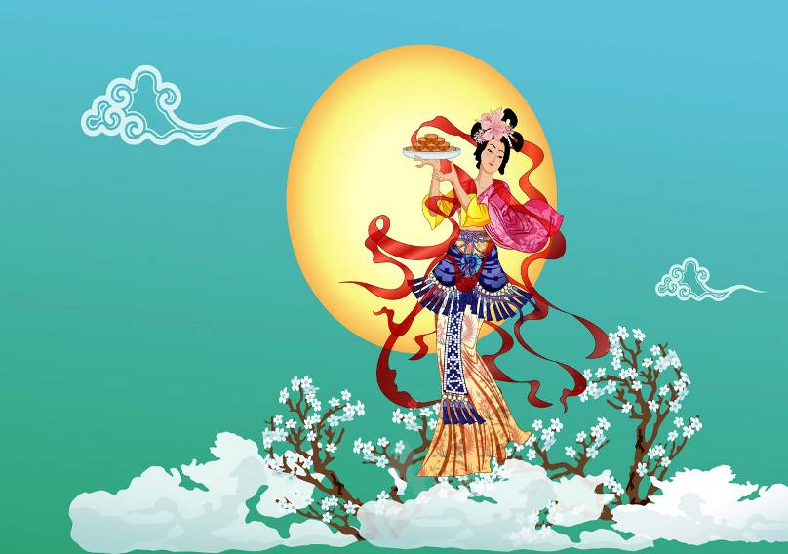
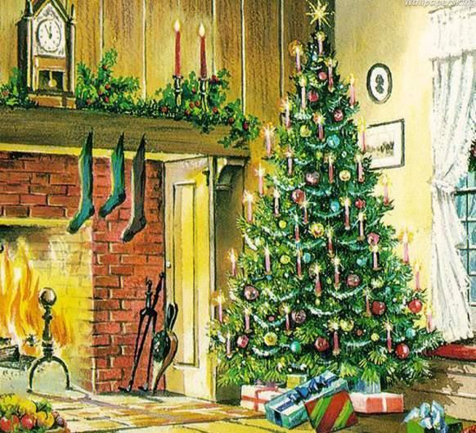
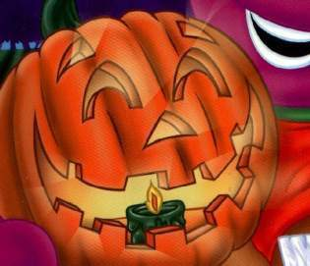
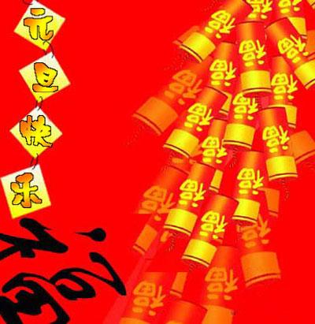
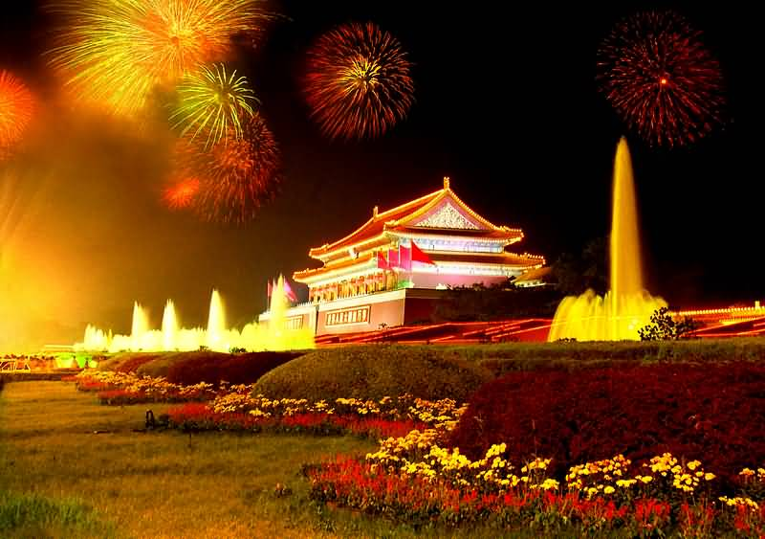
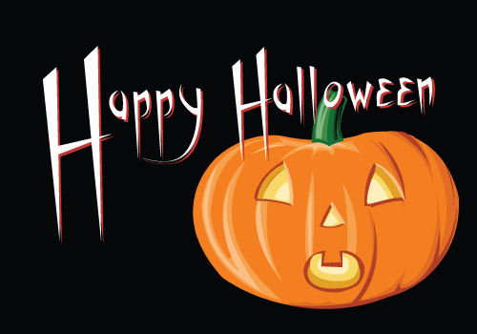
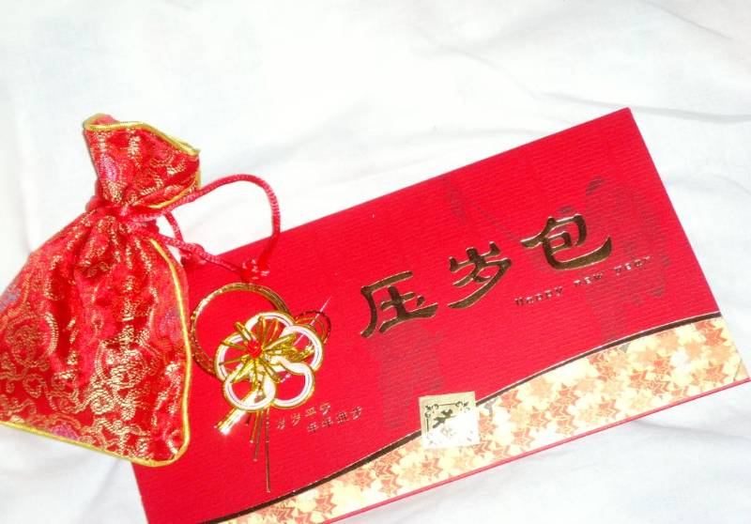
Different festivals

Slide 3
Group Competition
What festivals do you know?
Group
2
Group
1
VS

Slide 4
How do people celebrate …?
What do people usually do on that day?
get together
eat moon cakes
enjoy the full moon
have a big dinner
listen to the story
of Chang’e
Mid-Autumn Festival
On that day, people …

Slide 5
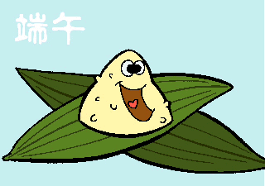
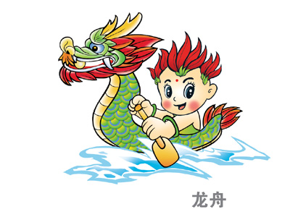
What do people usually do on that day?
Dragon Boat Festival (端午节)
eat rice dumplings
have a dragon boat
race (竞赛)

Slide 6
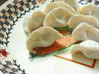
What do people usually do on that day?
Chinese New Year
(中国新年)
eat dumplings
get red packets
wear new clothes
enjoy fireworks

Slide 7
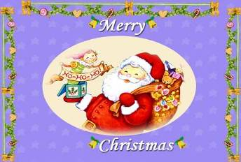
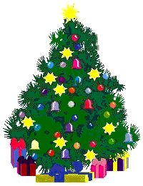
At Christmas, people usually …
Christmas (圣诞节)
Father Christmas
get together
get a lot of presents
sing songs
a tree with presents

Slide 8
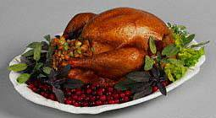
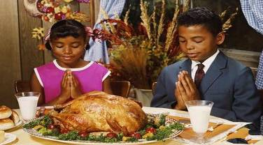
Thanksgiving Day (感恩节)
On Thanksgiving Day, people usually…
have a big dinner with the family
eat turkey
show thanks

Slide 9
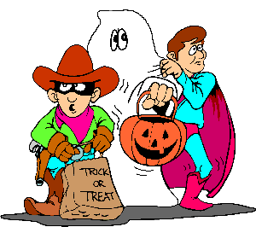
Halloween (万圣节)
play a special game
have a party
wear special clothes
dress up as a ghost
What will dress up as if you have the chance (机会)?
At Halloween, people usually …

Slide 10
Read the new words and phrases
celebrate v. 庆祝
guess n. 猜
dress up 装扮
festival n. 节日
present n. 礼物
get together 聚会
moon cake 月饼
full adj. 圆的、满的
ghost n. 鬼
Mid-Autumn Festival
Dragon Boat Festival
Chinese New Year
Christmas
Thanksgiving Day
Halloween

Slide 11
Millie is writing a list of festivals. Look at the pictures. Help her write the names of the festivals under the pictures.
Christmas Chinese New Year
Halloween Dragon Boat Festival
Thanksgiving Day Mid-Autumn Festival

Slide 12
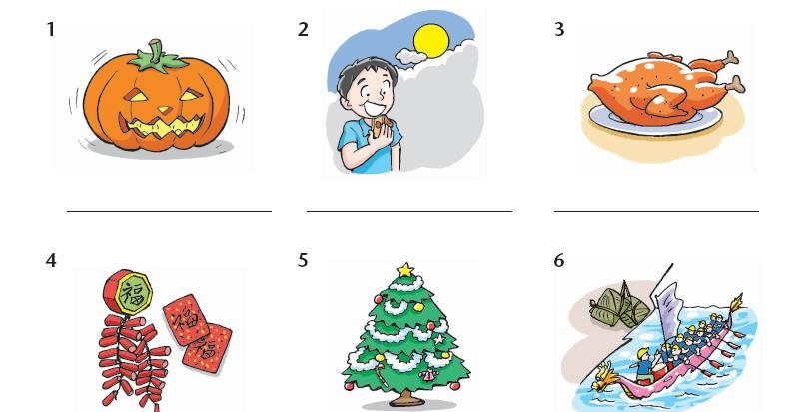
Halloween
Mid-Autumn Festival
Thanksgiving Day
Chinese New Year
Christmas
Dragon Boat Festival

Slide 13
Checking your memory
People in the USA eat the turkey’s (火鸡) meat on ____________________.
At __________________, we can get red packets from our parents.
Jim likes ____________________ because he likes eating moon cakes.
At ___________, they can open their Christmas presents.
Sandy likes ___________________ because she likes eating rice dumplings.
People often dress up as a ghost on__________.
Thanksgiving Day
Chinese New Year
Mid-Autumn Festival
Christmas
Dragon Boat Festival
Halloween

Slide 14
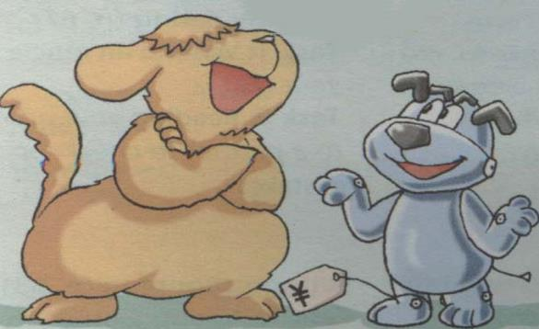
Have a guess
What festival are Eddie and Hobo talking about ?
How will they celebrate?

Slide 15
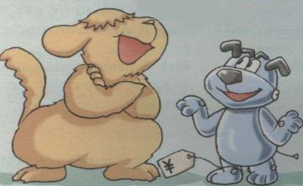
What festival are Eddie and Hobo
talking about?
Halloween.
2. How will they celebrate?
They will dress up.

Slide 16
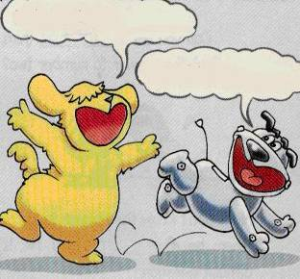
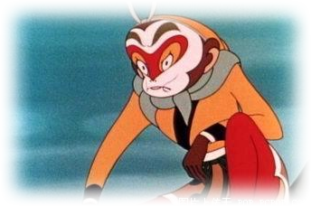
Why is Eddie so happy?
Because it’s Halloween today.
What does Hobo dress up as at last?
The Monkey King.

Slide 17
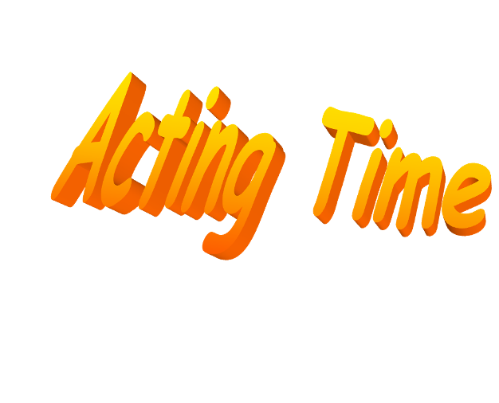
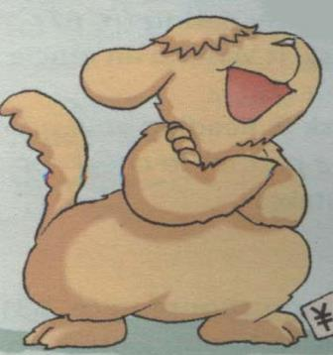
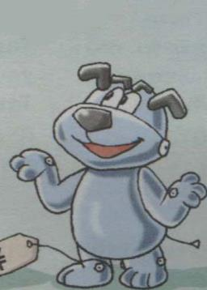
Actions (动作)
Tools (道具)
Feelings (情感)

Slide 18
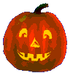
Summary
Today is ________. Eddie and Hobo will _______it.
Hobo is dressing ______ as a _____.
But Eddie says it’s not ________. So
Hobo will dress up as___________.
Halloween
celebrate
up
ghost
interesting
Monkey King

Slide 19
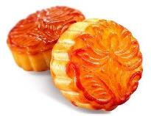
Listen to the tape and answer the questions
1. What is Tommy’s favourite festival?
Christmas.
2. What is Millie’s favourite festival?
The Mid-Autumn Festival.

Slide 20
Read after the tape and answer the questions
1. Why does Tommy like Christmas?
Because he always gets lots of nice presents at Christmas.
2. What do people do to celebrate the Mid-
Autumn Festival?
All the family get togeter and have a big dinner,eat moon cakes,and then enjoy the full moon.

Slide 21
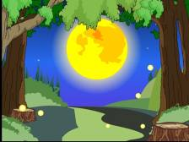
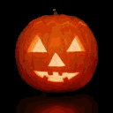
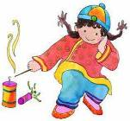
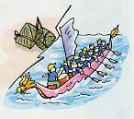
Work in pairs
A: Which is your favourite festival?
B: It’s …
A: Why do you like it?
B: Because … What festival do you like?
A: I like …
B: How do you celebrate it?/
What do you usually do on that day?
A: We usually …

Slide 22
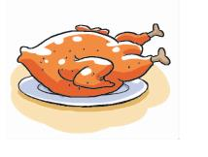
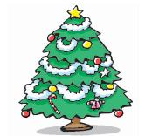
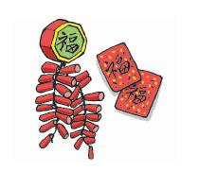
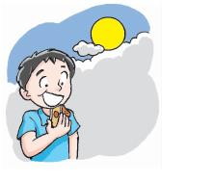
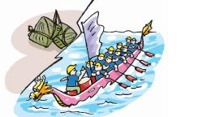
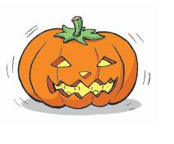
Learn from different festivals.
Learn about different cultures.
Enjoy festivals.
Enjoy your life.

Slide 23
Homework
Collect more information about the
festivals you like.
2. Review the new words and phrases.

